Slide 1
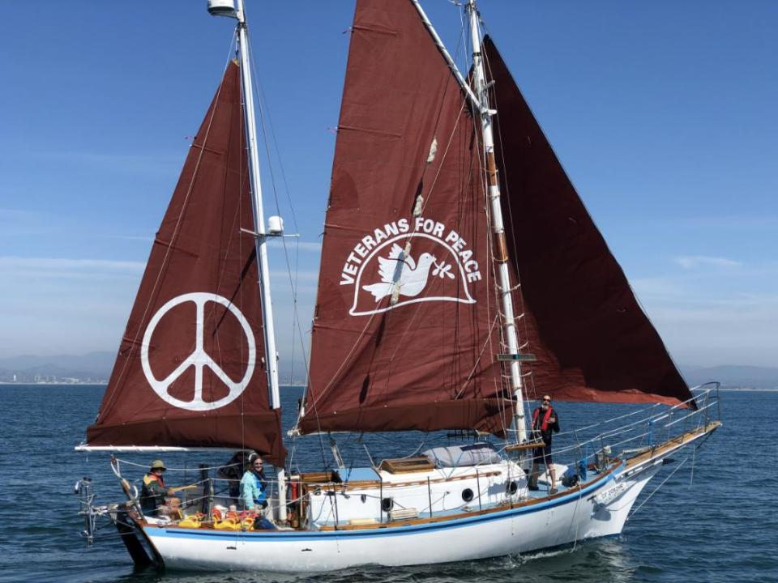
The Golden Rule: Do Unto Others as you would have others do unto you
Golden Rule Sails Again for a Nuclear Free Future!
Veterans For Peace
Golden Rule Project
www.vfpgoldenruleproject.org
vfpgoldenruleproject@gmail.com
(206) 992-6364
VFP Golden Rule Project
P.O. Box 87 Samoa, CA 95564

Slide 2
Outline - NEIS Night with the Experts
Intro/thanks to speakers, hosts, endorsers, attendees
VFP and its mission, VFP Resolution regarding nuclear power
The Golden Rule, history 58, including the mission statement written right after Fukushima, voyages esp great loop, program incl TPNW, BftB, bills in Congress
WILPF - End the Whole Nuclear Era
Nuclear Weapons and Nuclear Energy connection, especially uranium mining, milling, waste, depleted uranium, Pu needed for bombs. No other reason for Nuke Energy to exist.
Gerry -
Himself, intro, NPR sections, The VFP Nuclear Abolition Working Group, in chat
VFP-NPR LINK https://www.tinyurl.com/VFP-NPR2
GRAPHIC FOR JUNE 20 WEBINAR (PASTE the link in the CHAT)
Gerry - separate presentation, NPR and aggressive US foreign policy and Cuban missile crisis as an example of danger, succeeded from out of Turkey, nuclear policy inseparable from overall military policy. Increases chances of nuclear war - Ukraine, Palestine, China

Slide 3
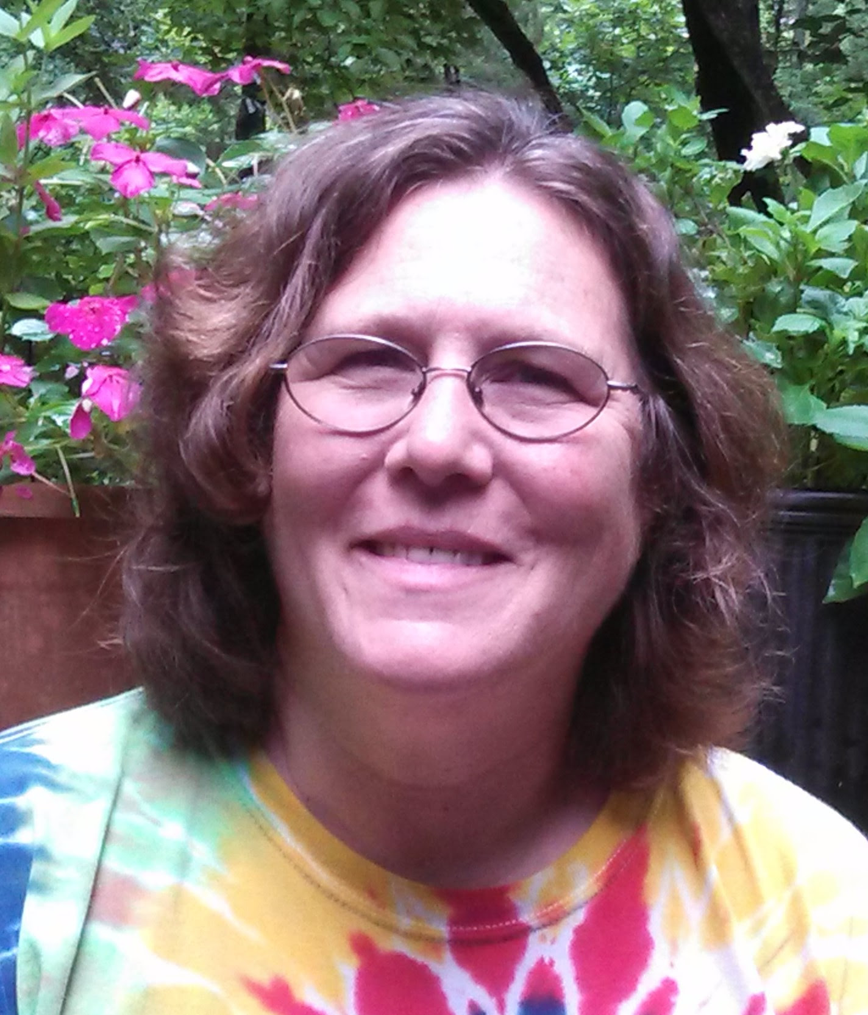
Interfaith Communities United for Justice and Peace
May 31, 2024
Veterans For Peace has sailed the historic anti-nuclear Golden Rule as a tool to educate people about nuclear issues and advocate for actions to stop the possibility of nuclear war. The Golden Rule Project teaches about the problems caused by the whole chain - from Uranium mining to nuclear energy and weapons to lack of nuclear waste disposal.
Many organizations are trying to stop the nuclear madness.
We invite discussion about all nuclear issues and actions we can take to end the nuclear era.
Helen Jaccard lis the Project Manager for the Golden Rule anti-nuclear sailboat, a Project of Veterans For Peace. She is also a member of Women's International League for Peace & Freedom's Disarm/End Wars Committee. Helen writes about the environmental costs of war and militarism, including radioactive contamination. She also talks about the harm from the entire nuclear chain, from cradle to grave. Helen has visited Fukushima, Hiroshima and Nagasaki to learn first hand from evacuees and hibakusha.
Many thanks to
Interfaith Communities United for Justice and Peace
Rick Banales, Director of Communications and Social Media
Steve Rohde, ICUJP Chairperson
Rececca Arvizu, ICUJP Board member (our facilitator today)
Jasmine Hailey

Slide 4
Faith-based Communities can have a HUGE impact on US and world policy!
Presbyterian Church Ministry
https://www.presbyterianmission.org/story/pcusa-supports-nuclear-weapons-ban-treaty/
Catholics: The Pope and Arch Bishop of Santa Fe John Wester
https://www.icanw.org/the_catholic_church_and_the_treaty_on_the_prohibition_of_nuclear_weapons
United Church of Churist: https://www.ucc.org/nuclear-weapons-abolition/
Soka Gakkai International, the World Council of Churches, Pax Christi International
https://www.icanw.org/faith_organizations_urge_nations_to_support_a_ban
“We reiterate our common position that nuclear weapons are incompatible with the values upheld by our respective faith traditions,” they said. These include “the right of people to live in security and dignity, the commands of conscience and justice, the duty to protect the vulnerable and to exercise the stewardship that will safeguard the planet for current and future generations”.
Friends (Quakers)
https://afsc.org/newsroom/joint-interfaith-statement-entry-force-treaty-prohibition-nuclear-weapons
United Methodist Church,

Slide 5
Joint Interfaith Statement Welcoming the First Meeting of the States Parties to the Treaty on the Prohibition of Nuclear Weapons (22 June 2022)
As faith communities from a diversity of traditions and located all over the world, we join together with one voice to mark this first Meeting of States Parties (MSP) to the Treaty on the Prohibition of Nuclear Weapons (TPNW). We welcome this historic occasion and celebrate this milestone that moves us closer to a world without nuclear weapons.

Slide 6
al poner en riesgo la vida de
la Humanidad y del Planeta
Disciples Peace Fellowship
Divine Word Missionaries
Dominican Sister of Hope
Dominican Sisters ~ Grand Rapids
Dominican Sisters of Sinsinawa
Endorsing Organizations
All Souls Nuclear Disarmament Task Force
Alliance of Baptists
American Friends Service Committee
Anglican Pacifist Fellowship
Bruderhof
Buddhist Council of New York
Cameroon Youths and Students Forum for Peace (CAMYOSFOP)
Canadian Interfaith Fast For the Climate
Casa Generalizia della Società del Sacro Cuore
Center for Peace Education
Centro de Estudios Ecuménicos-México
Christian Campaign for Nuclear Disarmament
Christian Reformed Church Office of Social Justice
Christians for Peace Newcastle Australia
Church and Peace - European Ecumenical Peace Network
Church Council of Greater Seattle
Church of Scotland
Colectivo familiares en Búsqueda Maria Herrera Chilpancingo
Comisión General Justicia y Paz
Community of Christ
Community of Christ - British Isles
Community of Christ - Western Europe Mission Centre
Community of Christ International Peace and Justice Team
Community Pope John XXIII - APG23
Company of the Daughters of Charity of St. Vincent de Paul
Comunidad Luterana Santísimo Redentor
Conferencia de iglesias Evangelicas Anabautistas Menonitas de Mexico (CIEAMM)
Conselho Nacional de Igrejas Cristãs do Brasil
Creation-Justice-Peace Steering Group, European Province Third Order Society St Francis
Deben prohibirse las armas nucleares porque son una ofensa a Dios al poner en riesgo la vida de la Humanidad y del Planeta
Disciples Peace Fellowship
Divine Word Missionaries
Dominican Sister of Hope
Dominican Sisters ~ Grand Rapids
Dominican Sisters of Sinsinawa
Dorothy Day Catholic Worker House, Washington, DC
Ecumenical of Peace Institute/CALC
Edmund Rice International
Eje de Iglesias de Morelos
Eje de Iglesias y Comunidades de Fe de la Brigada Nacional de Búsqueda
Ejes de Iglesia

Slide 7
Episcopal Peace Fellowship
Federation of Sisters of St. Joseph of Canada
Fellowship of Reconciliation
Franciscan Peace Center
Franciscan Sisters, Daughters of the Sacred Hearts of Jesus and Mary
Franciscan Sisters of the Sacred Heart
Friends World Committee for Consultation (Quakers)
Fundação Luterana de Diaconia
Global Ministries of the Christian Church (Disciples of Christ) and the United Church of Christ
Hale Ho'onani A.M.E. Fellowship
Imdosoc
Institute of the Blessed Virgin Mary
Interfaith Council of Southern Nevada
International Fellowship of Reconciliation - IFOR
InterReligious Task Force on Central America
JPIC NDS
Kairos Foundation of Nigeria
Kosmos Associates. Unity Earth
Kristna Fredsrörelsen i Göteborg
Kvekersamfunnet i Norge - the Religious Society of Friends in Norway
Leadership Conference of Women Religious
Maryknoll Office for Global Concerns
May Peace Prevail On Earth International
Melbourne Unitarian Peace Memorial Church
Mennonite World Conference
Missionary Oblates JPIC Office
Missionary Society of St Columban (Australia)
Mujeres para el Diálogo
Multifaith Association of South Australia Inc
Multifaith Voices for Peace and Justice
Muslim Peace Fellowship
National Council of the Churches of Christ in the USA
National Shrine of Our Lady if la Salette Pax Christi
New Humanity International NGO
Northern Friends Peace Board
One Billion Youth for Peace
Pace e Bene & Campaign Nonviolence
Pacific Conference of Churches (33 member churches and 10 National Council of Churches)
Pastoral Social, Iglesia Anglicana de México
Pax Christi Australia
Pax Christi Fatima Shrine Holliston MA
Pax Christi International
Pax Christi Long Island
Pax Christi MA
Pax Christi Metro New York
Pax Christi New York State
Pax Christi Philippines
Pax Christi Queensland
Pax Christi Victoria
Pax Christi Vlaanderen
Pax Christi Western Massachusetts

Slide 8
Pax Christi Western Massachusetts
Peace and Social Justice committee of Friends Meeting at Cambridge (Quaker)
Presbyterian Peace Fellowship
Presentation Sisters San Francisco, CA
Presentation Sisters USA Unit
Public Affairs Commission, Anglican Church of Australia
Quaker Peace and Legislation Committee
Raelian Movement
Red de Entidades para el Desarrollo Solidario-REDES
Religious of the Sacred Heart of Mary, Western American Area
School Sisters of Notre Dame, Central Pacific Province
Serviço de Paz - SERPAZ
Shepparton Interfaith Network
Sisters of Charity Federation
Sisters of Charity of Leavenworth Office of Justice, Peace, and Integrity of Creation
Sisters of Charity of Nazareth Congregational Leadership
Sisters of Charity of Nazareth Western Province Leadership
Sisters of Charity of New York
Sisters of Mercy of the Americas Justice Team
Sisters of Notre Dame de Namur USA
Sisters of Providence
Sisters of Providence Holyoke, Massachusetts
Sisters of Saint Joseph of Chestnut Hill Philadelphia, PA
Sisters of St. Francis of Assisi
Sisters of St. Francis of Philadelphia
Sisters of St. Francis, Clinton, Iowa
Sisters of St. Joseph of Baden, PA
Sisters of St. Joseph of Carondelet, LA
Sisters of the Good Shepherd, Province of Australia and Aotearoa New Zealand
Sisters of the Humility of Mary
Soka Gakkai International
SS. Francis and Therese Catholic Worker
St. Susanna Parish, Dedham, MA
Swedish fellowship of Reconciliation/Kristna Fredsrörelsen
THE CHURCH OF THE LORD (TCL) Worldwide
The Ethiopian Evangelical Church Mekane Yesus
The Faith and Justice Network (FJN) of the Mano River Basin Countries, West Africa
The Swedish Society of Friends (Quakers)
The United Church of Canada / L’Église Unie du Canada
Trinity Cathedral Episcopal Church, Cleveland, Ohio
Una luz en el camino
United Church of Christ, Justice and Local Church Ministries
United Reformed Church (UK)
United Religions Initiative
Uniting Church in Australia, Synod of Victoria and Tasmania
Valley and Mountain Fellowship
Vichara, Mavelikara, India
We Can Disarm the World
Wellspring Community Australia
Wheaton Franciscans
World Council of Churches
World Yoga Community
Youth Arts New York/Hibakusha Stories

Slide 9
The Golden Rule is a Project of Veterans For Peace
100 US chapters
10 international chapters
3000 members

Slide 10
VFP Golden Rule Project implements Veterans For Peace Statement of Purpose
To restrain our governments from intervening, overtly and covertly, in the internal affairs of other nations
To end the arms race and to reduce and eventually eliminate nuclear weapons

Slide 11
67 Nuclear Bomb Tests in the Marshall Islands Bikini Atoll, March 1, 1954 U.S. detonated a 15-megaton device equivalent to 1000 Hiroshima blasts.

Slide 12
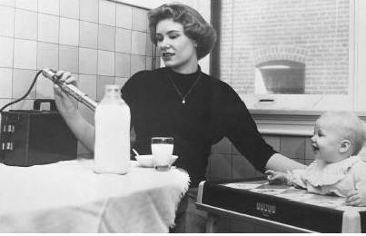
Strontium 90 in mother’s and cow’s milk

Slide 13
I Am Going Because . . .
I am going because, as Shakespeare said, “Action is eloquence.” Without some such direct action, ordinary citizens lack the power any longer to be seen or heard by their government.
I am going because it is time to do something about peace, not just talk about peace.
I am going because, like all men, in my heart I know that all nuclear explosions are monstrous, evil, unworthy of human beings.
I am going because war is no longer a fuedal jousting match; it is an unthinkable catastrophe for all men.
I am going because it is now the little children, and, most of all, the as-yet-unborn who are the front-line troops. It is my duty to stand between them and this horrible danger.
I am going because it is cowardly and degrading for me to stand by any longer, to consent, and thus to collaborate in atrocities.
I am going because I cannot say that the end justifies the means. A Quaker, William Penn, said, “A good end cannot sanctify evil means; nor must we ever do evil that good may come of it.” A communist, Milovan Djilas, says, “As soon as means which would ensure an end are shown to be evil, the end will show itself as unrealizable.”
I am going because, as Gandhi said, “God sits in the man opposite me; therefore to injure him is to injure God himself.”
I am going to witness to the deep inward truth we all know, “Force can subdue, but love gains.”
I am going because however mistaken, unrighteous, and unrepentant governments may seem, I still believe all men are really good at heart, and that my act will speak to them.
I am going in the hope of helping change the hearts and minds of men in government. If necessary I am willing to give my life to help change a policy of fear, force and destruction to one of trust, kindness, and help.
I am going in order to say, “Quit this waste, this arms race. Turn instead to a disarmament race. Stop competing for evil, compete for good.
I am going because I have to - if I am to call myself a human being.
When you see something horrible happening, your instinct is to do something about it. You can freeze in fearful apathy or you can even talk yourself into saying that it isn’t horrible. I can’t do that. I have to act. This is too horrible. We know it. Let’s all act.

Slide 15
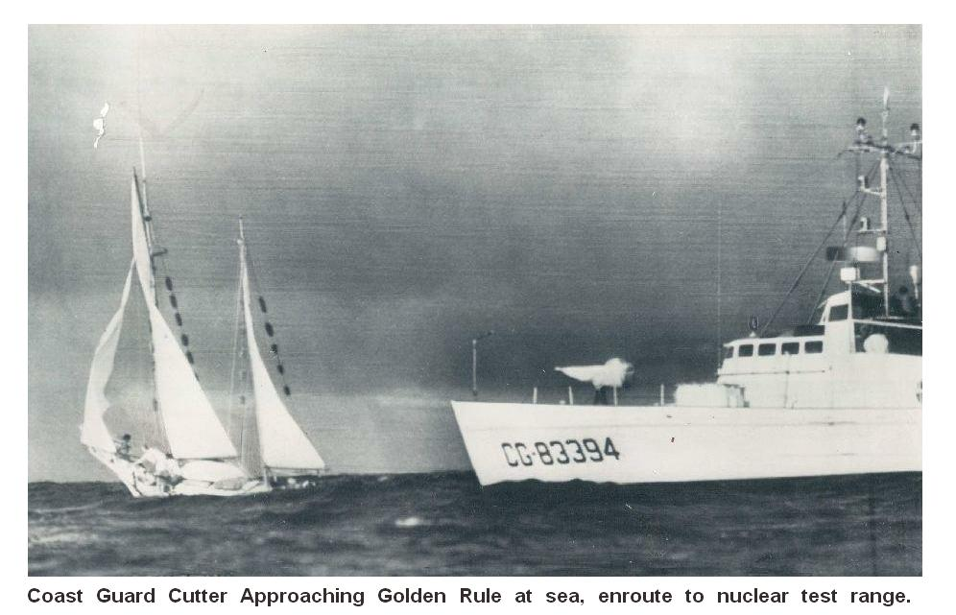

Slide 16
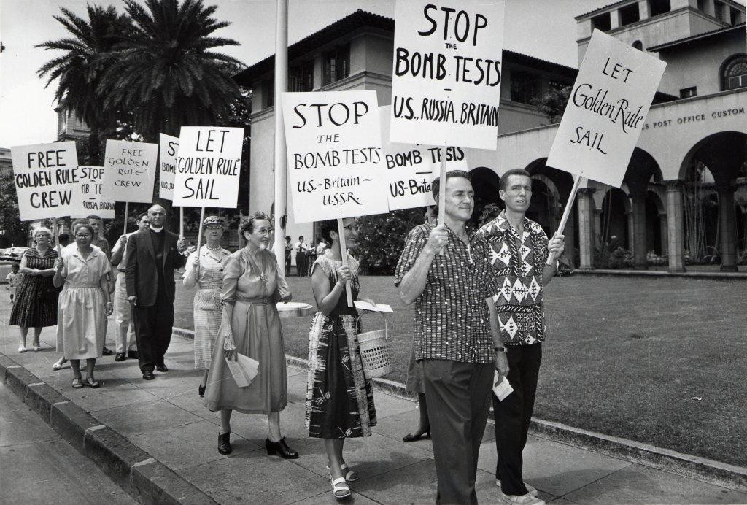
Anti-Nuclear Protests in Honolulu

Slide 17
The Phoenix of Hiroshima
Miichi (Nick) Mikami, Dr. Earle Reynolds, Jessica Reynolds, Barbara Reynolds, Ted Reynolds

Slide 18
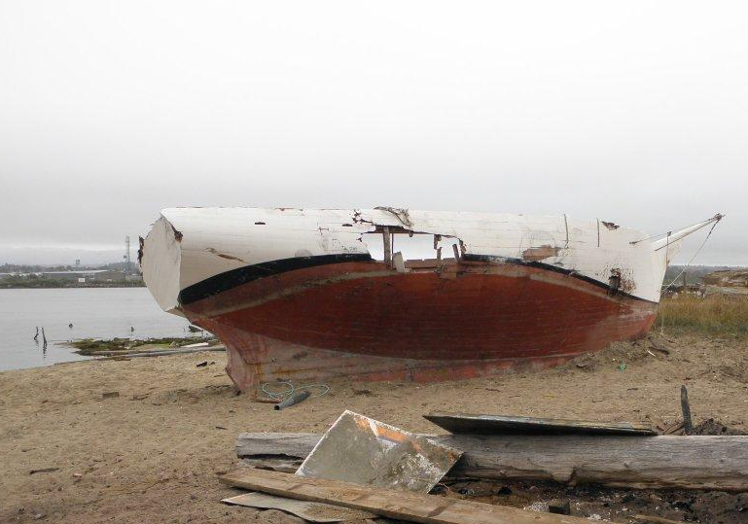

Slide 19
VFP Golden Rule Project Mission
The original nuclear protest boat, the Golden Rule, sails again
to promote a nuclear free future
to educate about the dangers of radiation to humanity and the environment, and
to support peaceful alternatives to war.
We Sail for a Nuclear-Free World and a Peaceful, Sustainable Future!

Slide 20
Launch! June 20, 2015

Slide 21
2016, 2024 Voyage 2015, 17-19,22

Slide 22
2019-21: 22 months in the Hawaiian Islands

Slide 23
“The Great Loop” Minneapolis Aug‘22 - Chicago Sept ‘23
10,300 miles
102 Cities or Towns visited
350 presentations - reached 10,500 people directly
100,000s of people reached through press
VFP Chapters
22 Chapters donated a total of $23,652 in 2022-23.
39 Chapters anchored GR GL Events

Slide 24
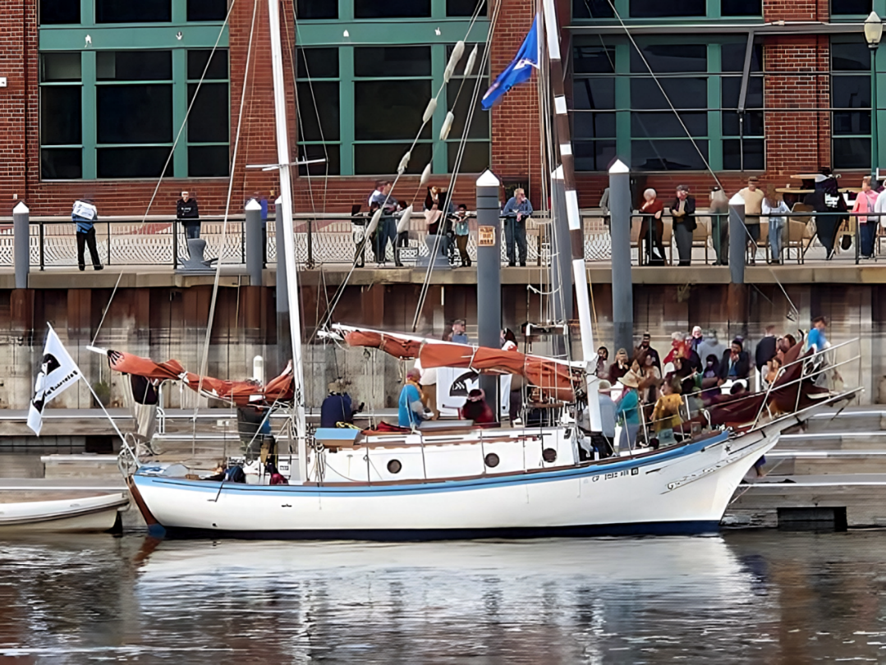

Slide 25
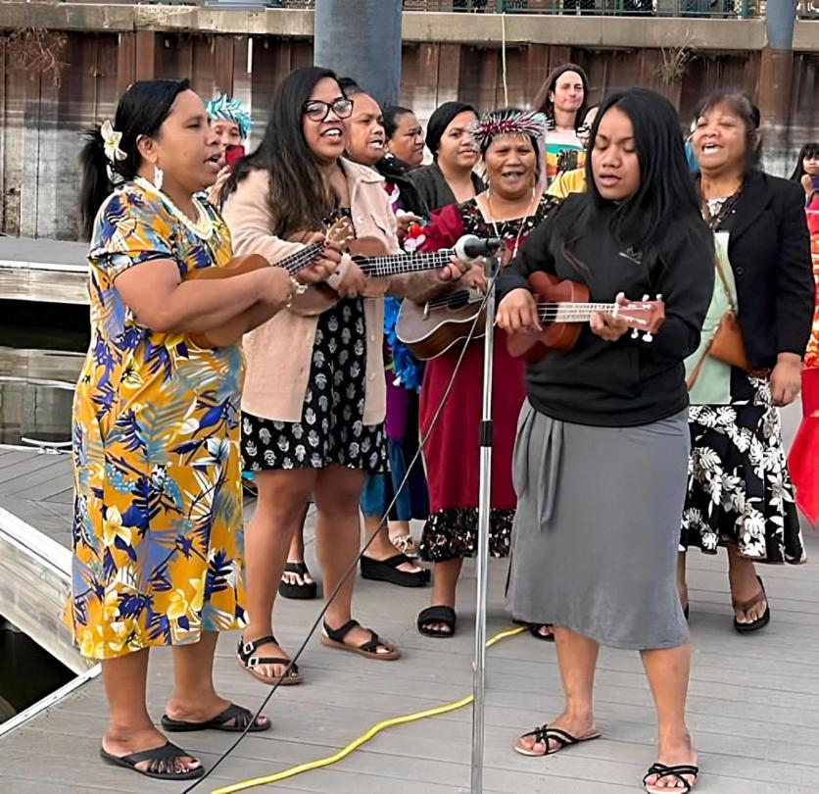

Slide 26
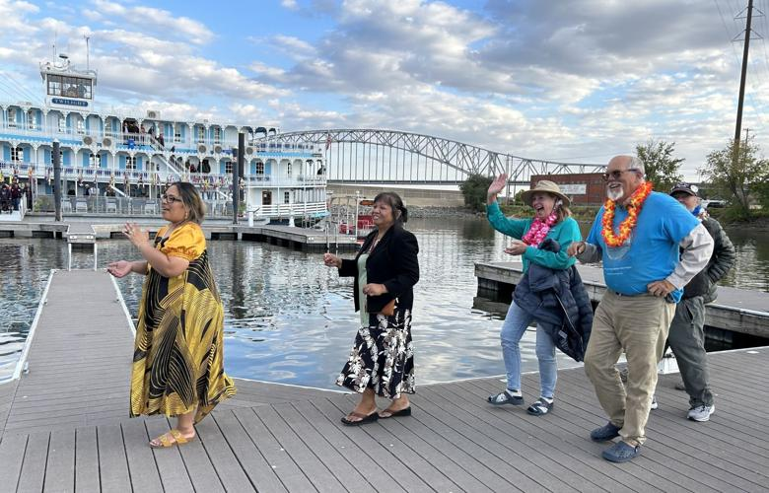

Slide 27
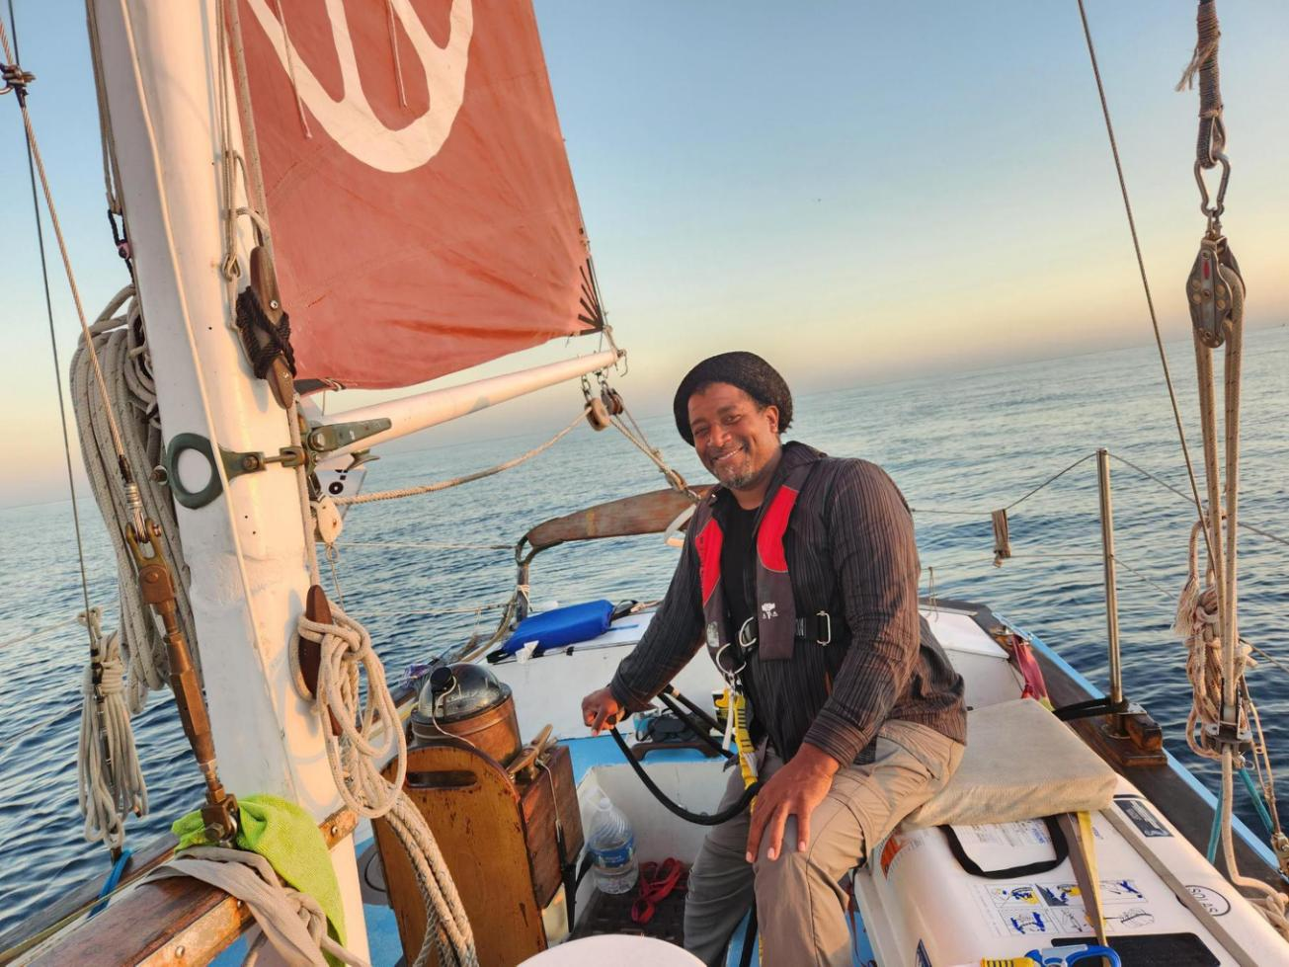
2023 Started with the voyage to Cuba!
Six Golden Rule representatives went by sea and five by air to Cuba for an “Arts & Cultural” visit Dec 31 - Jan 10
VFP Board Member Enya Anderson at the helm of the Golden Rule as it came into Hemingway Marina

Slide 28
The Entire Cuba Delegation (from land and sea!)

Slide 29
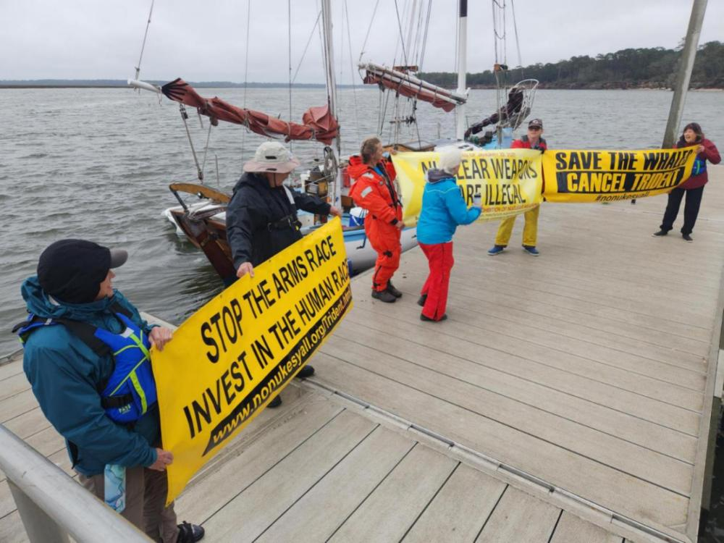
Sail-by and Protest at Kings Bay Nuclear-Armed Trident Submarine Base!

Slide 30
Peace picnics in the park!

Slide 31
Commemorating March 1, 1954 Castle Bravo destruction in the Marshall Islands

Slide 32
Over 40 Mayors and City Councils gave the Golden Rule a warm Proclamation of Welcome!

Slide 33
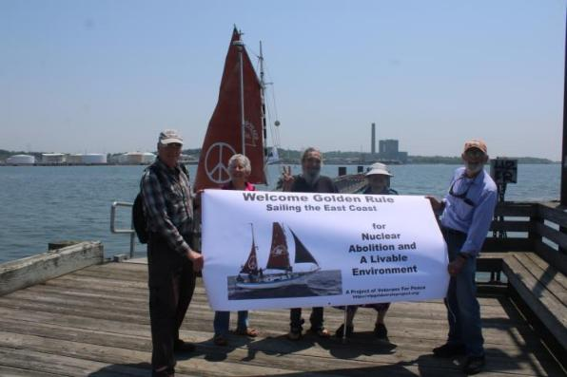
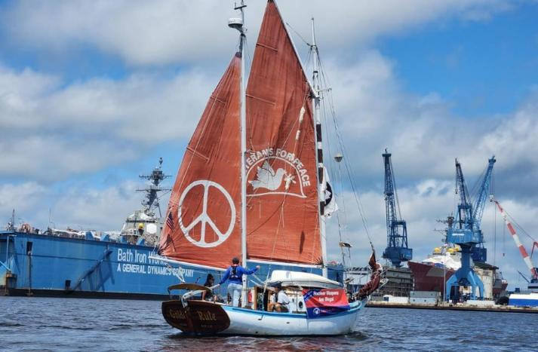
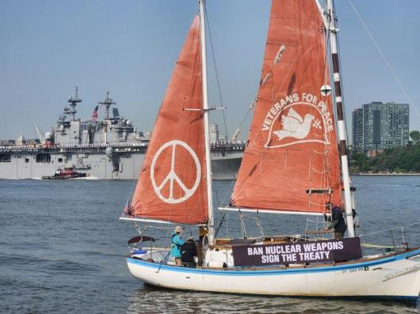
New Haven, Connecticut welcomed the Golden Rule - several groups sailed by Groton Electric Boat, manufacturer of nuclear-armed submarines.
Fleet Week Parade of War Ships, Hudson River, NYC
The ship of peace sails in protest of Bath Iron Works, makers of nuclear-capable war ships

Slide 34
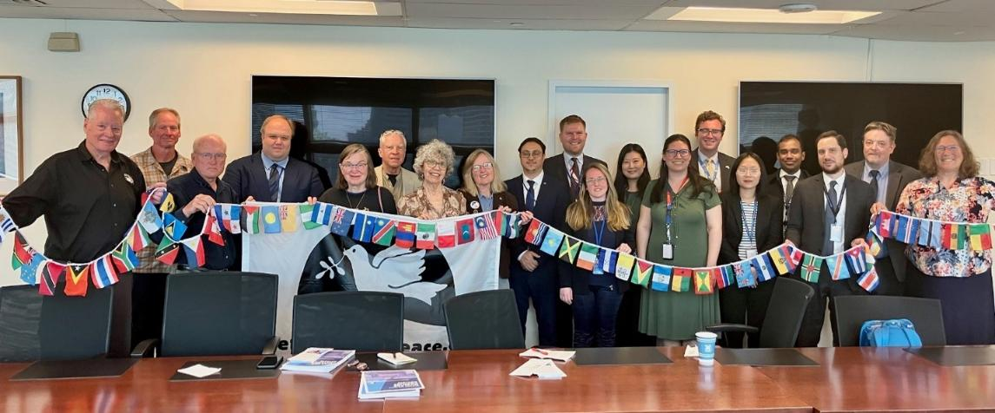
United Nations Missions!
Veterans For Peace and the Golden Rule team met with twelve UN missions, including New Zealand, Malaysia, Vietnam, Cuba, South Africa, Austria, Indonesia, Ireland, Costa Rica, Kiribati, and the Vatican
Veterans For Peace delegation visited with the Permanent UN Representative from the Republic of the Marshall Islands. Ambassador Amatlain Elizabeth Kabua gave a very warm welcome in her cozy UN office and spoke with the group for over two hours.

Slide 35
Rhode Island: Providence, Bristol
Golden Rule crew are greeted by members of the Pokanoket tribe.
The Extraordinary Rendition Band played rousing music on the dock!

Slide 36
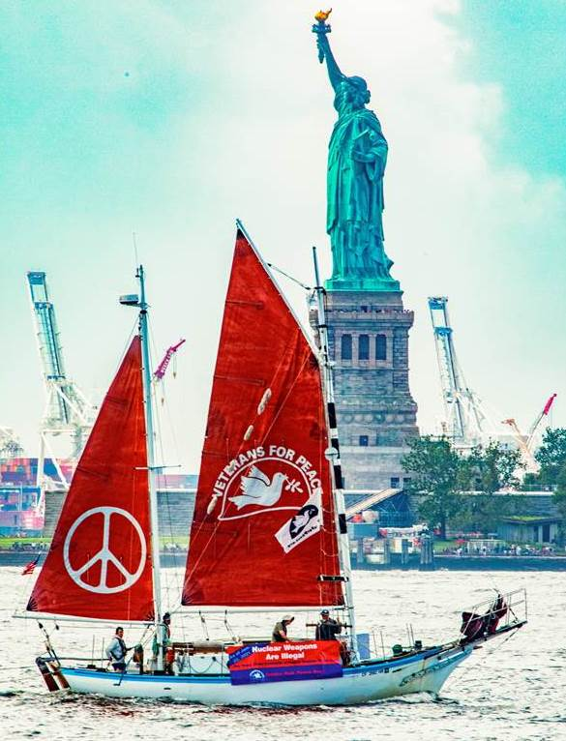

Slide 37
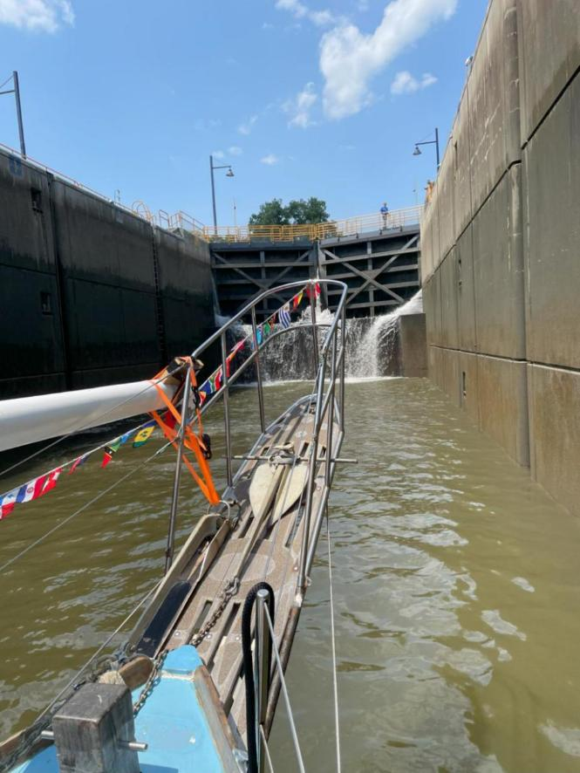
Erie Canal

Slide 38
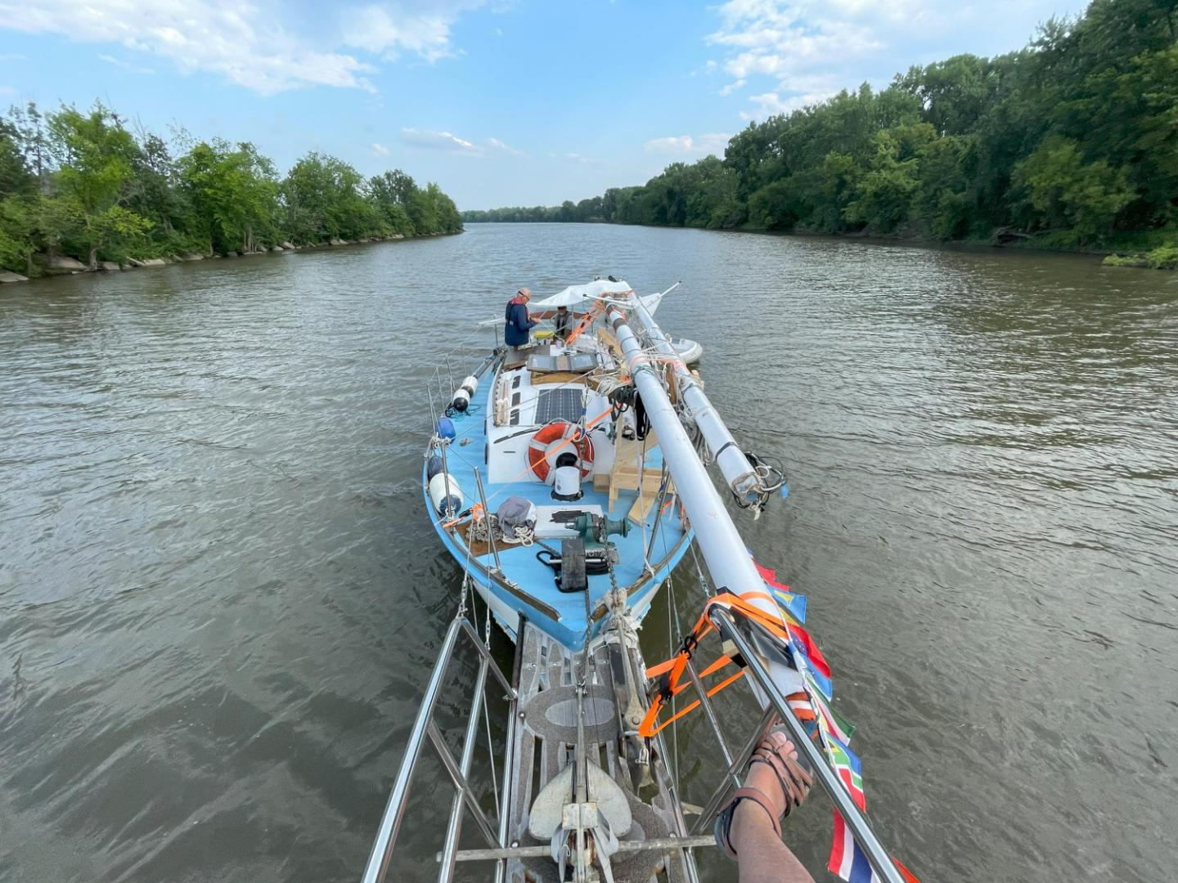

Slide 39
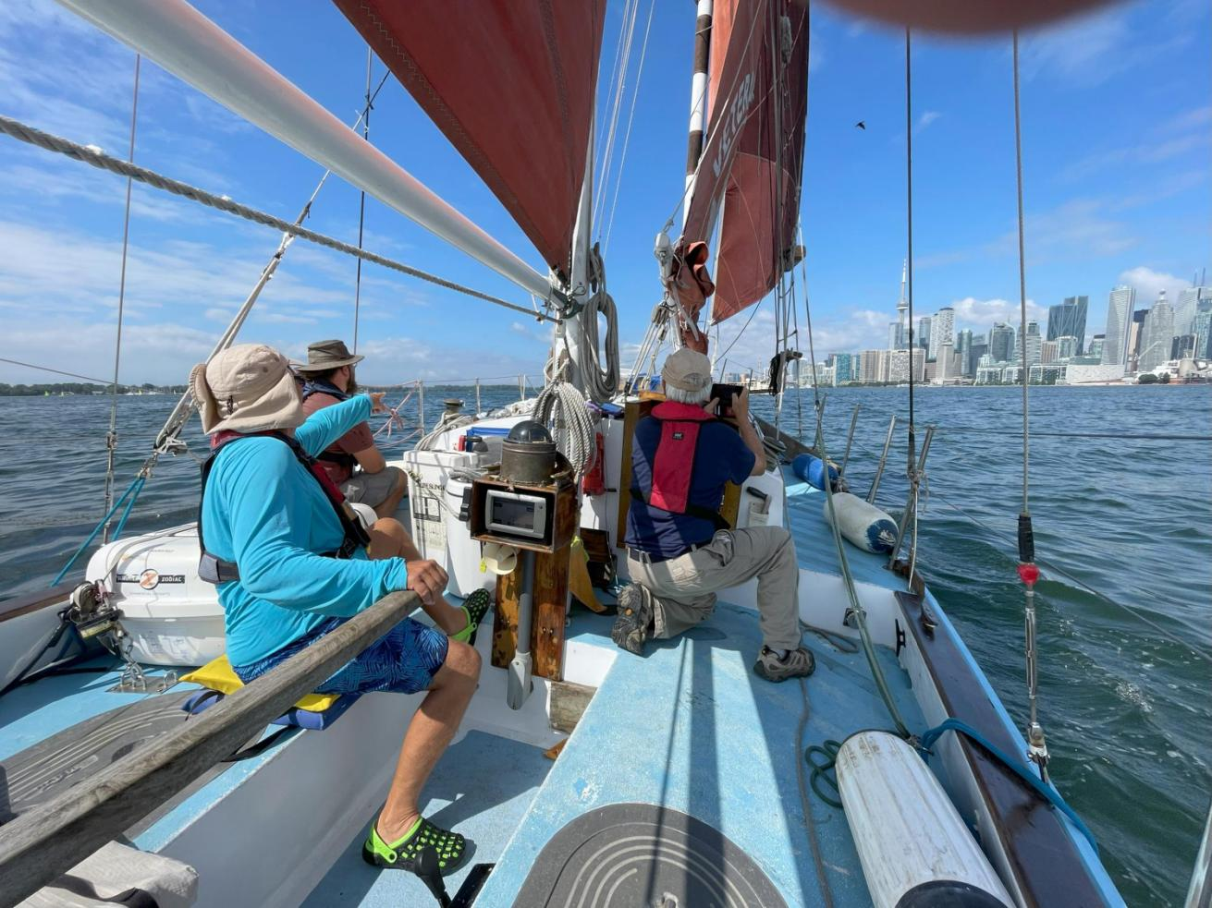
Toronto

Slide 40
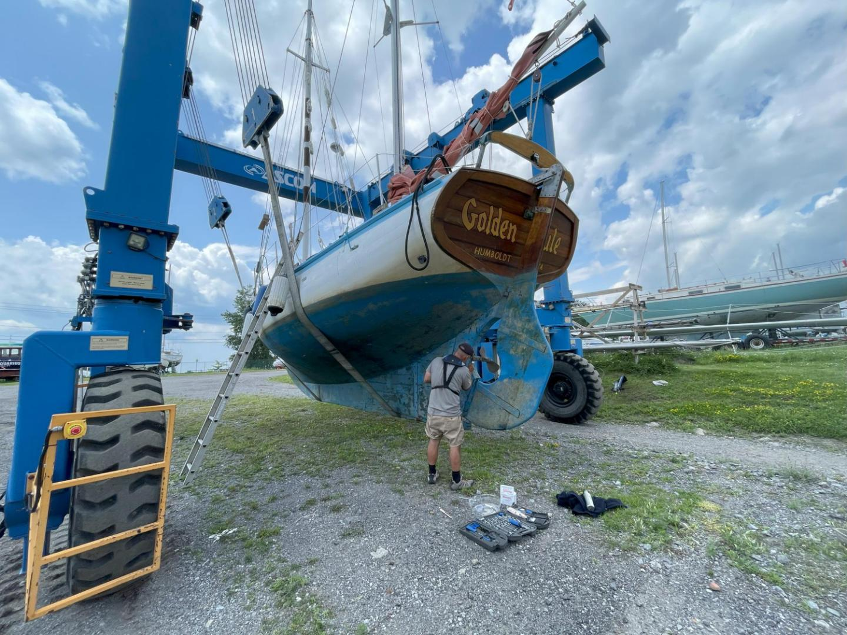

Slide 41
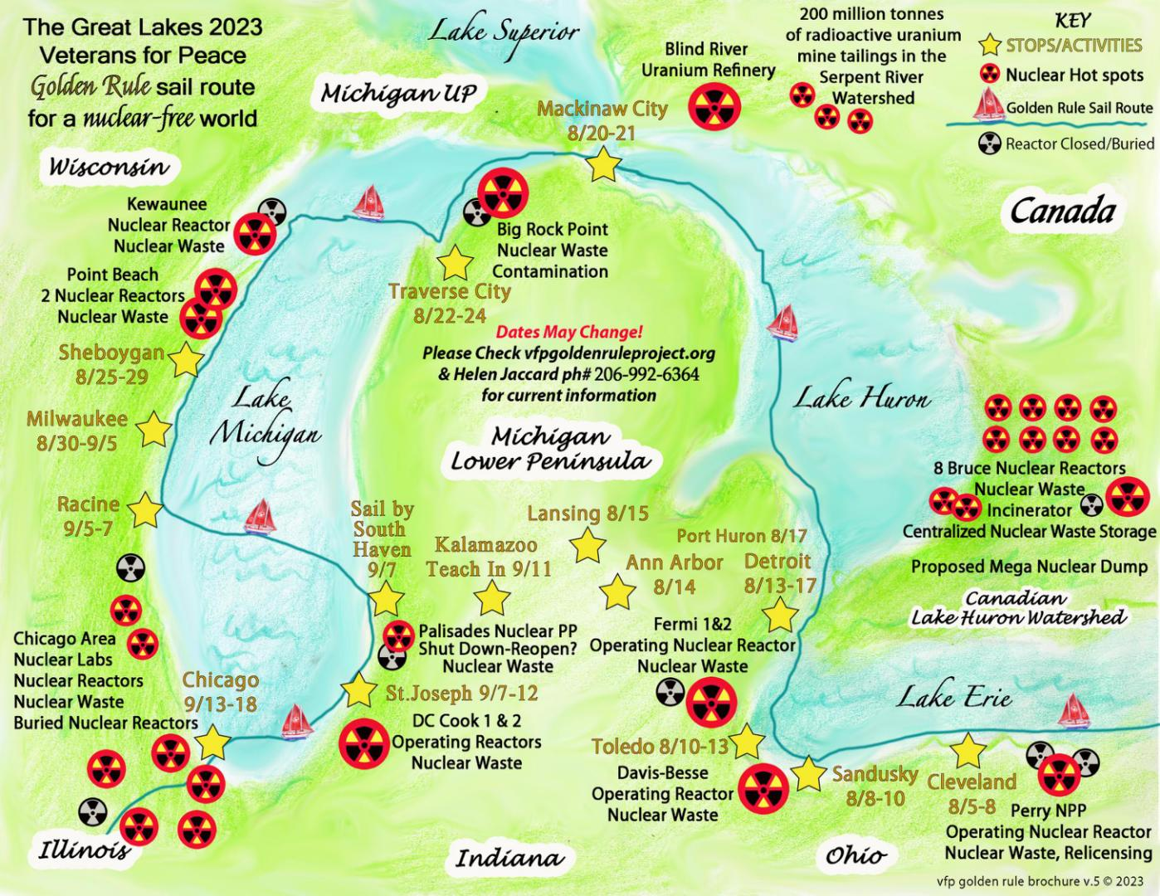

Slide 42
2024 Pacific Northwest Voyage
Sat 7/6 Eureka, CA
Humboldt Bay sail, celebration with the historic Madaket ferry
Mon 7/15 Eureka, CA
Departure, Press Conference
Sat 7/27 Bangor, WA
Protest Nuclear Submarines
Mon 7/29 – Mon 8/26 Seattle, Tacoma, Olympia, Bremerton, Everett, Vancouver BC, Friday Harbor
7/30 - 8/4 Fleet Week and Air Show Protest 8/2-6 Hiroshima Commemorations 8/27 Friday Harbor Yacht Club
Fri 8/30 – Wed 9/04 Victoria, BC
Victoria Classic Boat Festival
Fri 9/06 – Sun 9/08 Port Townsend, WA
Port Townsend Wooden Boat Festival
Fri 9/13 – Wed 9/18 Vancouver, WA & Portland, OR
9/14 Vancouver Peace Fair
Mon 9/30 Eureka, CA
Welcome Home Party, Press Conference

Slide 43
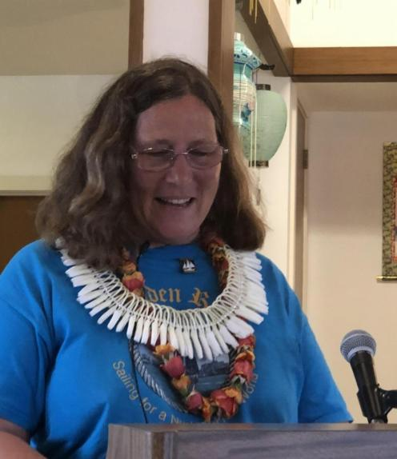
Program: 600+ Presentations

Slide 44
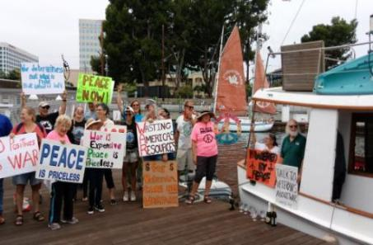
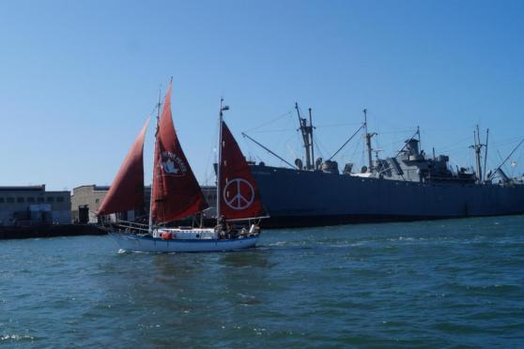
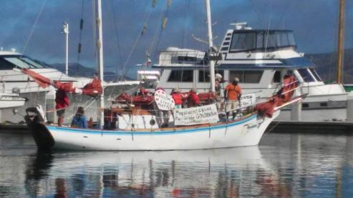
Program: Fleet Week Protests
Bringing a message of Peace in contrast to the Machines of War, Inspiring Activists!
Fleet Week in Seattle, Portland, San Francisco, Los Angeles, San Diego

Slide 45
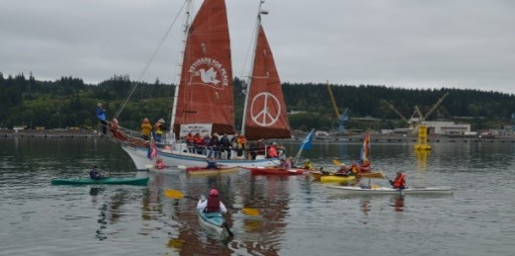
Program: Protest at Nuclear-Armed Submarine Base
First water-based protest since 1982 was with Golden Rule in 2016

Slide 46
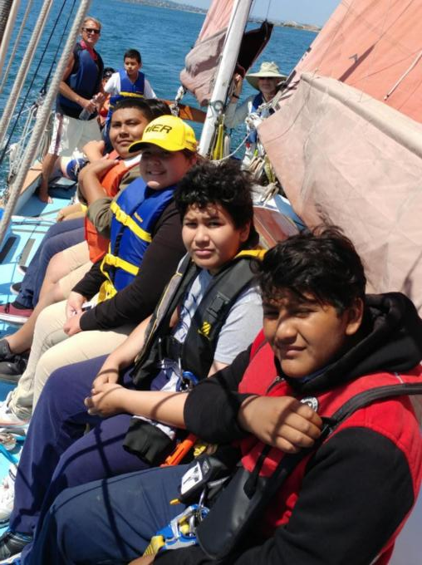
Program: Day Sails

Slide 47
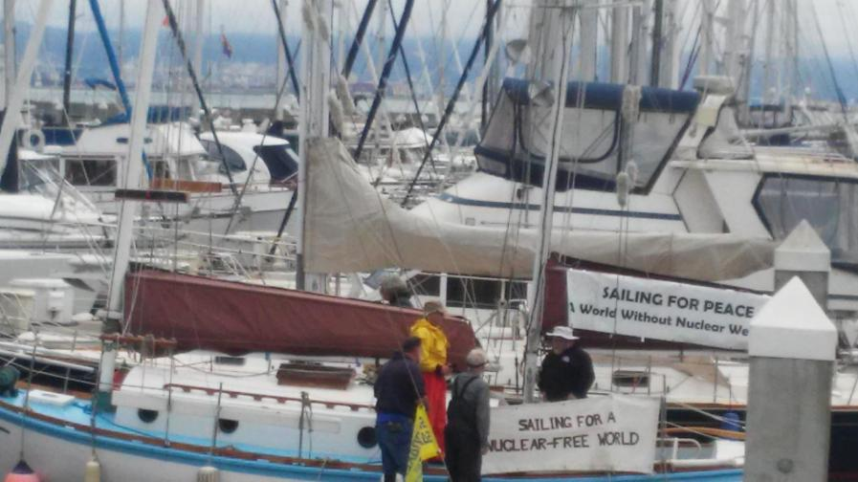
Program: Boat tours

Slide 48
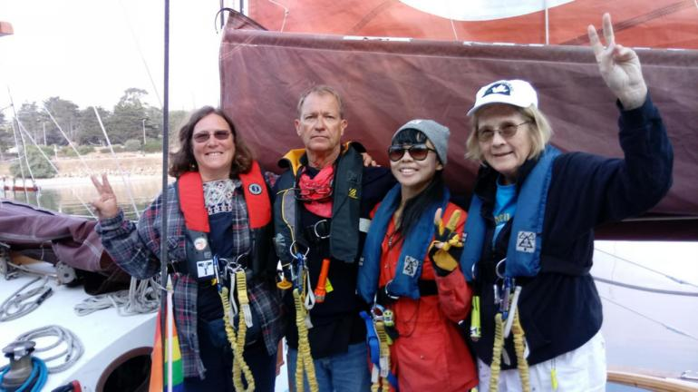
Program: Guest Crew

Slide 49
The Golden Rule A Weapon of Mass Education
Past nuclear weapons tests, use, lasting effects on people and environment
Nuclear weapons are already used in war through threat of use
Effects of a nuclear war
Current dangers (China, Russia, N Korea)
Organizations (mentioned as Great Loop sponsors above)

Slide 50
Sponsors, Collaborators, Partners
Women’s International League for Peace & Freedom
Physicians for Social Responsibility
ICAN
Peace Action
CodePink Women for Peace
Back from the Brink
World BEYOND War
RootsAction
NuclearBan.US
People’s Network for Planet, Justice, & Peace
Earth Quaker Action Team and local Quaker Meetings
United for Peace & Justice

Slide 51
Actions
Get your City Aboard!
Meet/educate politicians and get them aboard with City/County/State Resolutions in support of or to join
UN Treaty on the Prohibition of Nuclear Weapons and other treaties,
Back from the Brink,
Mayors for Peace
Bills before Congress
HRes 77 - the Back from the Brink bill
HR-2775 - 118th Congress (2023-2024): To direct the United States to sign the Treaty on the Prohibition of Nuclear Weapons and convert nuclear weapons industry resources and personnel to purposes relating to addressing the climate crisis, and for other purposes.
VFP No Nukes Working Group and Nuclear Posture Review
Divestment - Show up and get Cities, Pension Funds to divest!
Direct Action - National Labs, Weapons Manufacturers, Shareholder Meetings, City/County/States!
Write, speak, educate, make music - media, social media!

