Slide 1
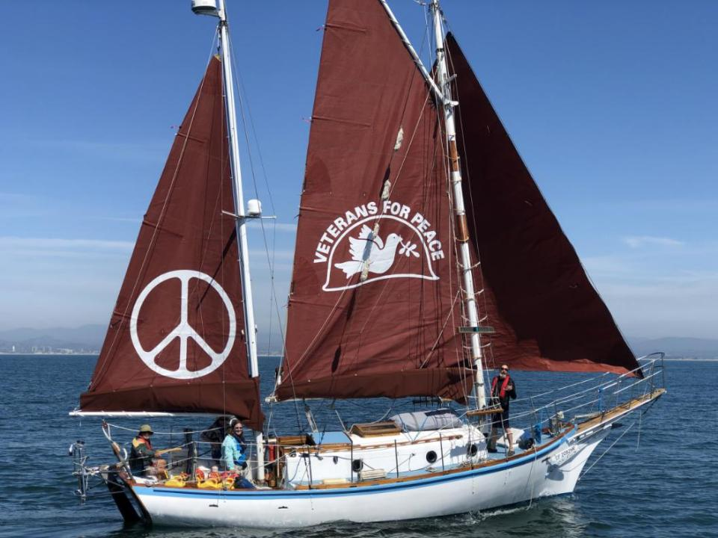
The Golden Rule:
Do Unto Others as you would have others do unto you
Golden Rule Sails Again for a Nuclear Free Future!
Veterans For Peace
Golden Rule Project
www.vfpgoldenruleproject.org
vfpgoldenruleproject@gmail.com
(206) 992-6364
VFP Golden Rule Project
P.O. Box 87
Samoa, CA 95564

Slide 2
Outline - NEIS Night with the Experts
Intro/thanks to speakers, hosts, endorsers, attendees
VFP and its mission, VFP Resolution regarding nuclear power
The Golden Rule, history 58, including the mission statement written right after Fukushima, voyages esp great loop, program incl TPNW, BftB, bills in Congress
WILPF - End the Whole Nuclear Era
Nuclear Weapons and Nuclear Energy connection, especially uranium mining, milling, waste, depleted uranium, Pu needed for bombs. No other reason for Nuke Energy to exist.
Gerry -
  Himself, intro, NPR sections, The VFP Nuclear Abolition Working Group, in chat
  VFP-NPR LINK https://www.tinyurl.com/VFP-NPR2
  GRAPHIC FOR JUNE 20 WEBINAR (PASTE the link in the CHAT)
Gerry - separate presentation, NPR and aggressive US foreign policy and Cuban missile crisis as an example of danger, succeeded from out of Turkey, nuclear policy inseparable from overall military policy. Increases chances of nuclear war - Ukraine, Palestine, China
What about decommissioning NPP and disassembling weapons? What about Pu stockpiles in US, Japan, ??
Nuclear proliferation through nuclear energy? - Saudi Arabia and others
Entire industry plagued by secrecy, lies, violence (mining)

Slide 3

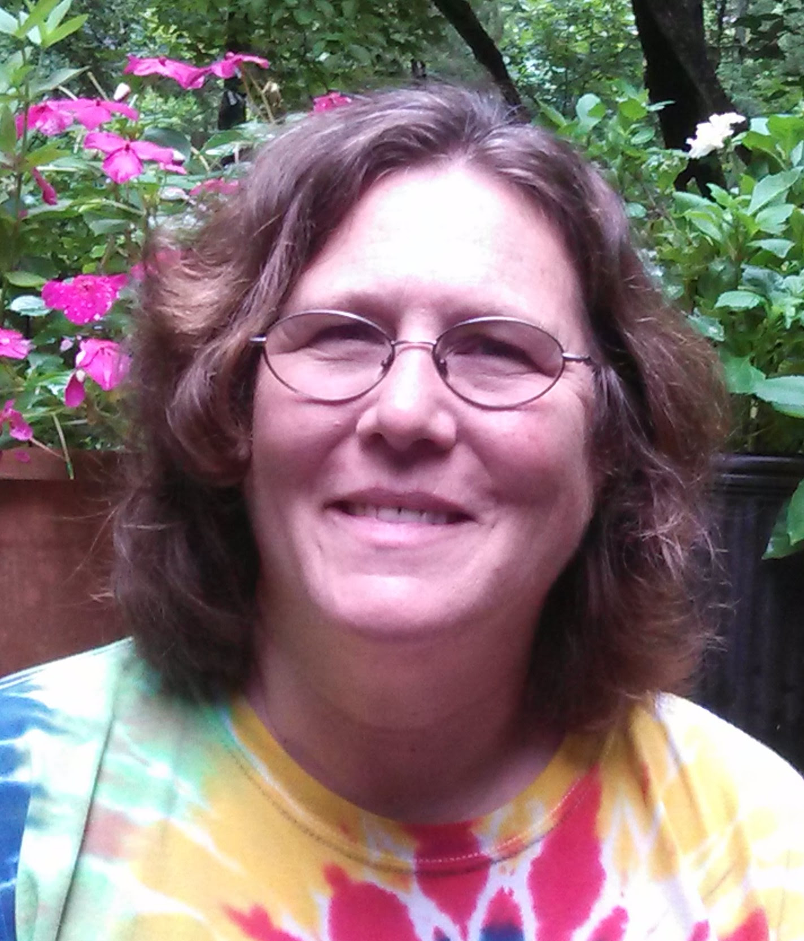
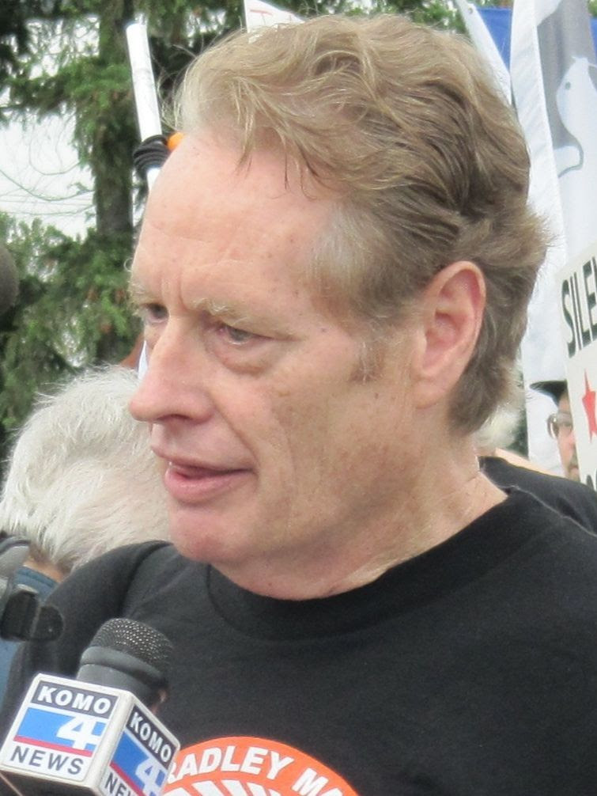
NEIS “A Night with the Experts”
Nuclear Power and Weapons in a Time
of Rising Tensions
May 30, 2024
Veterans For Peace has sailed the historic anti-nuclear Golden Rule as a tool to educate people about nuclear issues and advocate for actions to stop the possibility of nuclear war. The Golden Rule Project teaches about the problems caused by the whole chain - from Uranium mining to nuclear energy and weapons to lack of nuclear waste disposal.
Many organizations are trying to stop the nuclear madness.
We invite discussion about all nuclear issues and actions we can take to end the nuclear era.
Helen Jaccard lis the Project Manager for the Golden Rule anti-nuclear sailboat, a Project of Veterans For Peace. She is also a member of Women's International League for Peace & Freedom's Disarm/End Wars Committee. Helen writes about the environmental costs of war and militarism, including radioactive contamination. She also talks about the harm from the entire nuclear chain, from cradle to grave. Helen has visited Fukushima, Hiroshima and Nagasaki to learn first hand from evacuees and hibakusha.
Gerry Condon is a past president and current Board member of Veterans For Peace, and President of the Golden Rule's steering committee. Gerry is a Vietnam-era war resister.
Many thanks to
Host: NEIS Board of Directors
NEIS Director David Kraft
Kathleen Rude, flier maker
Jan Boudart, Secretary, NEIS.org and facilitator for Night With The Experts
Jacob Hamblin and Linda Richards “Making the Unseen Visible”
https://us02web.zoom.us/w/83055280771?tk=-ZkpczMuWATusYgBujPKc2S9B061abFD8sn_vk7kPEc.DQYAAAATVnsCgxZKSGFFdFQzVlIxQ0NGVFhjWm9ZaTRBAAAAAAAAAAAAAAAAAAAAAAAAAAAAAAAAAAAAAA&pwd=MC80OG5EdTFKQVdjREZBdzFMbVpqdz09

Slide 4


The Golden Rule is a
Project of Veterans For Peace
100 US chapters
10 international chapters
3000 members

Slide 5
VFP Golden Rule Project implements Veterans For Peace Statement of Purpose
To restrain our governments from intervening, overtly and covertly, in the internal affairs of other nations
To end the arms race and to reduce and eventually eliminate nuclear weapons

Slide 6
VFP Resolution - Abolish Nuclear Power
Resolution 2011-4: Abolishment Of Nuclear Power Plants
Approved at the 2011 VFP National Convention
“Whereas Veterans for Peace understands the importance of linking nuclear power plants and nuclear weapons with the entire military industrial complex”
“Whereas in addition to the serious health, safety, environmental, and economic issues involved with nuclear power plants, and the inherent risks of nuclear proliferation and terrorist attacks associated with nuclear power plants, the multiple links between nuclear power and nuclear weapons make it impossible to abolish nuclear weapons as long as nuclear power plants continue to operate”
“Therefore Be It Resolved that Veterans For Peace opposes any effort to expand nuclear energy and calls for the rapid reduction of existing nuclear power plants, and the complete elimination of nuclear power plants by 2020, and
Be It further Resolved that Veterans For Peace supports the development of a safe, sustainable, and democratic energy system based on solar, wind, and other sustainable sources.”

Slide 7
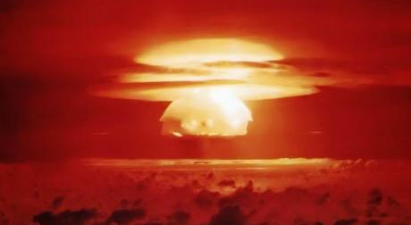
67 Nuclear Bomb Tests in the Marshall Islands
Bikini Atoll, March 1, 1954
U.S. detonated a 15-megaton device equivalent to 1000 Hiroshima blasts.

Slide 8
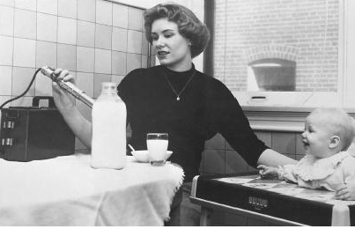
Strontium 90 in mother’s and cow’s milk

Slide 9
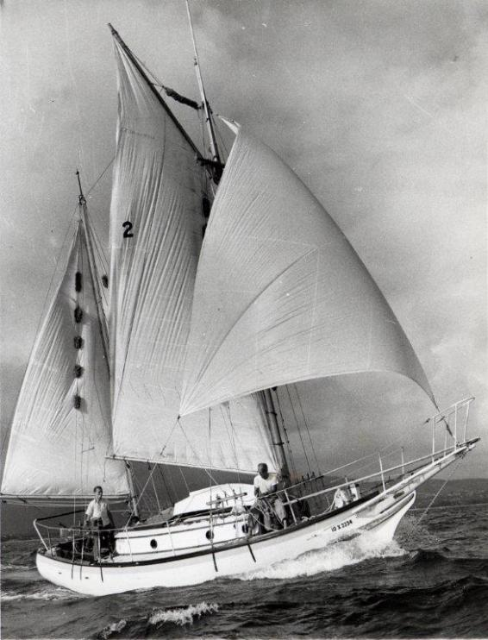

Slide 10
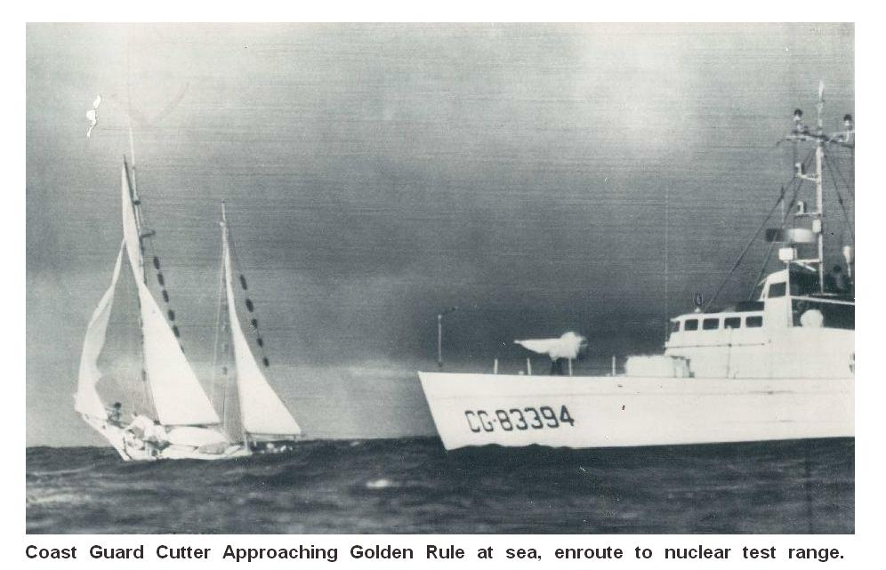

Slide 11
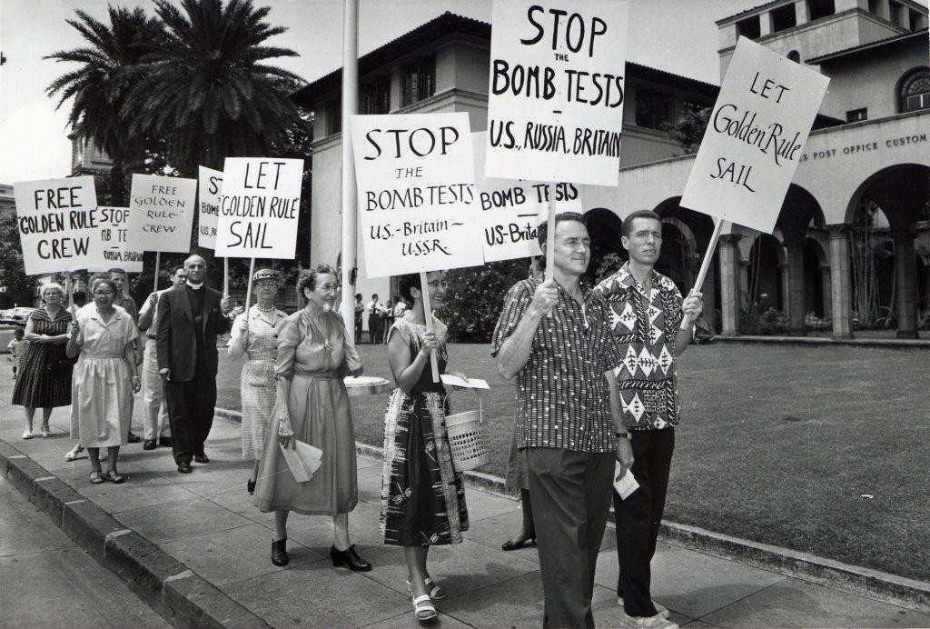
Anti-Nuclear Protests in Honolulu

Slide 12
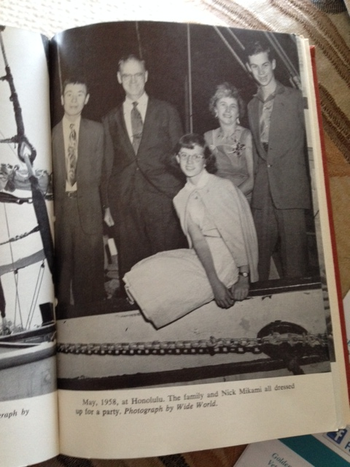
The Phoenix of Hiroshima
Miichi (Nick) Mikami, Dr. Earle Reynolds, Jessica Reynolds, Barbara Reynolds, Ted Reynolds

Slide 13
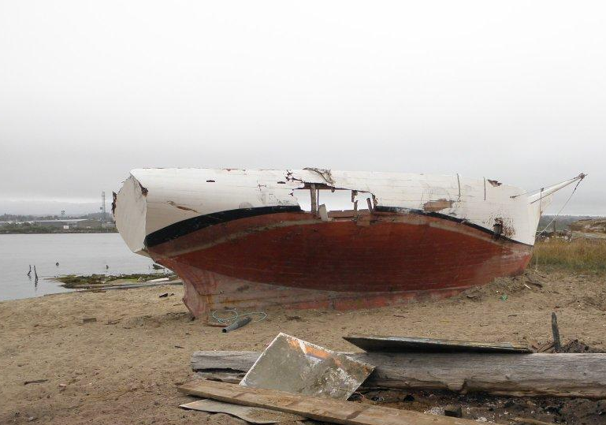

Slide 14
VFP Golden Rule Project Mission
The original nuclear protest boat, the Golden Rule, sails again
to promote a nuclear free future
to educate about the dangers of radiation to humanity and the environment, and
to support peaceful alternatives to war.
We Sail for a Nuclear-Free World and a Peaceful, Sustainable Future!

Slide 15
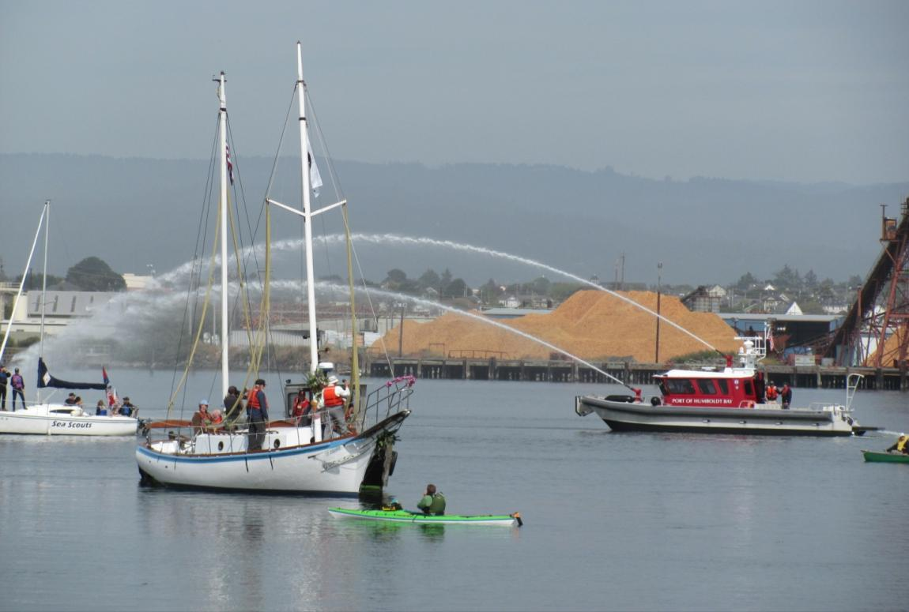
Launch! June 20, 2015

Slide 16
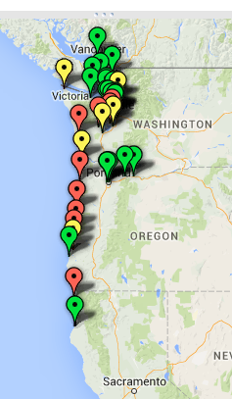
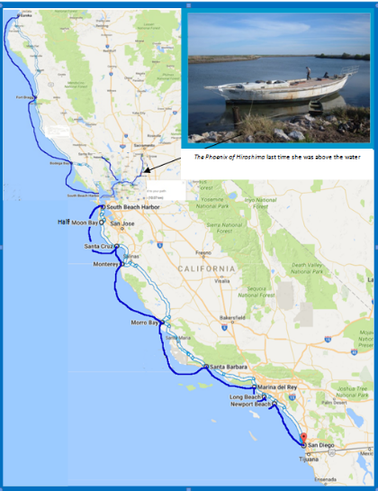
2016, 2024 Voyage 2015, 17-19,22

Slide 17
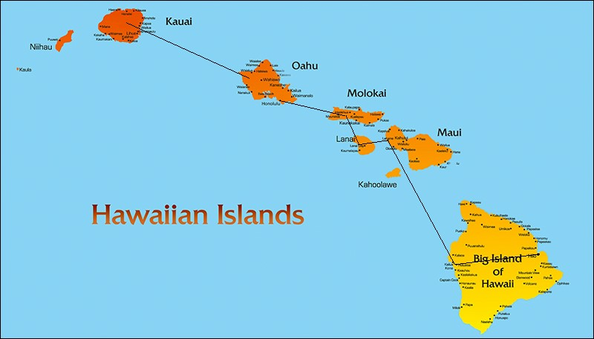
2019-21: 22 months in the Hawaiian Islands

Slide 18
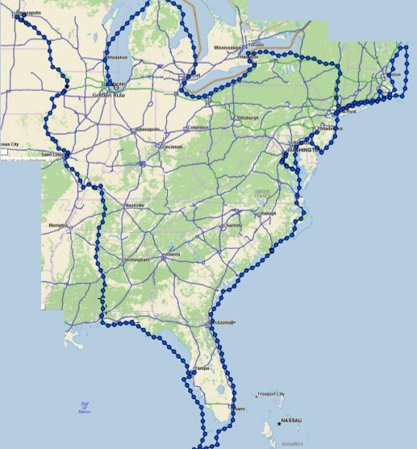
“The Great Loop”
Minneapolis Aug‘22 - Chicago Sept ‘23
10,300 miles
102 Cities or Towns visited
350 presentations -
reached 10,500 people directly
100,000s of people reached through press
VFP Chapters
22 Chapters donated a total of $23,652 in 2022-23.
39 Chapters anchored GR GL Events

Slide 19
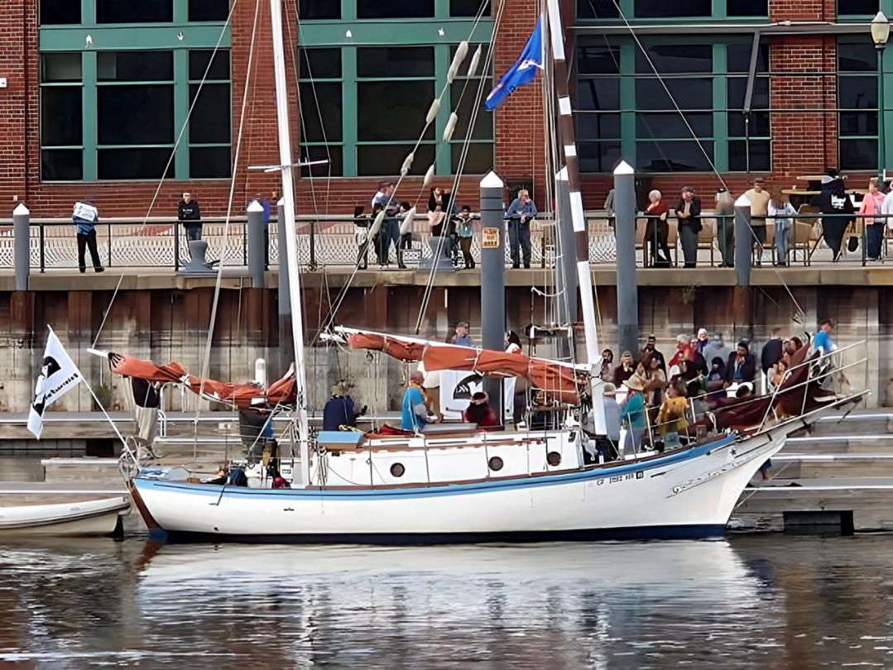

Slide 20
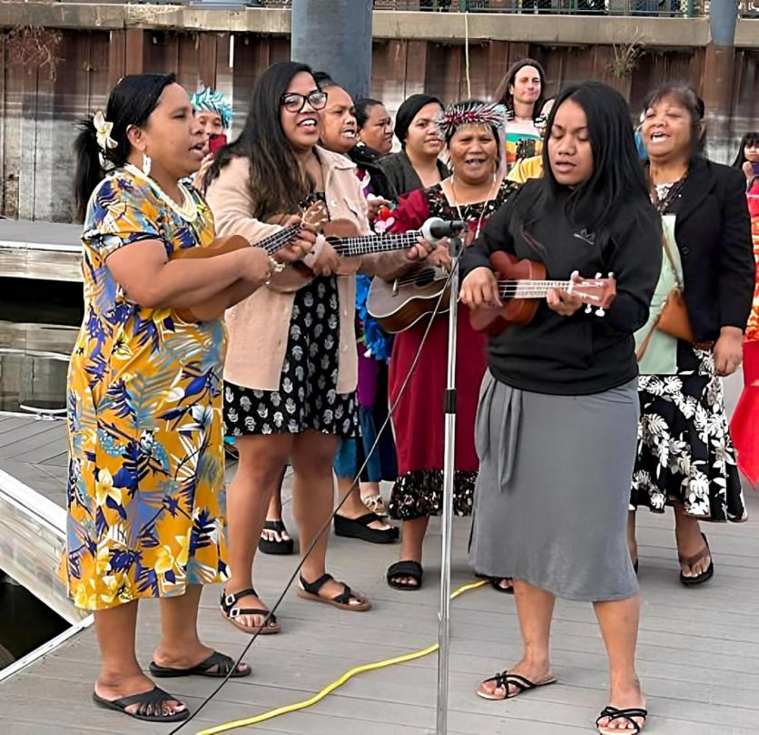

Slide 21
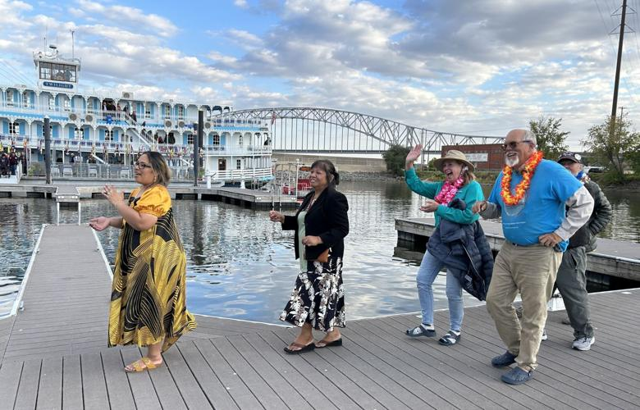

Slide 22
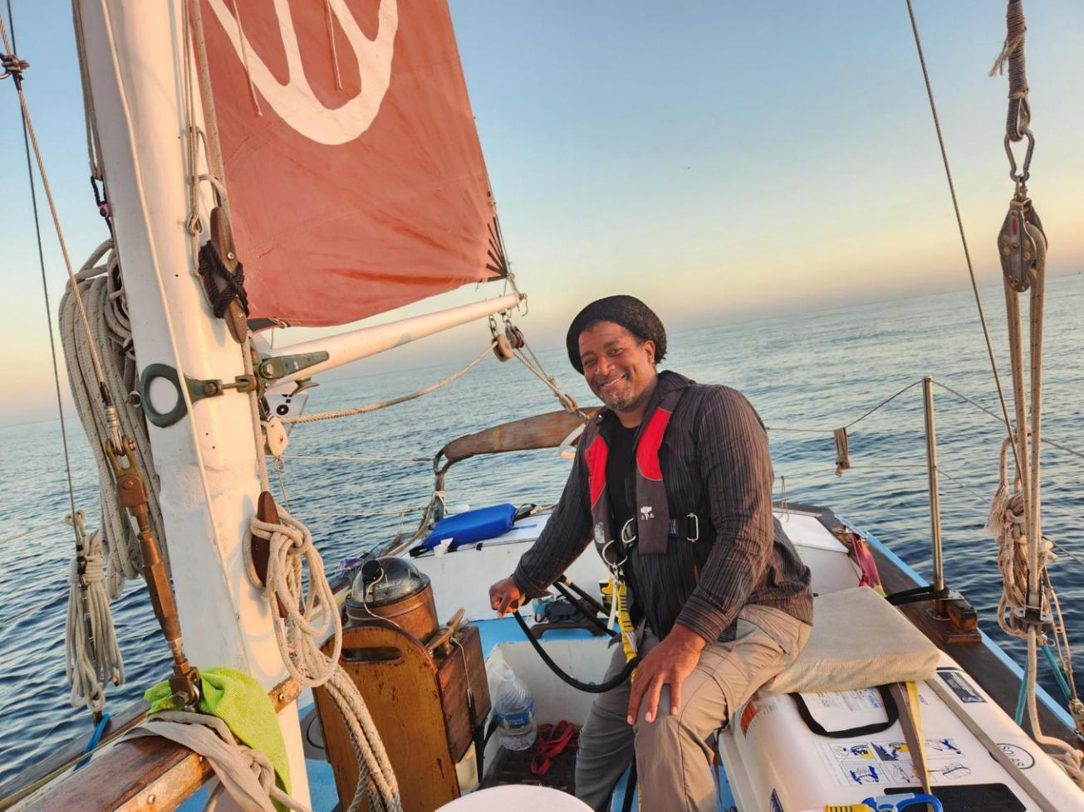
2023 Started with the voyage to Cuba!
Six Golden Rule representatives went by sea and five by air to Cuba for an “Arts & Cultural” visit
Dec 31 - Jan 10
VFP Board Member Enya Anderson at the helm of the Golden Rule as it came into
Hemingway Marina

Slide 23
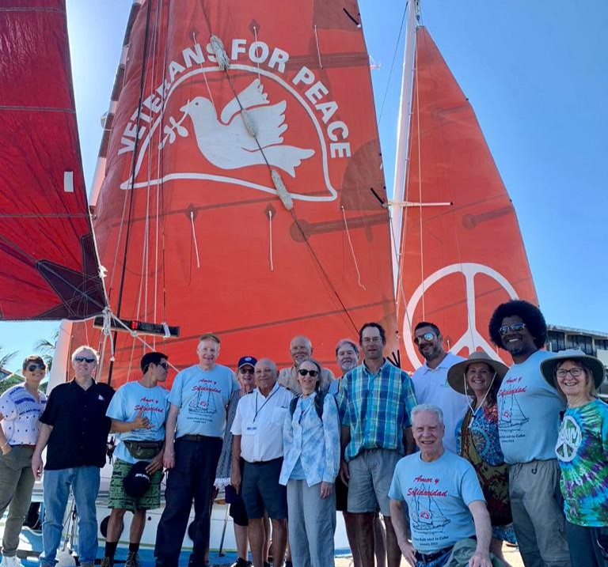
The Entire Cuba Delegation (from land and sea!)

Slide 24
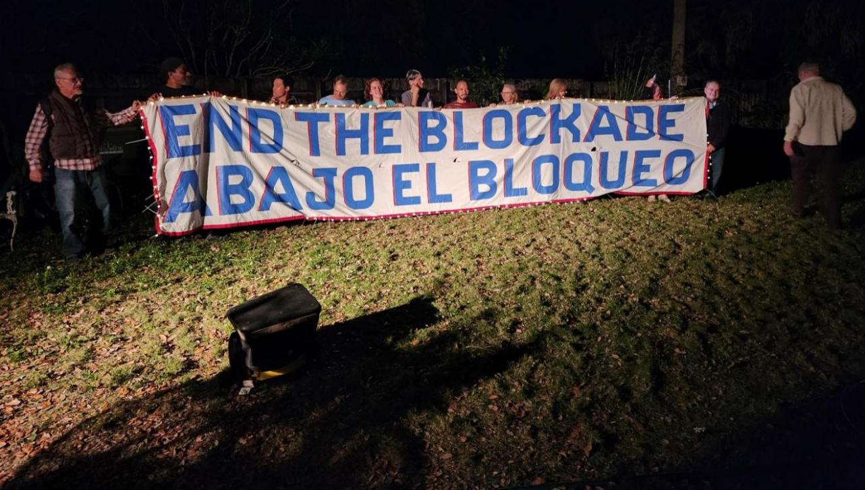
Golden Rule Reps joined Miami activists to call for the end of the Cuba Blockade

Slide 25
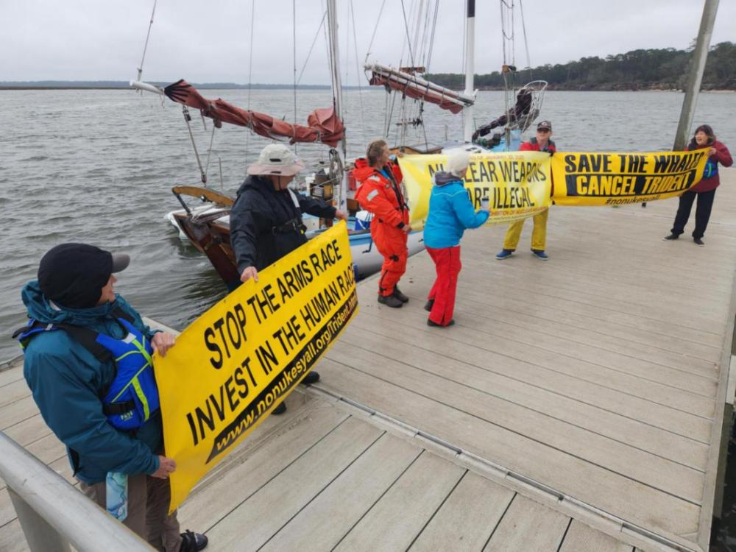
Sail-by and Protest at
Kings Bay Nuclear-Armed Trident Submarine Base!

Slide 26
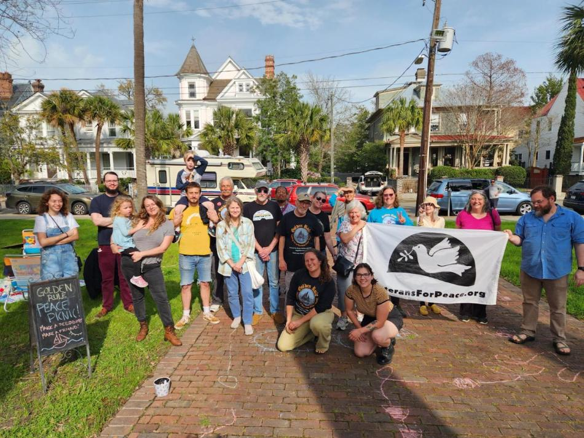
Peace picnics in the park!

Slide 27
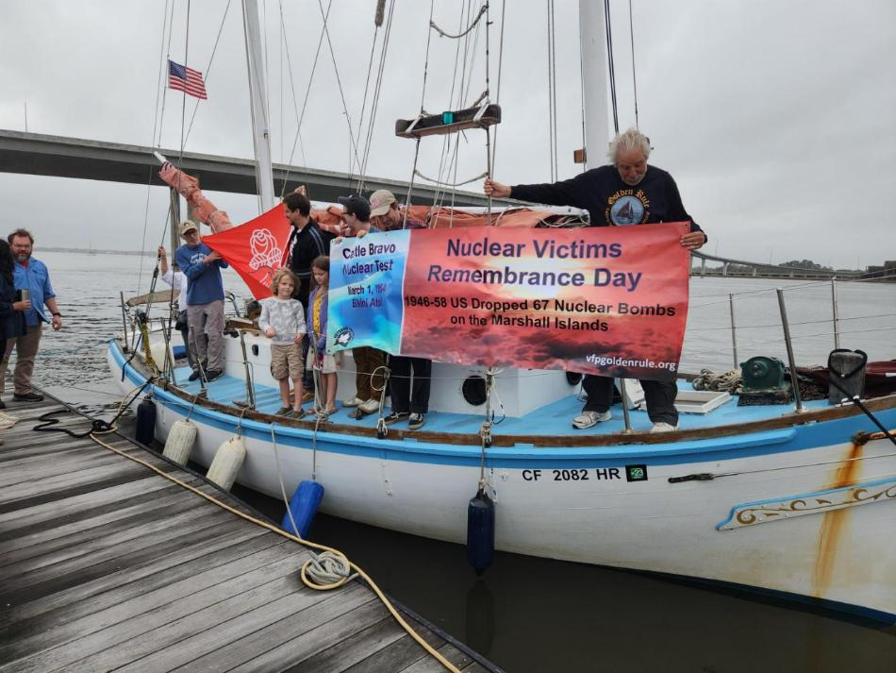
Commemorating March 1, 1954 Castle Bravo destruction in the Marshall Islands

Slide 28
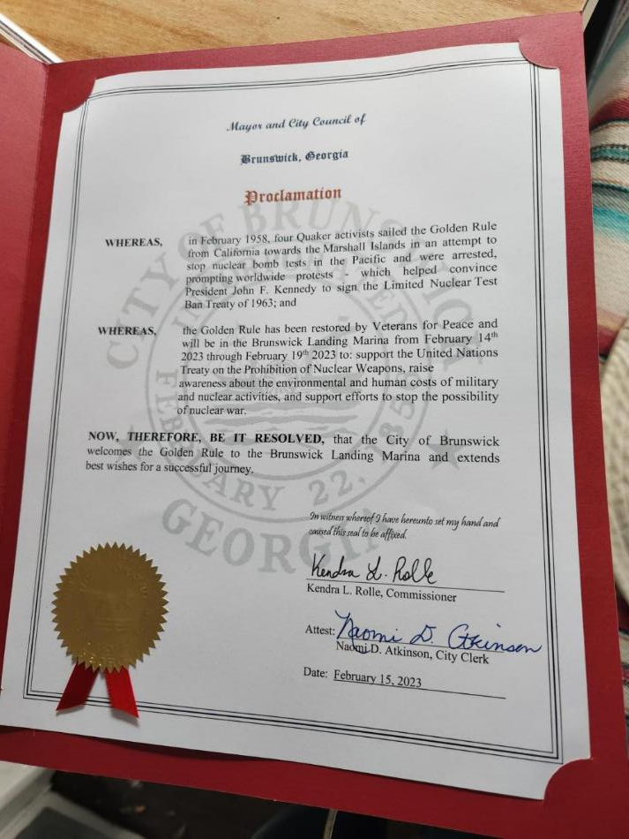
Over 40 Mayors and City Councils gave the Golden Rule a warm Proclamation of Welcome!

Slide 29

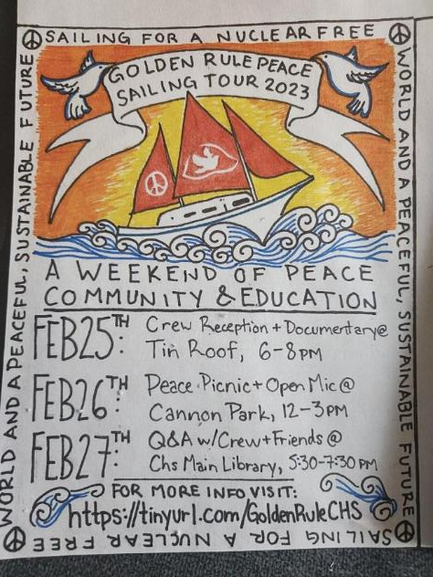
Beautiful Unique flyers

Slide 30
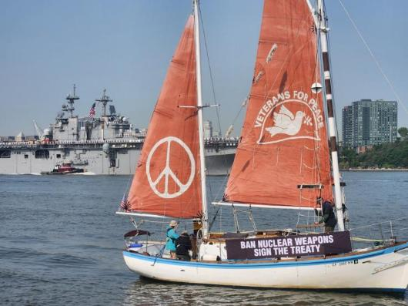
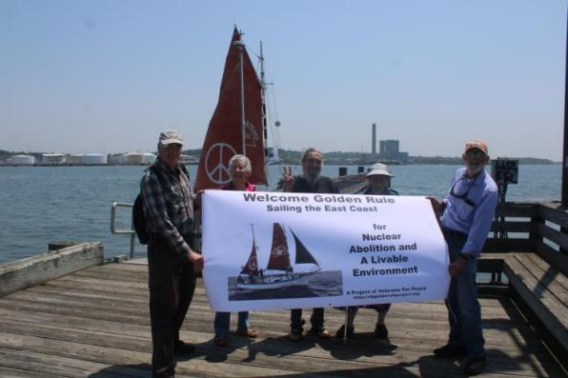
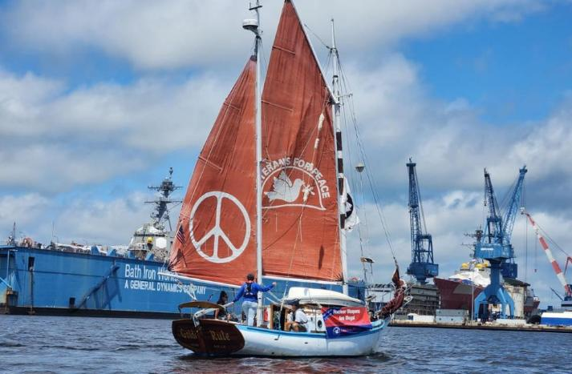
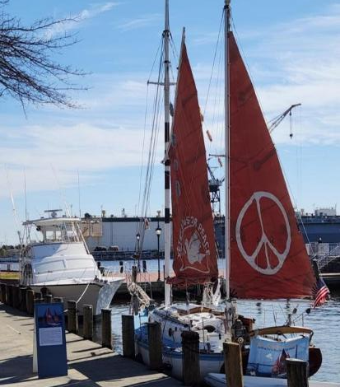
Fleet Week Parade of War Ships, Hudson River, NYC
New Haven, Connecticut welcomed the Golden Rule - several groups sailed by Groton Electric Boat, manufacturer of nuclear-armed submarines.
Norfolk, Virginia - home to all branches of the military
The Golden Rule with a huge navy ship in the background
The ship of peace sails in protest of Bath Iron Works,
makers of nuclear-capable war ships

Slide 31
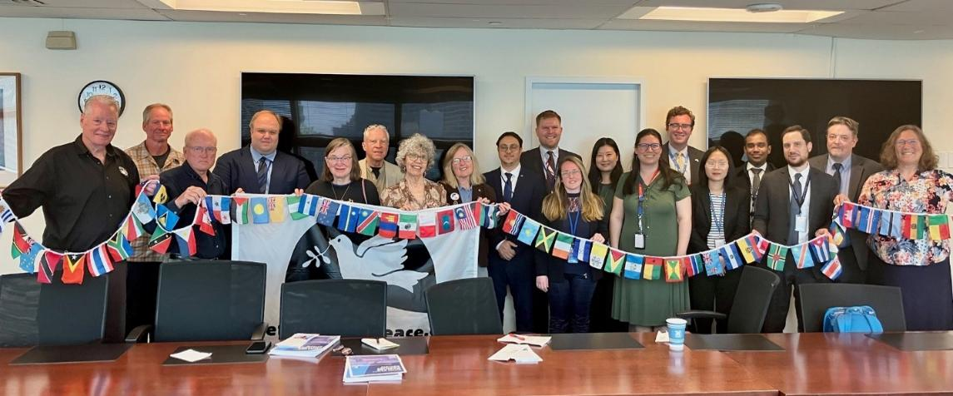
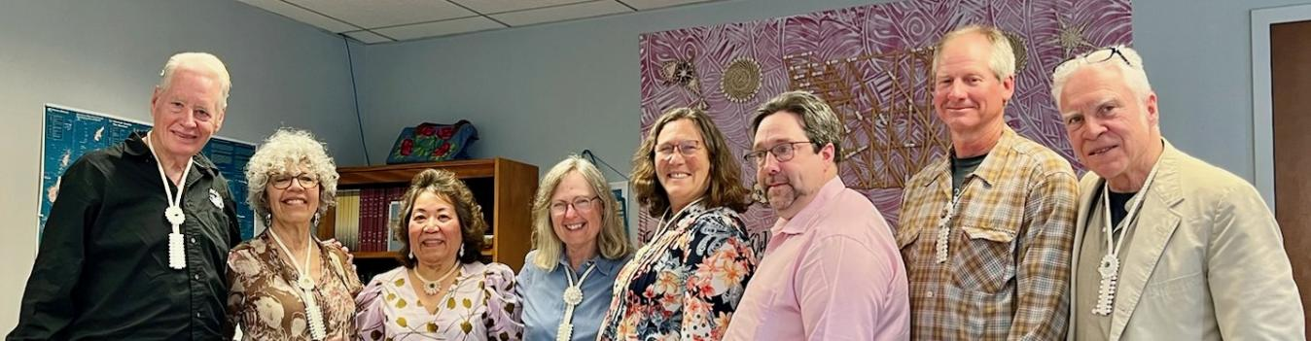
United Nations Missions!
Veterans For Peace and the Golden Rule team met with twelve UN missions, including New Zealand, Malaysia, Vietnam, Cuba, South Africa, Austria, Indonesia, Ireland, Costa Rica, Kiribati, and the Vatican
Veterans For Peace delegation visited with the Permanent UN Representative from the Republic of the Marshall Islands. Ambassador Amatlain Elizabeth Kabua gave a very warm welcome in her cozy UN office and spoke with the group for over two hours.

Slide 32
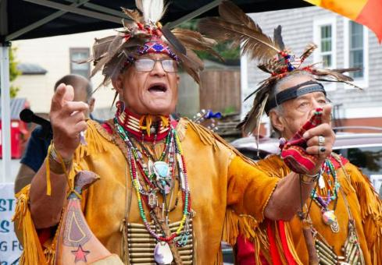
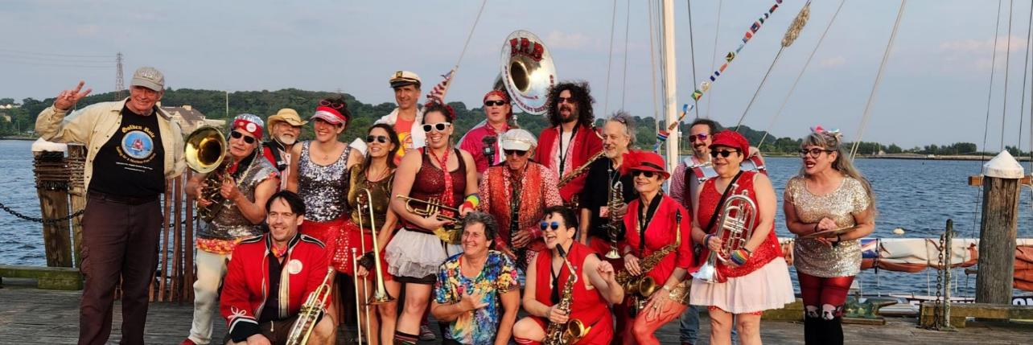
Rhode Island: Providence, Bristol
Golden Rule crew are greeted by members of the Pokanoket tribe.
The Extraordinary Rendition Band played rousing music on the dock!

Slide 33
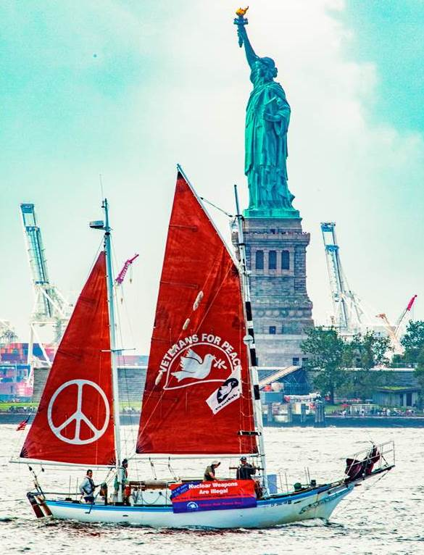

Slide 34
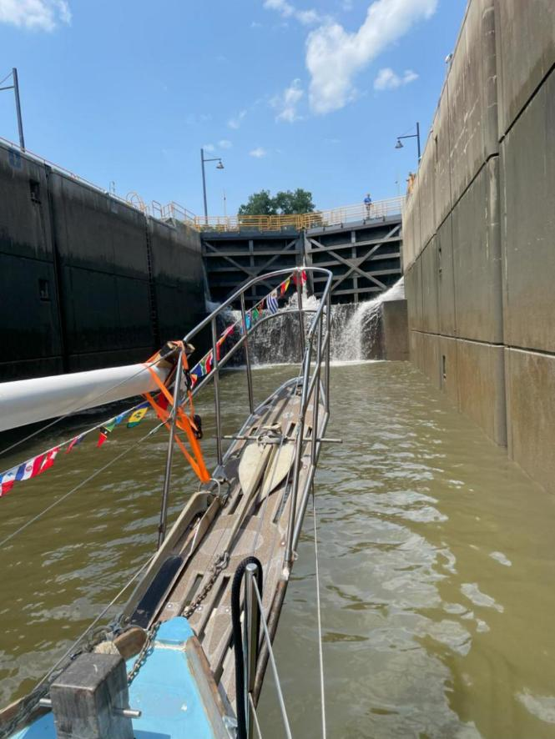
Erie Canal

Slide 35
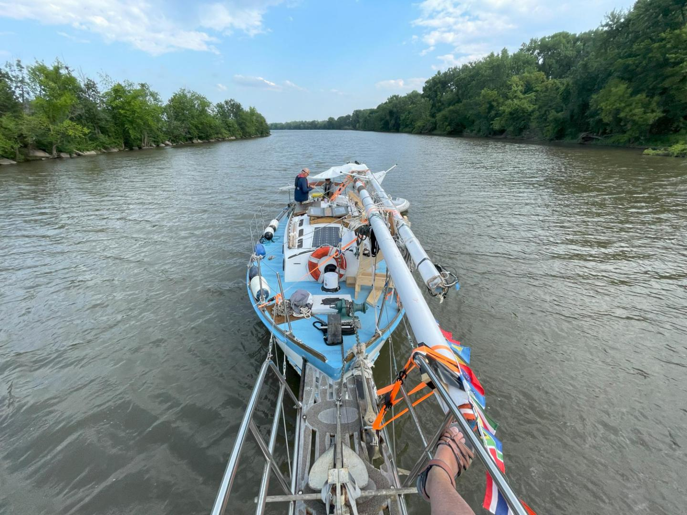

Slide 36
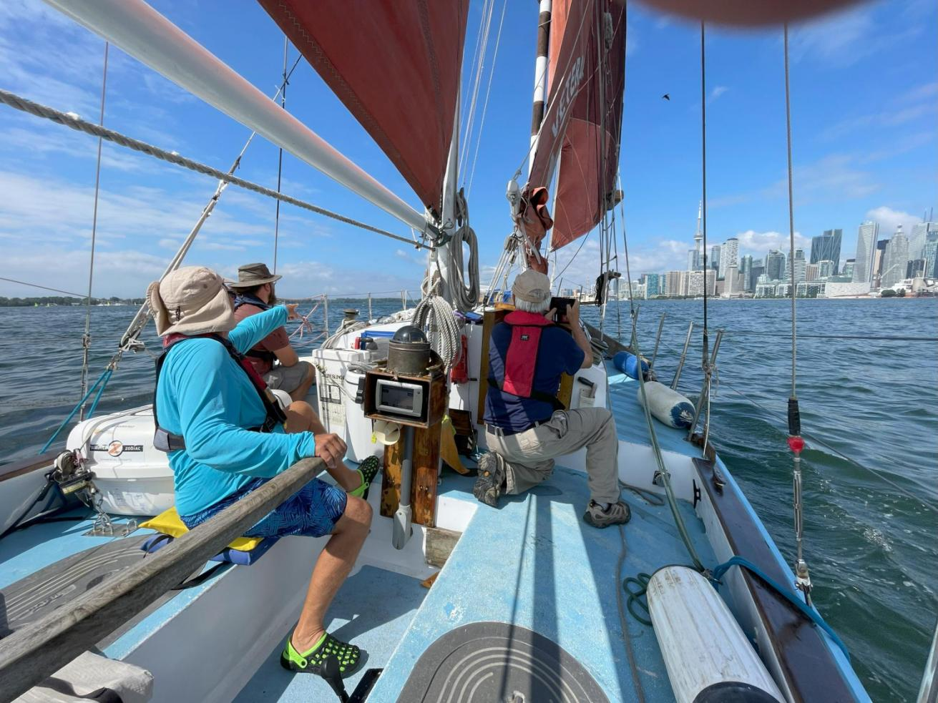
Toronto

Slide 37
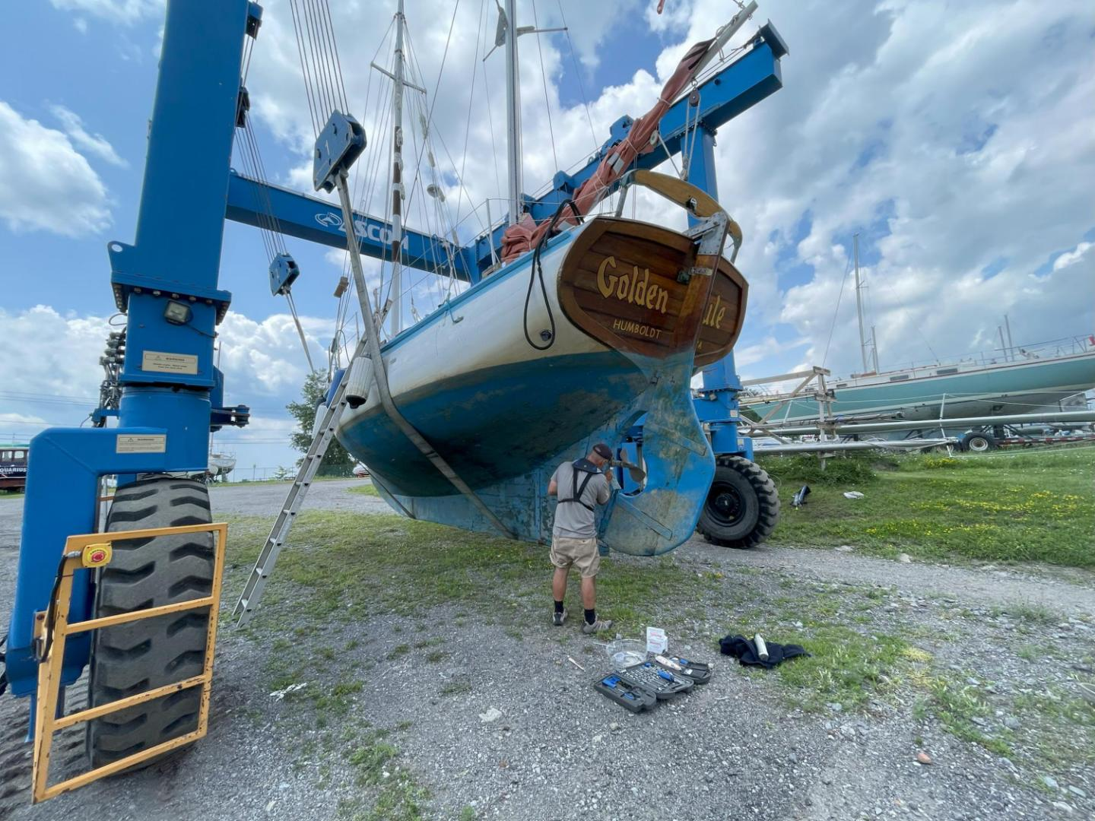

Slide 38
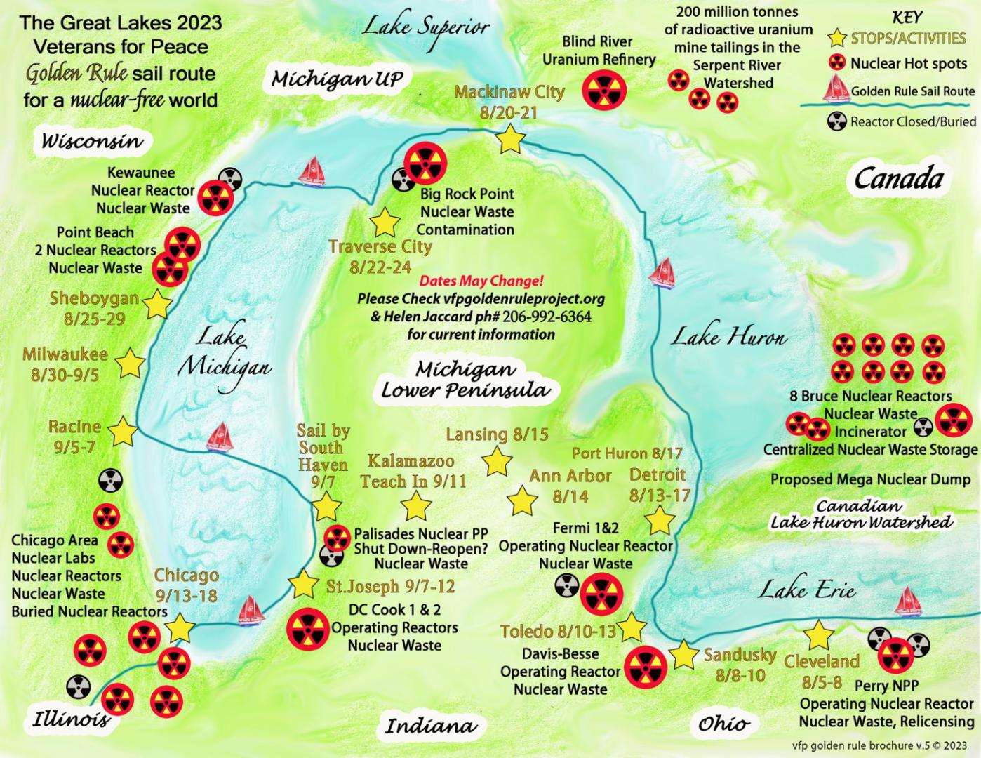

Slide 39
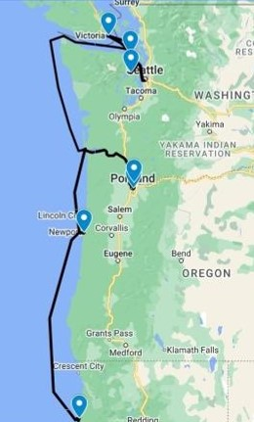
2024 Pacific Northwest Voyage
Sat 7/6 Eureka, CA
  Humboldt Bay sail, celebration with the historic Madaket ferry
Mon 7/15 Eureka, CA
  Departure, Press Conference
Sat 7/27 Bangor, WA
  Protest Nuclear Submarines
Mon 7/29 – Mon 8/26 Seattle, Tacoma, Olympia, Bremerton, Everett, Vancouver BC, Friday Harbor
  7/30 - 8/4 Fleet Week and Air Show Protest
  8/2-6 Hiroshima Commemorations
  8/27 Friday Harbor Yacht Club
Fri 8/30 – Wed 9/04 Victoria, BC
  Victoria Classic Boat Festival
Fri 9/06 – Sun 9/08 Port Townsend, WA
  Port Townsend Wooden Boat Festival
Fri 9/13 – Wed 9/18 Vancouver, WA & Portland, OR
  9/14 Vancouver Peace Fair
Mon 9/30 Eureka, CA
  Welcome Home Party, Press Conference

Slide 40
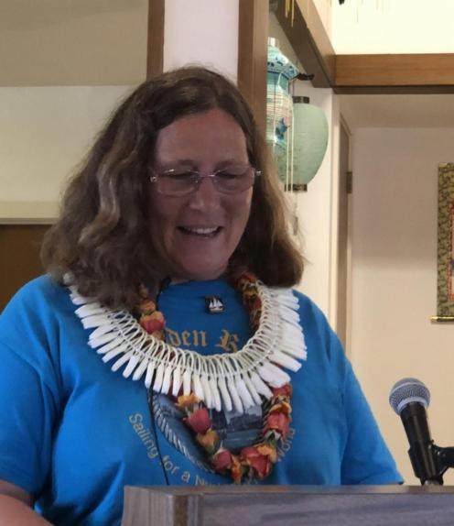
Program: 600+ Presentations

Slide 41
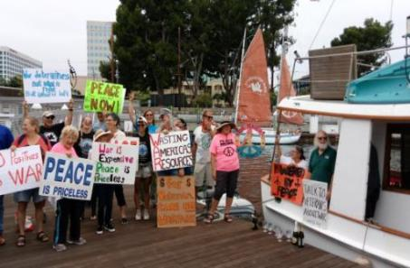
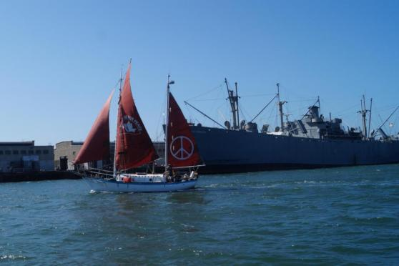
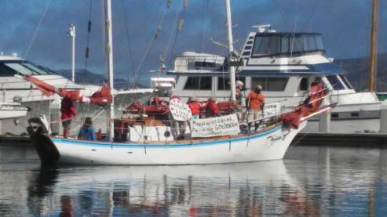
Program: Fleet Week Protests
Bringing a message of Peace in contrast to the Machines of War, Inspiring Activists!
Fleet Week in Seattle, Portland, San Francisco, Los Angeles, San Diego

Slide 42
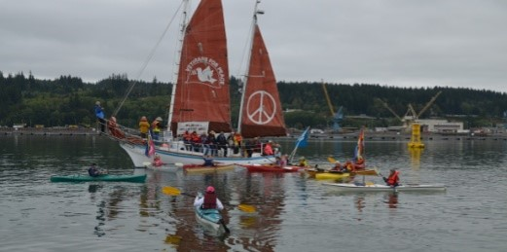
Program: Protest at
Nuclear-Armed Submarine Base
First water-based protest since 1982 was with Golden Rule in 2016

Slide 43
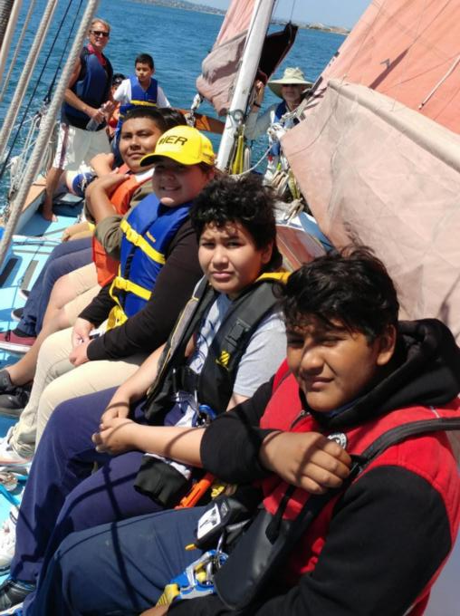
Program:
Day Sails

Slide 44
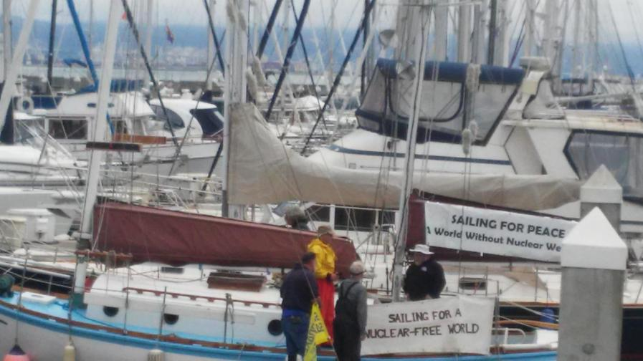
Program: Boat tours

Slide 45
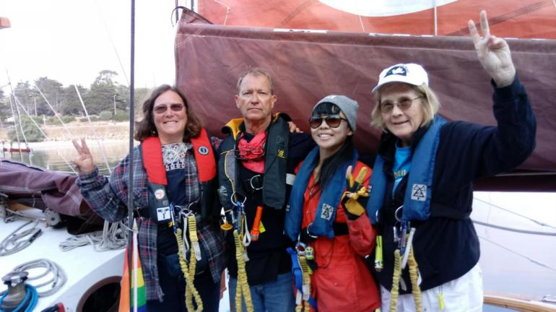
Program: Guest Crew

Slide 46
The Golden Rule
A Weapon of Mass Education
Past nuclear weapons tests, use,
lasting effects on people and environment
Nuclear weapons are already used in war
through threat of use
Effects of a nuclear war
Current dangers (China, Russia, N Korea)
Organizations (mentioned as Great Loop sponsors above)

Slide 47
Sponsors, Collaborators, Partners
Women’s International League for Peace & Freedom
Physicians for Social Responsibility
ICAN
Peace Action
CodePink Women for Peace
Back from the Brink
World BEYOND War
RootsAction
NuclearBan.US
People’s Network for Planet, Justice, & Peace
Earth Quaker Action Team and local Quaker Meetings
United for Peace & Justice

Slide 48
Actions
  Get your City Aboard!
    Meet/educate politicians and get them aboard with City/County/State Resolutions in support of or to join
    UN Treaty on the Prohibition of Nuclear Weapons and other treaties,
    Back from the Brink,
    Mayors for Peace
  Bills before Congress
    HRes 77 - the Back from the Brink bill
    HR-2775 - 118th Congress (2023-2024): To direct the United States to sign the Treaty on the Prohibition of Nuclear Weapons and convert nuclear weapons industry resources and personnel to purposes relating to addressing the climate crisis, and for other purposes.
  VFP No Nukes Working Group and Nuclear Posture Review
  Divestment - Show up and get Cities, Pension Funds to divest!
  Direct Action - National Labs, Weapons Manufacturers, Shareholder Meetings, City/County/States!
  Write, speak, educate, make music - media, social media!

Slide 49
Take Action!
VFP Nuclear Posture Review: www.tinyurl.com/VFP-NPR2
- share it widely, and use it as a tool in your own anti-nuclear activities.
The Nuclear Ban Treaty Collective has resources to help with your actions, including banners. nuclearban.us
Ask your Congressional Representatives to support federal legislation to:
Embrace the Goals and Provisions of the TPNW, H. Res. 77
Maintain Congress’ constitutional authority to declare war or a nuclear strike, H.R. 669
Redirect military spending to meet human needs, H.R. 1134
Redirect nuclear weapons spending to clean energy and human needs, H.R. 2775
3. As your member of Congress to join the Parliamentary Pledge of the
International Campaign to Abolish Nuclear Weapons
(ICAN) https://pledge.icanw.org/.
4. Enroll your City or State in the ICAN Cities Campaign. https://cities.icanw.org/ and Mayors For Peace.

Slide 50
NUCLEAR WEAPONS WASTE
Typically, nuclear arms retired from the U.S. arsenal are not melted down, pulverized, crushed, buried or otherwise destroyed. Instead, they are painstakingly disassembled, and their parts, including their deadly plutonium cores, are kept in a maze of bunkers and warehouses across the United States. Any individual facility within this gargantuan complex can act as a kind of used-parts superstore from which new weapons can — and do — emerge.
The reserve and surplus pits, along with pits recovered from disassembled nuclear weapons, totalling over 12,000 pieces, are stored in the Pantex plant.[19]
5,000 of them, comprising about 15 tons of plutonium, are designated as strategic reserve; the rest is surplus to be withdrawn.[49]

Slide 51





1f4a7f
PURSUE GLOBAL ELIMINATION
WE CALL ON THE UNITED STATES TO LEAD A GLOBAL EFFORT TO PREVENT NUCLEAR WAR.
END SOLE PRESIDENTIAL AUTHORITY
END HAIR-TRIGGER ALERT
CANCEL ENHANCED WEAPONS
RENOUNCE FIRST USE
Notes:
The first 4 policy points are interim steps to lower nuclear danger that most anti-nuclear advocates agree are essential. We are calling on the United States to:
renounce the option of using nuclear weapons first;
end the sole, unchecked authority of any president to launch a nuclear attack;
take U.S. nuclear weapons off hair-trigger alert;
cancel the plan to replace its entire arsenal with enhanced weapons; and
The language of the 5th policy point was crafted carefully to make our ultimate goal clear, while creating room for legislators and policy makers to embrace language they felt comfortable with. It says: “actively pursue a verifiable agreement among nuclear-armed states to eliminate their nuclear arsenals”. Such an agreement can be implemented through the Treaty on the Prohibition of Nuclear Weapons under its Article 4 provisions.

Slide 52
The Golden Rule:
Do Unto Others as you would have others do unto you
Golden Rule Sails Again for a Nuclear Free Future!
Veterans For Peace
Golden Rule Project
www.vfpgoldenruleproject.org
vfpgoldenruleproject@gmail.com
(206) 992-6364
VFP Golden Rule Project
P.O. Box 87
Samoa, CA 95564

Slide 53
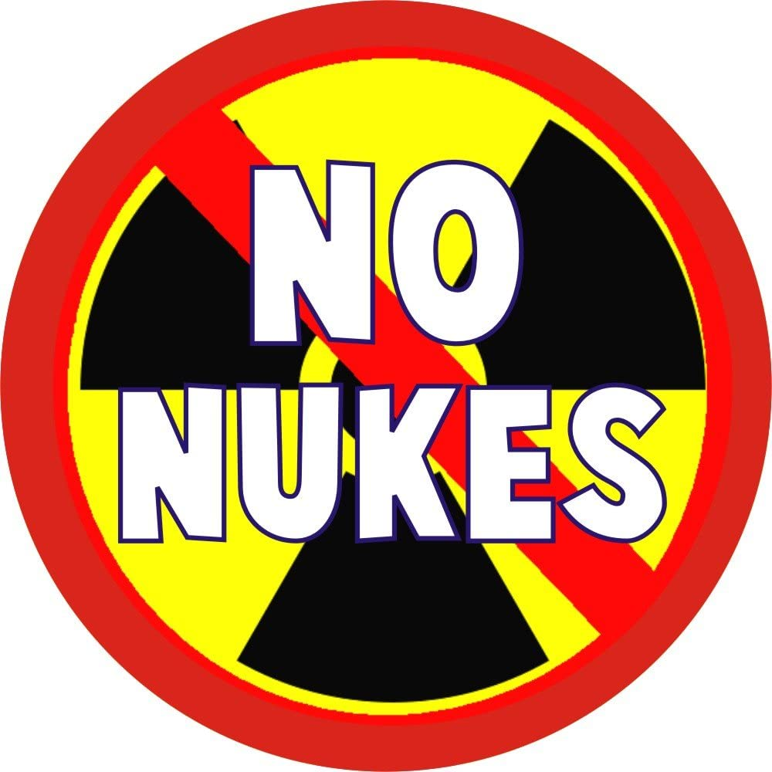
Veterans For Peace
Nuclear Abolition Working Group
Notes:
Welcome
Thank you to ....
organizers
sponsors
indigenous whose land we are on
Program overview - who is speaking about what

Slide 54


Slide 55
THE STATE OF NUCLEAR WEAPONS IN THE WORLD TODAY

Slide 56


2. Reduce the probability of an accidental, unauthorized, or unintentional nuclear exchange by taking U.S. nuclear weapons off hair-trigger alert and storing warheads separately from delivery systems
Notes:
Launches nearly occurred during the Cuban Missile Crisis due to failure of communication in one case and possibly a rogue commander in another.
And the same sort of nuclear brinksmanship that was seen in the Cuban Missile Crisis is with us still.
Note to Helen: (There are other cases of near-launches of nuclear missiles)

Slide 57


Where US Nuclear Bombs Are Stored in Europe, US Nuclear Posture vis-a-vis Russia

Slide 58
US Nuclear Posture vis-a-vis China
The VFP Nuclear Posture Review proposes an immediate halt to US military exercises in the South China Sea.
It recommends rescinding the nuclear submarine sales
to Australia and other AUKUS military threats to China.

Slide 59

US Nuclear Posture vis-a-vis N Korea
The VFP Nuclear Posture Review proposes the following confidence-building measures be taken first by the Biden administration to revive the US-DPRK talks with the objectives of ending the costly, “forever” US war against the DPRK and achieving nuclear disarmament on the Korean Peninsula in a step-by-step process:

Slide 60

US Nuclear Posture vis-a-vis
India, Pakistan
The VFP Nuclear Posture Review proposes that the US not engage in alliances such as the “Quad” (Australia, India, Japan and the United States), as they are likely to be perceived as a threat by Pakistan and increase the possibility of a nuclear exchange.

Slide 61
WEAPONIZING SPACE
The VFP Nuclear Posture Review Proposes negotiating an international treaty to plug the gaps of the Outer Space Treaty,
such as the Proposed Prevention of an Arms Race in
Space (PAROS) Treaty.
This would require the Prohibition of both weapons in outer space and anti-satellite weapons on Earth.

Slide 62
The VFP Nuclear Abolition Working Group does hereby commit to work with others both within and beyond Veterans For Peace to use our veteran’s voice and influence the United States Government to 1. Adopt and announce a policy of “No First Use” of nuclear weapons and make that policy credible by publicly decommissioning U.S. ICBMs that can only be used in a first strike;
2. Reduce the probability of an accidental, unauthorized, or unintentional nuclear exchange by taking U.S. nuclear weapons off hair-trigger alert and storing warheads separately from delivery systems;
3. Cancel plans to replace the entire US arsenal with enhanced weapons at a cost of more than $1 trillion over the next 30 years;
4. Redirect the money thus saved into environmentally and socially sound programs, including the accelerated cleanup of highly toxic and radioactive waste left during eight decades of the nuclear cycle;
5. End the sole, unchecked authority of any president (or his or her delegates and their delegates) to launch a nuclear attack and require Congressional approval of any use of nuclear weapons;
6. Comply with our obligations under the 1968 Treaty on the Non-Proliferation of Nuclear Weapons (NPT) by actively pursuing a verifiable agreement among nuclear-armed states to eliminate their nuclear arsenals;
7. Sign and ratify the United Nations Treaty on the Prohibition of Nuclear Weapons;
8. Phase out nuclear energy, stop producing depleted uranium weapons, and stop uranium mining, processing and enrichment;
9. Clean up radioactive sites from the nuclear cycle and develop an environmentally and socially sound nuclear waste disposal program; and
10. Fund health care and compensation for victims of radiation.

Slide 63


1. Adopt and announce a policy of “No First Use” of nuclear weapons and make that policy credible by publicly decommissioning U.S. ICBMs that can only be used in a first strike
Link for No First Use Global: https://nofirstuse.global/
Notes:
'No-first-use' (NFU) is a policy that can be adopted by a nuclear armed (or allied) state to never initiate a nuclear exchange by being the first to use nuclear weapons. China and India have declared such policies. The Soviet Union/Russia had such a policy from 1982 to 1993.”
Why no-first-use?
The use of nuclear weapons – whether by accident, miscalculation, crisis escalation or intent – would cause catastrophic medical, humanitarian, environmental, economic and political consequences. Adoption of no-first-use policies, and ending the current military preparations for such use, would considerably lower the risks of a nuclear catastrophe occurring.
Veterans for Peace has joined the organization, NoFirstUse Global, as a participating organization. https://nofirstuse.global/ (copy to chat)

Slide 64
2. Reduce the probability of an accidental, unauthorized, or unintentional nuclear exchange by taking U.S. nuclear weapons off hair-trigger alert and storing warheads separately from delivery systems
Notes:
Launches nearly occurred during the Cuban Missile Crisis due to failure of communication in one case and possibly a rogue commander in another.
And the same sort of nuclear brinksmanship that was seen in the Cuban Missile Crisis is with us still.
Note to Helen: (There are other cases of near-launches of nuclear missiles)

Slide 65

3. Cancel plans to replace the entire US arsenal with enhanced weapons at a cost of more than $1.7 trillion over the next 30 years
Notes:
The military and weapons industries have made a lot of headway on the “nuclear modernization” program.
Elements of the program include new warheads, delivery systems, command/control systems, all costing nearly $2 Trillion.
Consequences of “nuclear modernizatin” include the more headway, the harder to reverse. In this way, the US is now stoking a new nuclear arms race.
What else could that $1.7 Trillion be used for? (see the next page)
(Helen will research and finish what progress has been made)

Slide 66

4. Redirect the money thus saved into environmentally and socially sound programs, including the accelerated cleanup of highly toxic and radioactive waste left during eight decades of the nuclear cycle
Notes:
What could $1.7 Trillion buy? This rocket represents some of the things we could use this money for. (Read some of the items on the rocket and point to it with your cursor.)
Another use of the money is to clean up 15,000 abandoned uranium mines and other radioactive sites.
(Additional ideas to talk about)
Congress: Eleanor Holmes Norton bill (Helen insert title of the bill )
Activists & link to Prop1.org,
protests at banks, weapons manufacturers
Buy stock in banks and weapons manufacturers and pension funds
Organization for move the money campaign
(Helen - this slide needs a little more work)

Slide 67


5. End the sole, unchecked authority of any president (or his or her delegates and their delegates) to launch a nuclear attack and require Congressional approval of any use of nuclear weapons
Notes:
(Here are some ideas for discussion):
Putting the proposal before Congress gives time for cooler heads to prevail.
In the constitution, it’s CONGRESS who must declare war. This must be made true for nuclear war as well! The founders of the United States did not want this power in the hands of a single individual because they had watched the reckless behavior of the European monarchs.
We have had Presidents who were incapacitated and were not in charge and we might not know who was in charge of the nuclear launch authority. (Woodrow Wilson, possibly Ronald Reagan or Donald Trump) There are Jack D. Ripper kinds of characters, as in Dr. Strangelove, out there!
Dan Ellsberg talks about the various levels to which this authority can be delegated. Although most of that structure remains a secret, Ellsberg met an Admiral who had such authority and who in turn delegated it to others. There are, therefore, other people who could give the command to launch nuclear weapons.

Slide 68

6. Comply with our obligations under the
1968 Treaty on the Non-Proliferation of Nuclear Weapons (NPT) by actively pursuing a verifiable agreement among nuclear-armed states to eliminate their nuclear arsenals
Obligations:
Don’t transfer/receive nukes or control of nukes
Accept IAEA safeguards / verification
Promote nuclear energy
Negotiate to cease the nuclear arms race
Negotiate for nuclear disarmament
Participation in the NPT
Recognized nuclear-weapon state ratifiers
Recognized nuclear weapon state acceders
Other ratifiers
Other acceders or succeeders
Acceder which announced its withdrawal (North Korea, 2003)
Unrecognized state, abiding by treaty
Non-signatories (India, Israel, Pakistan, and South Sudan)
Partially recognized state which ratified (Republic of China - Taiwan)
Notes:
The Republic of the Marshall Islands sued the 9 nuclear-armed nations to try to get them to comply with the NPT.

Slide 69


7. Sign and ratify the
United Nations Treaty on the Prohibition of Nuclear Weapons
Notes:
Publicizing the United Nations Treaty on the Prohibition of Nuclear Weapons is a great way to let people know that nuclear weapons are now illegal under international law.
(Helen finish) Talk about the TPNW - it’s a big topic,very important!
It’s the last weapon of mass destruction to be outlawed.
Every city, county and state can be asked to urge the US government to ratify the TPNW. Most of these resolutions also mention the rest of the Back from the Brink measures. And where the Golden Rule goes, they can welcome the Golden Rule in the resolution.
Although the nuclear-armed nations have not signed on, it shows the will of the global community and is an international effort that succeeded.
This raises the pressure on the nuclear-armed nations to take action to eliminate nuclear weapons.
ICAN, International Campaign to Abolish Nuclear Weapons,is an organization you can contact to learn more. The link is ICANW.org
(Helen - go through the slides and add other organizations and links to them)

Slide 70


8. Phase out nuclear energy, stop producing depleted uranium weapons, and stop uranium mining, processing and enrichment
At every step of the nuclear chain there is contamination and there are risks of accidents.
Fire at Fukushima following the 3/11/11 triple disaster and nuclear meltdown
Notes:
Many in the military are and were exposed to depleted uranium, as were civilians. Sardegna and Fallujah are particular examples of use of depleted uranium that has produced many cancers and birth defects. The health effects that occur in both those exposed and their children are devastating.
Risk of Meltdown, Explosions: There have been at least 28 nuclear plant incidents and accidents, and 6 meltdowns, including Santa Susana Field Lab in 1959, Chernobyl in 1986 and Fukushima in 2011.
Two sides of the same coin: Nuclear power and weapons share important processes - uranium mining, milling, and enrichment. The 15,000 abandoned uranium mines in the US are causing cancer and birth defects in mostly indigenous areas. Radiation and chemicals used for manufacturing is harming health of nearby residents.
Used to produce plutonium: Plutonium doesn’t exist in nature - it is extracted from “spent” nuclear fuel rods. Until the 1970s, “clean, unlimited, cheap” nuclear power was only an excuse for reactors to produce plutonium for bombs.
Used for “depleted” uranium weapons: When uranium is enriched, the depleted uranium (DU) left over is used to coat bullets, missiles and armored tanks. So much DU was used in Fallujah, Iraq, that from 2010-13 at least 14% of babies born had defects.
No place for waste: There’s no place for long-term storage of “spent” fuel rods and other high-level radioactive waste.
Not carbon-free: Tons of carbon is burned to build and decommission a nuclear power plant and for processing uranium into fuel.
Expensive: Nuclear power is more expensive than other power sources, especially when considering the cost of decommissioning and the cleanup after meltdowns (paid for by taxpayers).
Keep the old? Concrete in old power plants is cracking from being exposed to radiation for so long. Many are the same design as the Fukushima Daiichi plants. Dangers of meltdown are increased by bigger storms and sea level rise.
Build new ones? They will be less prone to meltdown, but the other problems remain. For the time and expense involved, we could advance wind, solar and battery technology and learn how to use less power.

Slide 71

9. Clean up radioactive sites from the nuclear cycle and develop an environmentally and socially sound nuclear waste disposal program
See Cleanupthemines.org for
more information about
15,000 abandoned uranium mine sites.
Notes:
This graphic only covers what the US government is responsible to remediate.
Nuclear waste is normally held onsite, and if done properly is the best option for now.
WIPP and the Texas and New Mexico facilities represent potential problems because our highways, railways and waterways are not set up to handle a radioactive accident.
Starting with uranium mining and milling, which has contaminated 15,000 sites in 15 western states, the entire nuclear chain uses fossil fuels and contaminates sites.

Slide 72

10. Fund health care and compensation for victims of radiation
Notes:
Victims include the “hibakusha” atomic bomb survivors in Japan, those exosed to testing in the Marshall Islands and Nevada, those downwind of tests, atomic veterans, atomic cleanup veterans, and those near mining, milling and manufacturing sites.
Not to mention Three Mile Island and Santa Suzanna field lab (where over 50 cases of childhood leukemia were caused by a meltdown)

Slide 73
Olympia Schedule
Wed 8/14 | 8 am - 4 pm | Transit from Tacoma to Olympia (8 hours) | Dock at Percieval Landing (First Come First Served)
Thu 8/15 | 10:00 am - noon | Welcome Ceremony, Press Conference (tentative) | Dock at Percieval Landing
 | noon - 4 pm | Olympia - day sails, boat tours
 | 5:30 PM | Fellowship of Reconcilliation Picnic | Percieval Landing
 | 6:30 PM | (Simultaneous with FOR) Quaker meeting
Fri 8/16 | noon - 4 pm | Olympia - day sails, boat tours | Dock at Percieval Landing
 | 4 pm - 6 pm | Vigil with Peace Groups
 | 7 pm to 9 pm | Potluck, presentation | Traditions Cafe
Sat 8/17 |  | Transit to Bainbridge Island (11 hours, tentative, may not stop there)

