Slide 1
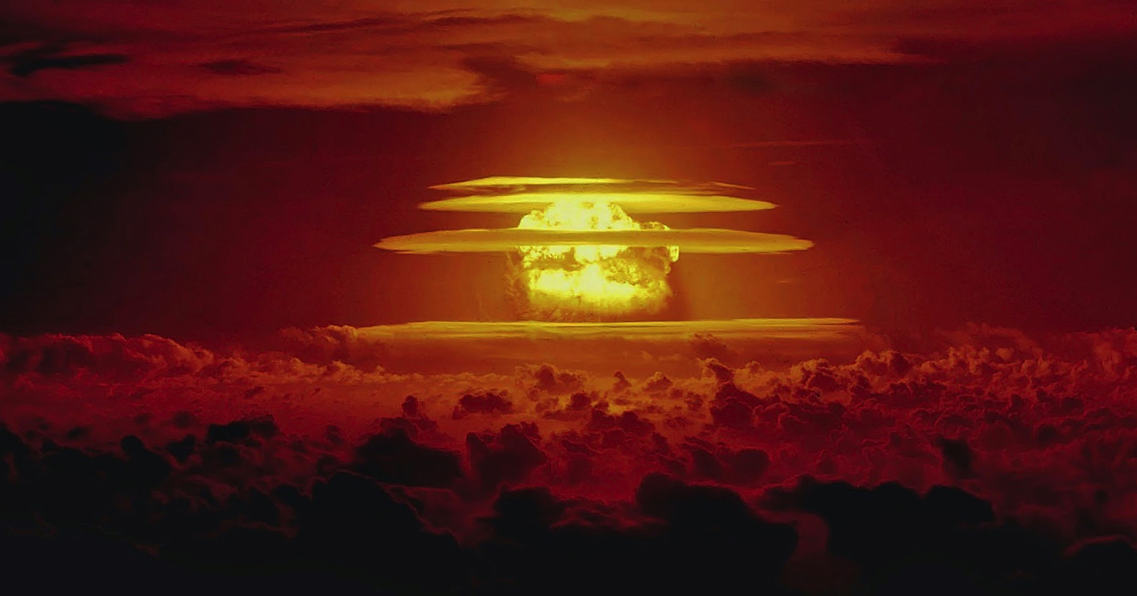
Remembering Nuclear Victims
Commemorating 70th Anniversary of the US Largest Nuclear Blast
Castle Bravo Nuclear Test - March 1, 1954
15 megatons - 1000 times more powerful than the bomb dropped on Hiroshima.
Notes:
March 1st marks seventy years since the US used its biggest ever nuclear weapon - on Bikini Atoll in the Marshall Islands. The bomb was 15 megatons, a thousand times more powerful than the bomb dropped on Hiroshima. On this day we remember the victims of the Castle Bravo nuclear blast and all other victims of the nuclear era, which has brought untold pain, death and damage, affecting both people and planet in profound ways.

Slide 2
Nuclear Victims
Indigenous people near uranium deposits - 15,000 abandoned uranium mines
Church Rock uranium tailings spill into Rio Puerco
Trinity test, exposing indigenous and poor people near Alamagordo, NM and throughout North America
People in Hiroshima and Nagasaki
Nuclear testing - Nevada, the Marshall Islands, and several other places in the world. Exposed people were used for human radiation experiments in the Marshall Islands
Atomic Veterans and Atomic Cleanup Veterans
People living near nuclear meltdowns - Santa Susanna Field Lab, Three Mile Island, Chernobyl, Fukushima and others

Slide 3
Veterans For Peace delegation visited with the Permanent UN Representative from the Republic of the Marshall Islands. Ambassador Amatlain Elizabeth Kabua gave a very warm welcome in her cozy UN office and spoke with the group for over two hours.

Slide 4
The Marshall Islands and the United States today
When the Golden Rule was in New York City we met the Permanent UN Representative from the Republic of the Marshall Islands, Ambassador Amatlain Elizabeth Kabua. She explained that there were several issues that could be improved:
Although the Marshallese have increased radiation-caused cancer, there is no chemotherapy facility anywhere in the Marshall Islands.
Although Marshall Islanders, like the indigenous people in the United States, volunteer at a proportionately high rate for the US military, there is no VA clinic in the Marshall Islands.
For the last three decades, Marshall Islanders have sought compensation from the U.S. for the health and environmental effects of nuclear testing. They’ve been denied standing to sue in U.S. courts, and Congress has declined their requests. The Compact of Free Association (COFA) which governs the relationship between the US, Palau, Micronesia and the Republic of the Marshall Islands was renegotiated in 2023. However, Congress has yet to fund the $7 billion dollars that was approved.

Slide 5
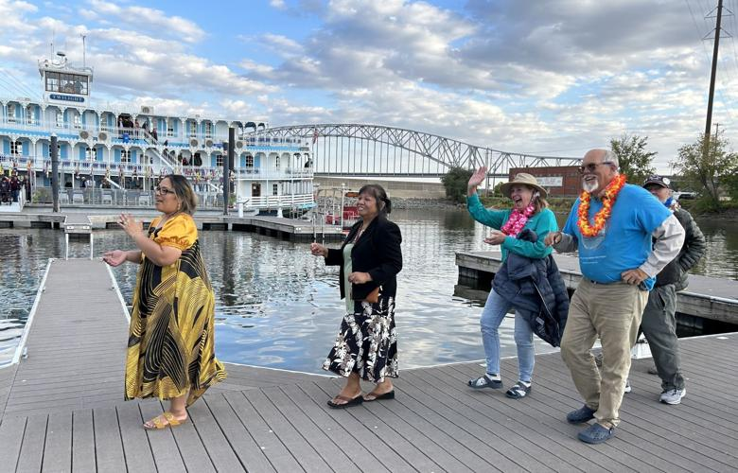
Marshall Islanders in the United States

Slide 6
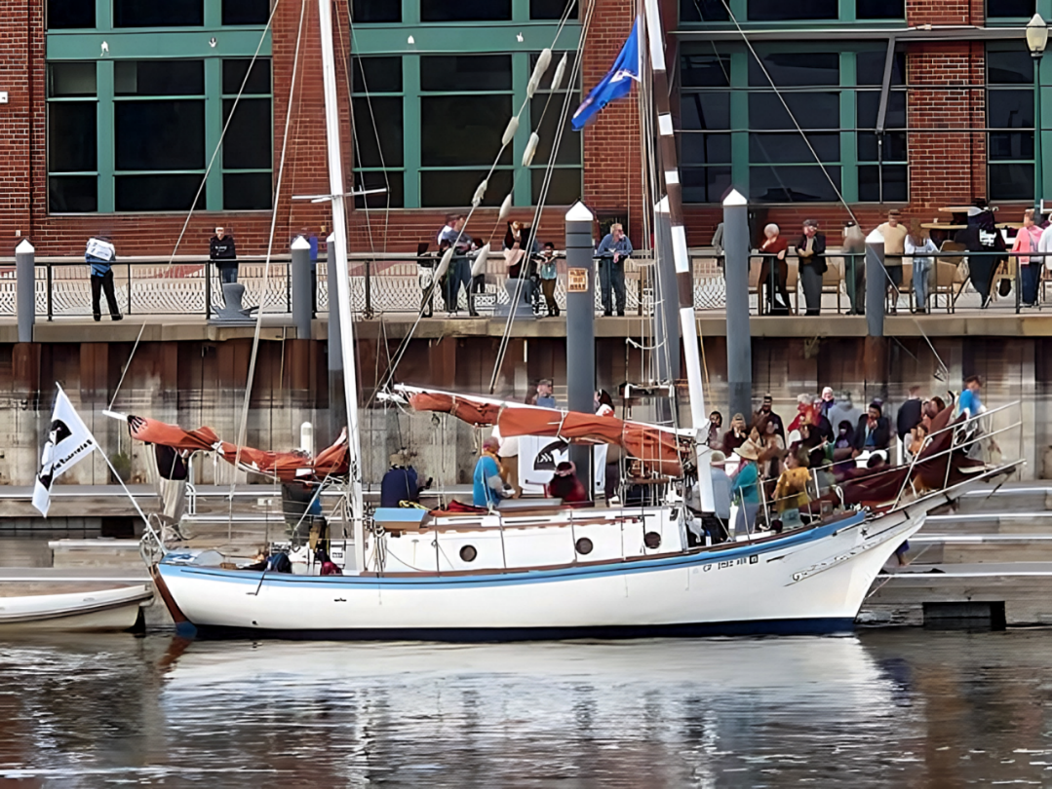

Slide 7
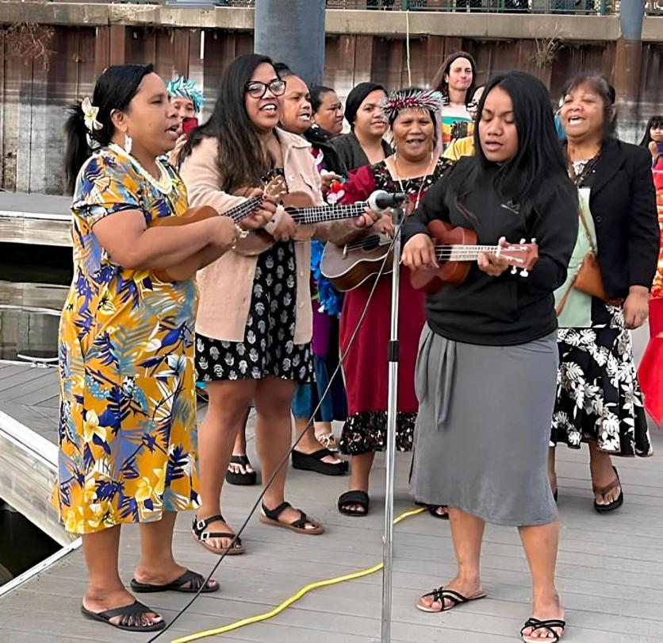

Slide 8
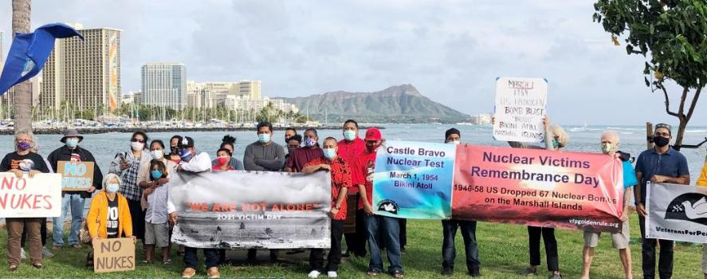
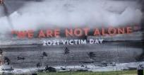
Solidarity with Marshall Islanders

Slide 9
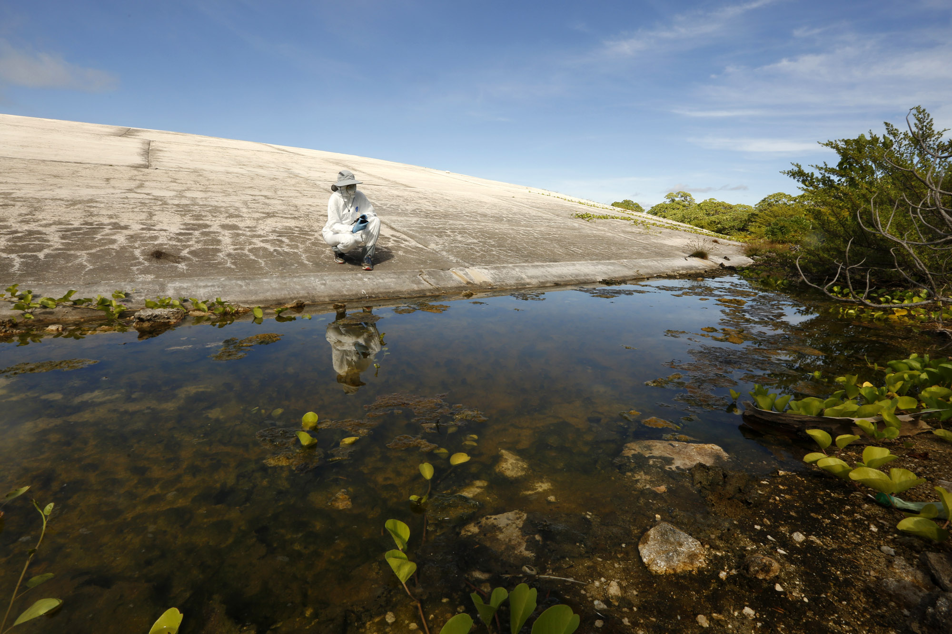
Runit dome - cracking and releasing radiation from nuclear tests in the Marshall Islands and Nevada - a further victimization of the Marshallese as sea levels rise to consume their islands.

Slide 10
There’s no better way to remember Castle Bravo and other Nuclear Victims than by taking action on behalf of the victims of radiation and pushing for the abolition of nuclear weapons.

Slide 11
Take Action!
On March 1, let’s remember all of the Victims of Radiation - from Hiroshima and Nagasaki; nuclear testing areas; and uranium mining, milling, processing and disposal sites.
Let your Senator and Representative know that you support fully funding the Compact of Free Association (COFA).
Tell them that you support the Radiation Compensation and Exposure Act, including its expansion to include those people exposed from the Trinity test in New Mexico in 1945.
The Nuclear Ban Treaty Collective has resources to help with your actions, including banners. nuclearban.us
Ask your Congressional Representatives to support federal legislation to:
Embrace the Goals and Provisions of the TPNW, H. Res. 77
Maintain Congress’ constitutional authority to declare war or a nuclear strike, H.R. 669
Redirect military spending to meet human needs, H.R. 1134
Redirect nuclear weapons spending to clean energy and human needs, H.R. 2775
Enroll your City or State in the ICAN Cities Campaign. https://cities.icanw.org/ and Mayors For Peace.

