Slide 1
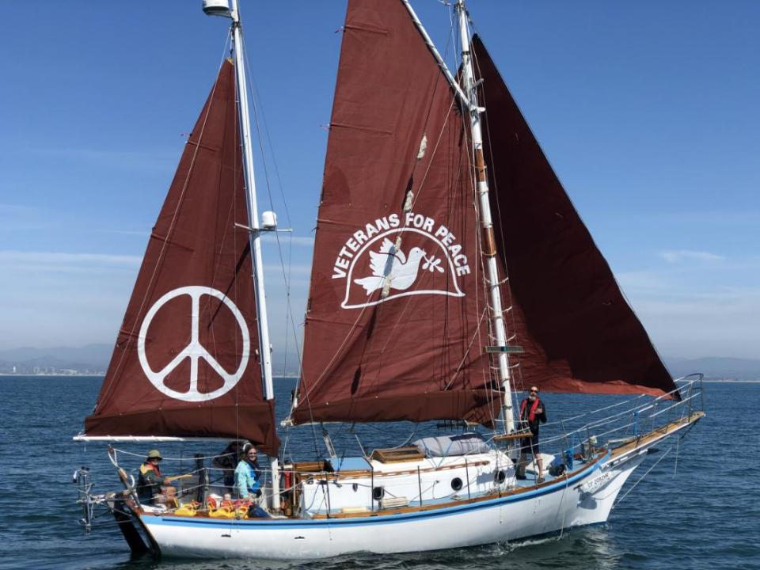
The Golden Rule: Do Unto Others as you would have others do unto you
Golden Rule Sails Again for a Nuclear Free Future!
Veterans For Peace
Golden Rule Project
www.vfpgoldenruleproject.org
vfpgoldenruleproject@gmail.com
(206) 992-6364
VFP Golden Rule Project
P.O. Box 87 Samoa, CA 95564

Slide 2
Golden Rule Project implements Veterans For Peace Statement of Purpose
To restrain our governments from intervening, overtly and covertly, in the internal affairs of other nations
To end the arms race and to reduce and eventually eliminate nuclear weapons

Slide 3
2016 Voyage 2015, 17-19,22

Slide 4
2019-21: 22 months in the Hawaiian Islands

Slide 5
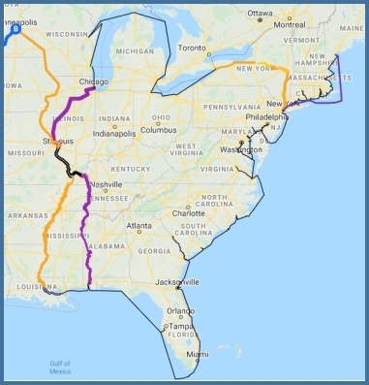
“The Great Loop” Minneapolis Aug‘22 - Chicago Sept ‘23
10,300 miles
102 Cities or Towns visited
350 presentations - reached 10,500 people directly
100,000s of people reached through press
VFP Chapters
22 Chapters donated a total of $23,652 in 2022-23.
39 Chapters anchored GR GL Events

Slide 6
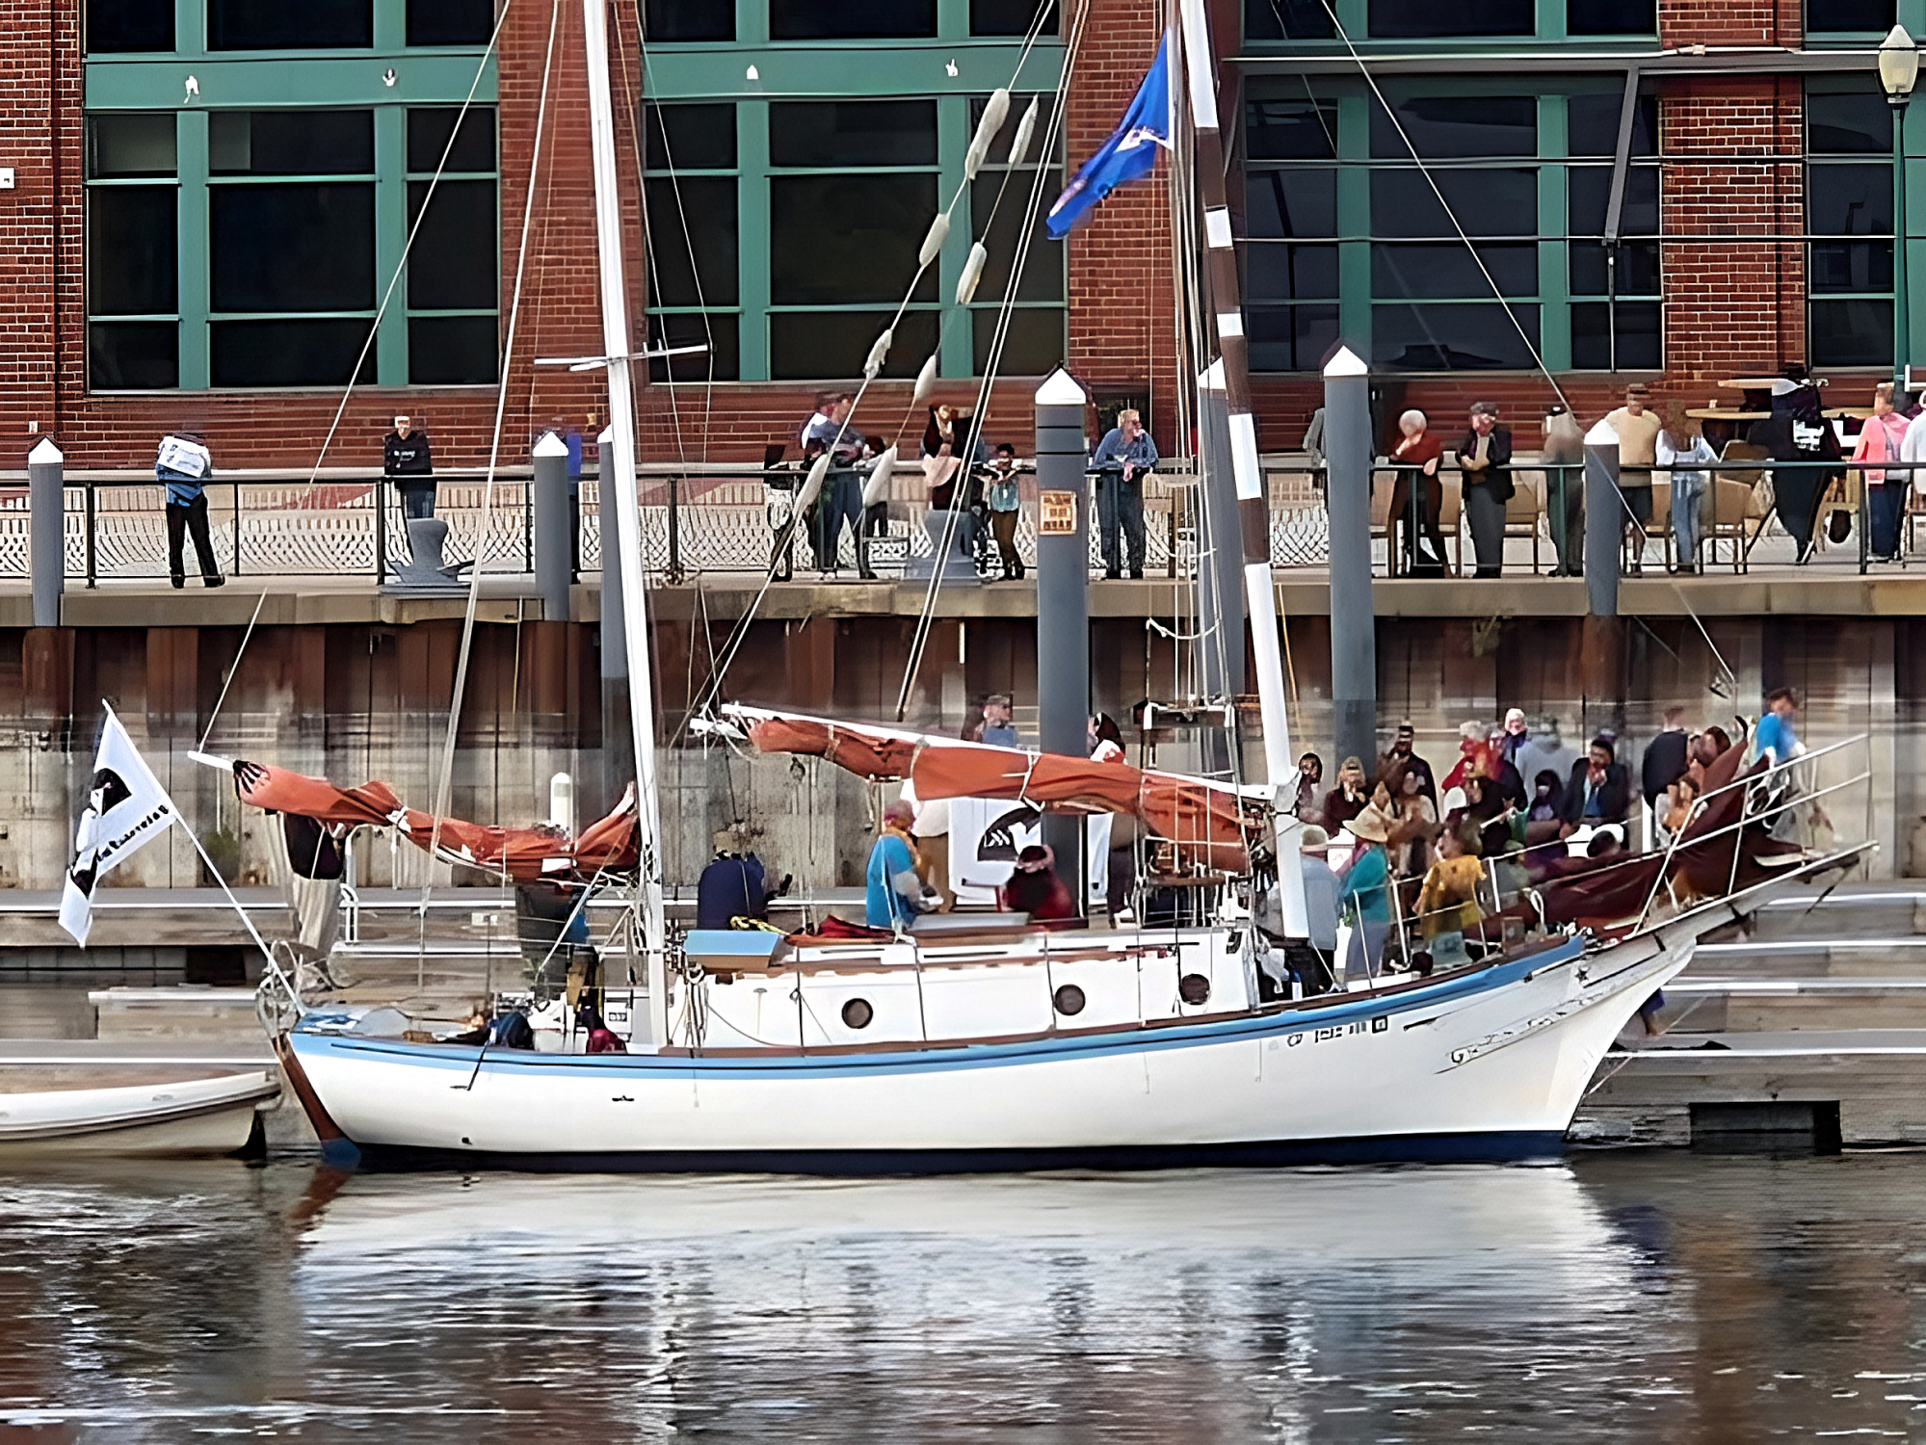

Slide 7
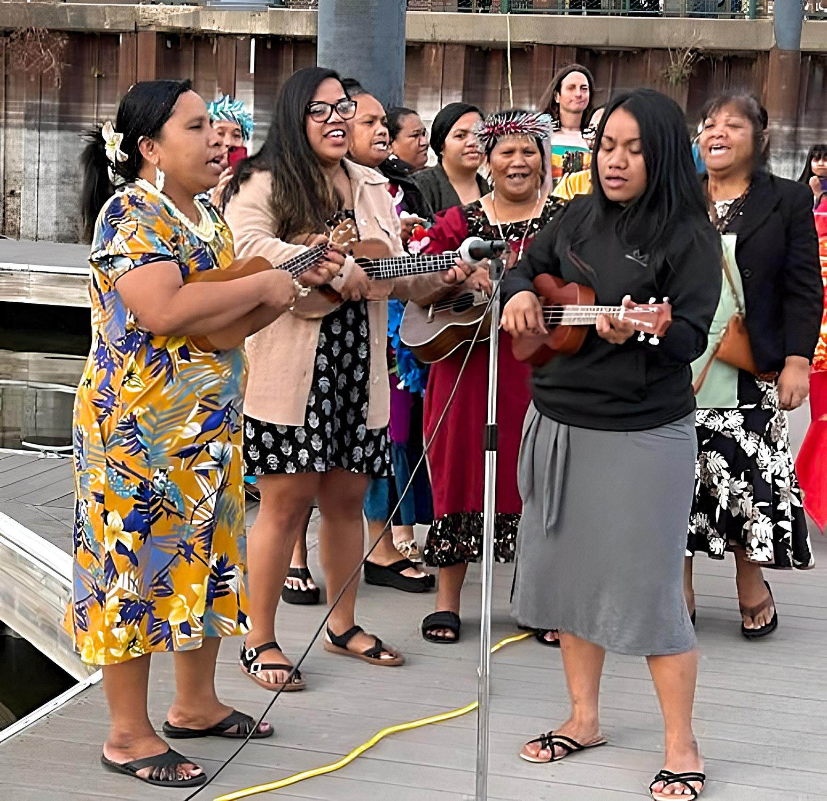

Slide 8
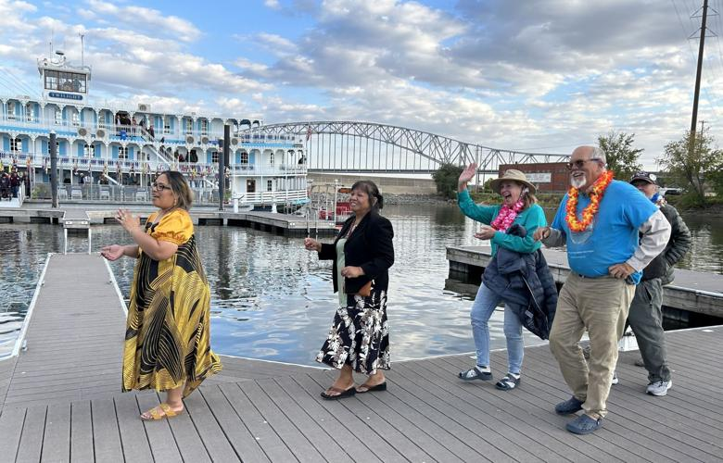

Slide 9
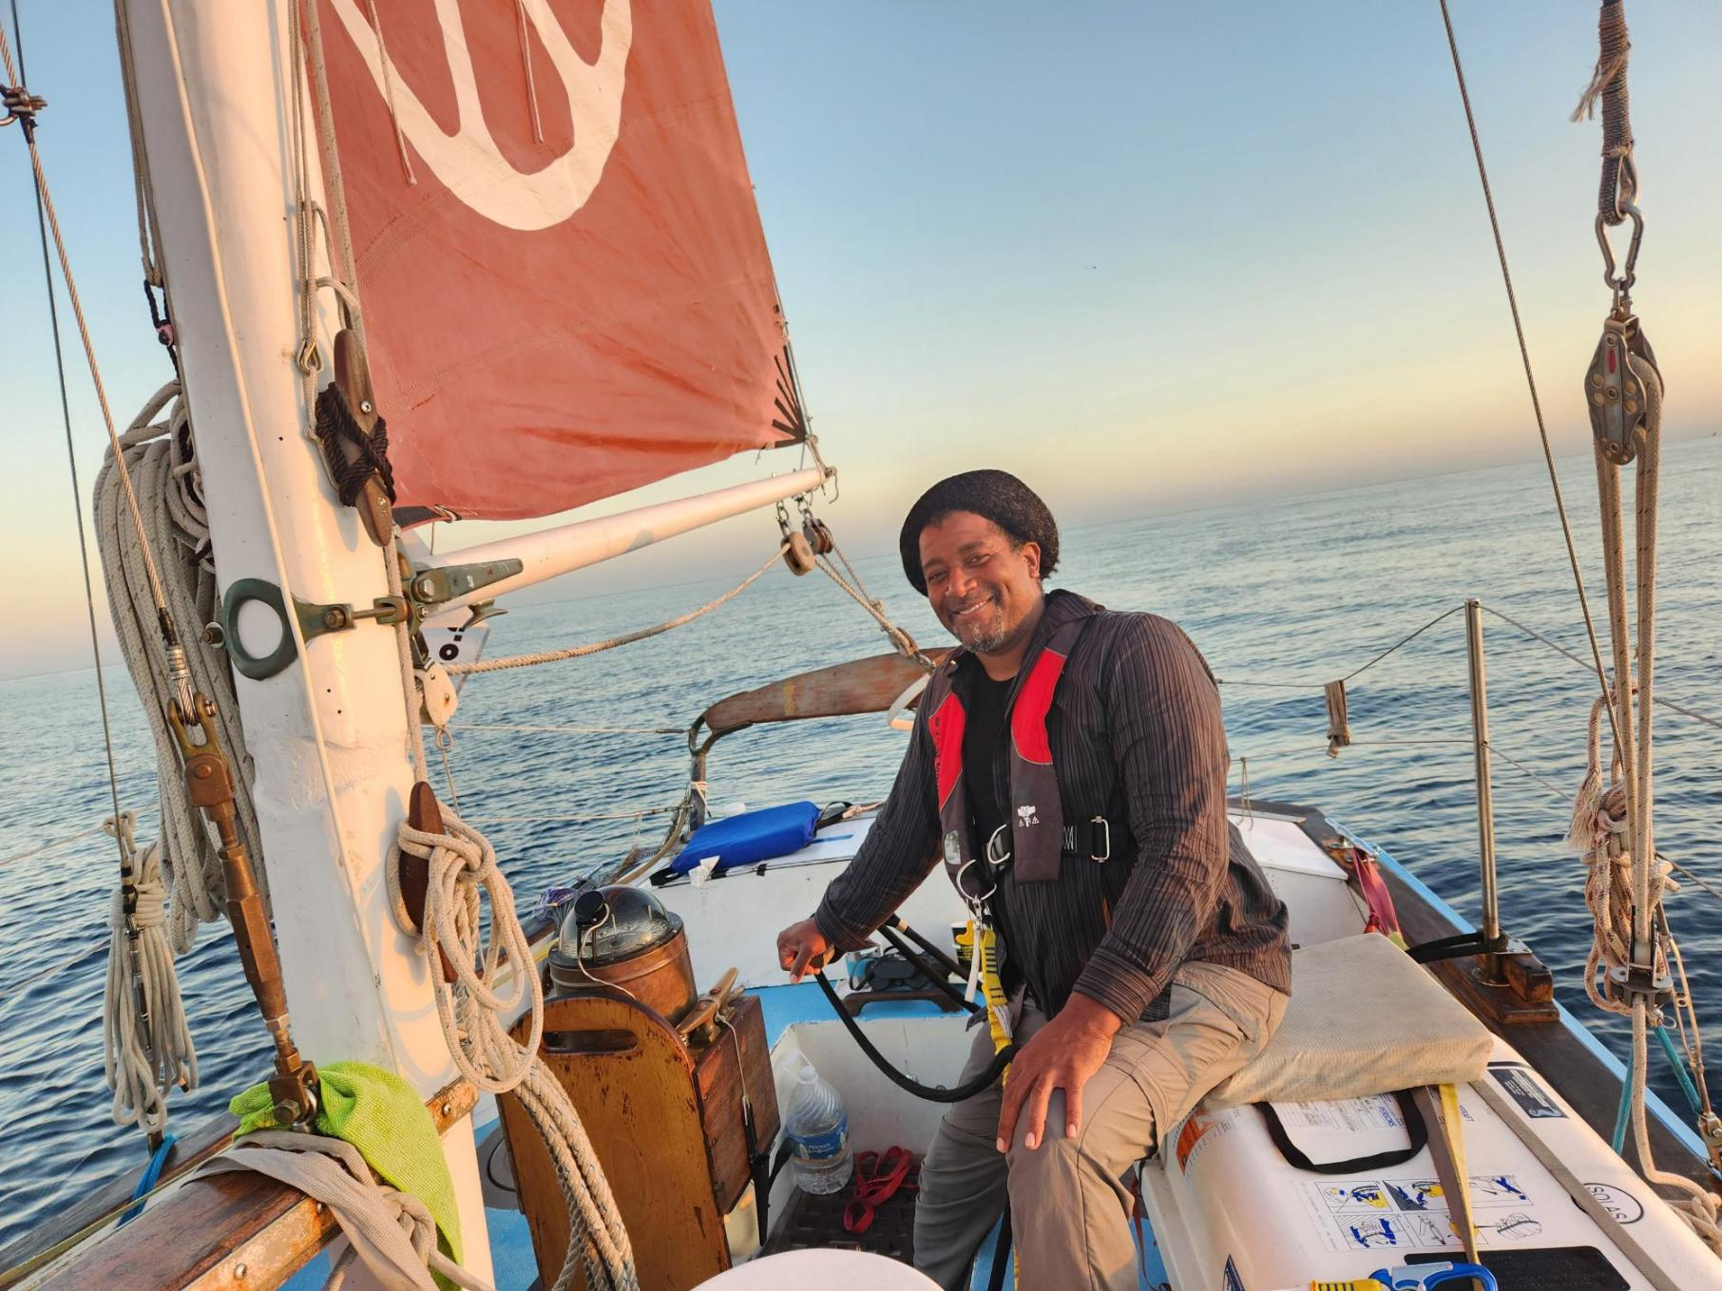
2023 Started with the voyage to Cuba!
Six Golden Rule representatives went by sea and five by air to Cuba for an “Arts & Cultural” visit Dec 31 - Jan 10
VFP Board Member Enya Anderson at the helm of the Golden Rule as it came into Hemingway Marina

Slide 10
The Entire Cuba Delegation (from land and sea!)

Slide 11
Golden Rule Reps joined Miami activists to call for the end of the Cuba Blockade

Slide 12
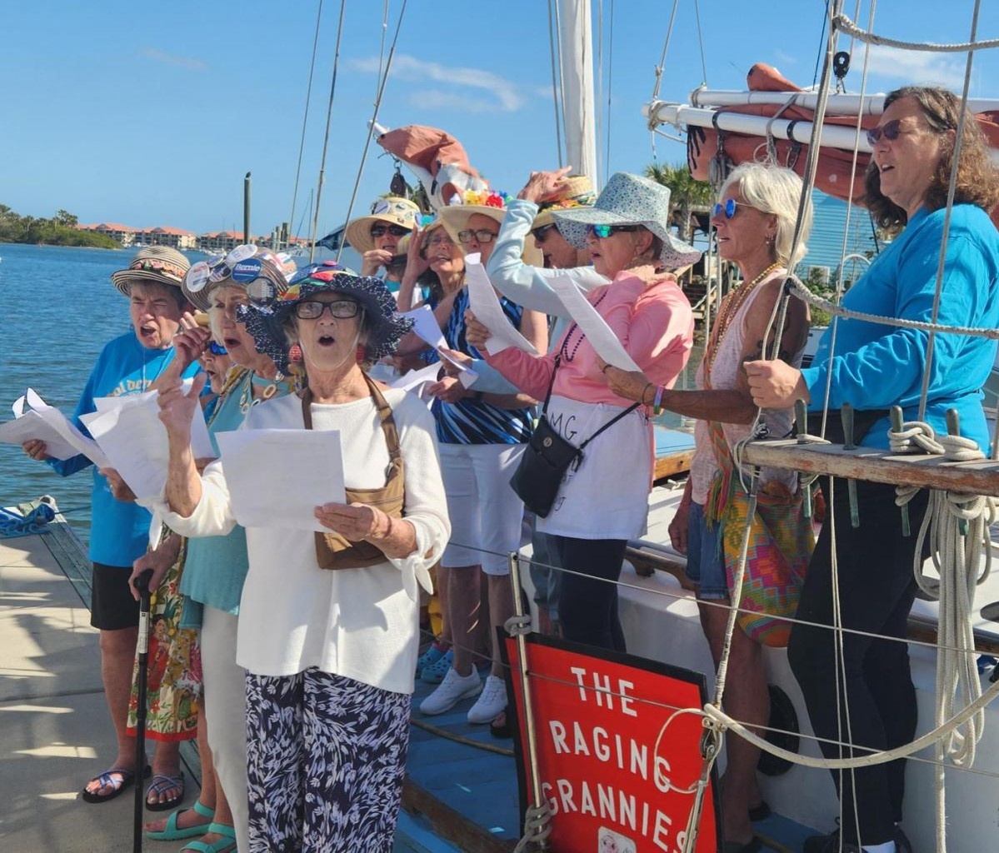
January - Miami, New Smyrna
The Raging Grannies sang and Citizens welcomed the Golden Rule
We interacted with many groups of faith:
Friends Meetings, Soka Gakkai Buddhists, Buddhist Mahayana sect from Vietnam Retreat Center,
Activists: Hands Off Cuba!, Raging Grannies, CodePink

Slide 13
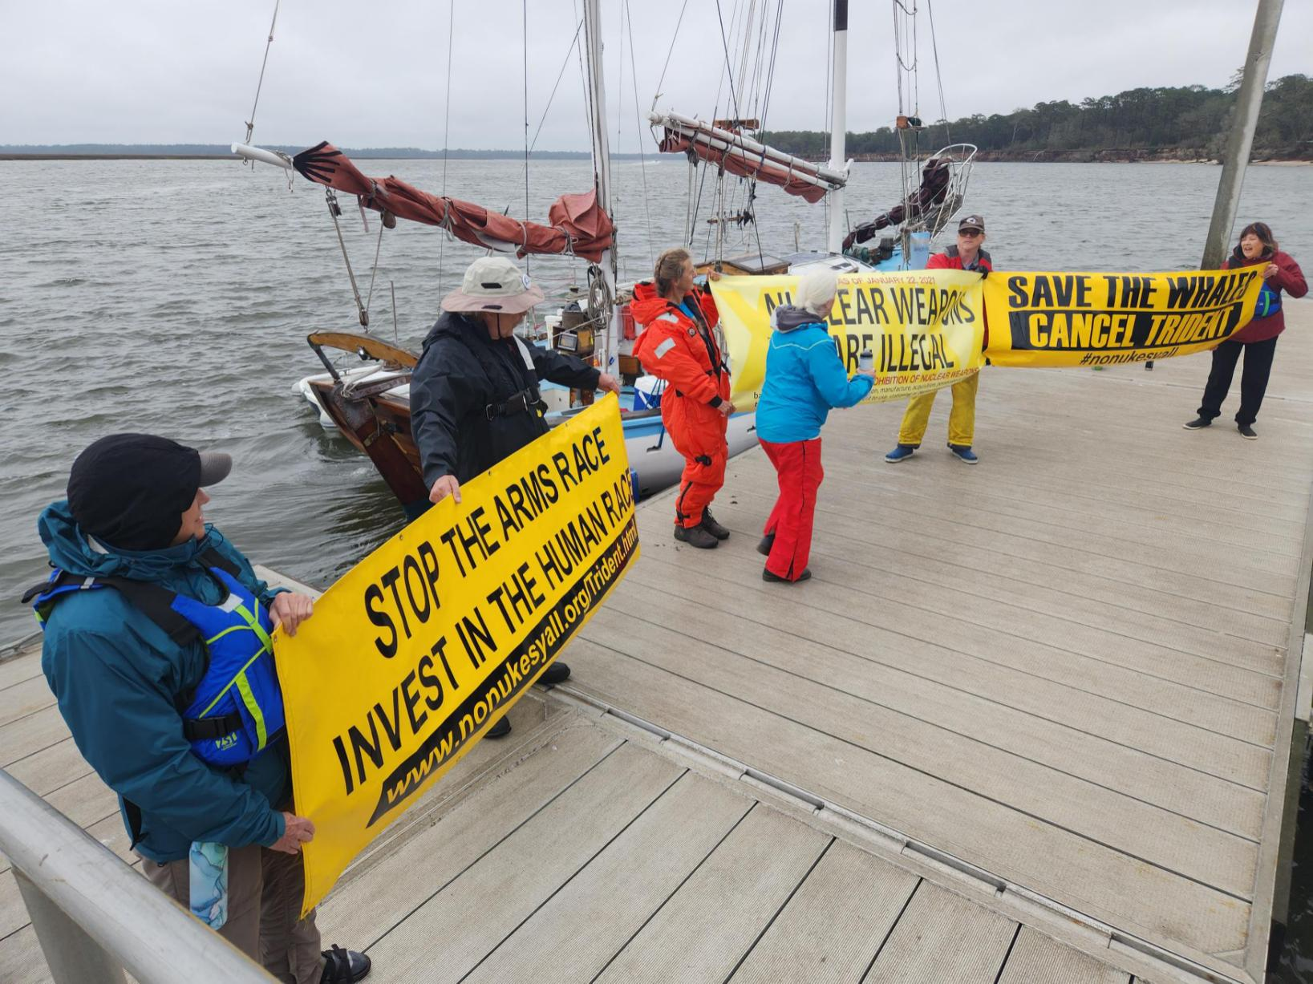
February: Jacksonville, FL, coast of Georgia
Nuclear Watch South, Sail-by and Protest at Kings Bay Nuclear-Armed Trident Submarine Base!

Slide 14
Black high school students visit the Golden Rule

Slide 15
Peace picnics in the park!

Slide 16
Commemorating March 1, 1954 Castle Bravo destruction in the Marshall Islands

Slide 17
Activist Joanne Sweeney entertained us with peace folk music

Slide 18
We fly the sails whenever possible!

Slide 19
Over 40 Mayors and City Councils gave the Golden Rule a warm Proclamation of Welcome!

Slide 20
Beautiful Unique flyers

Slide 21
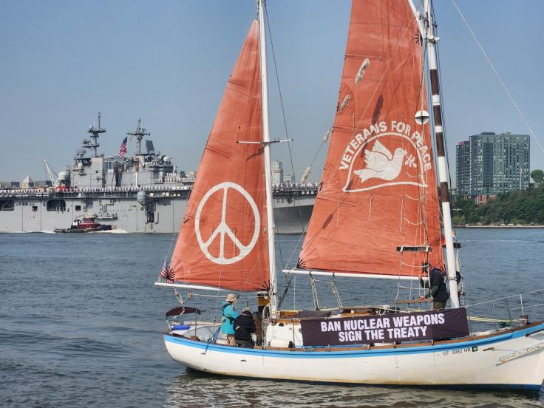
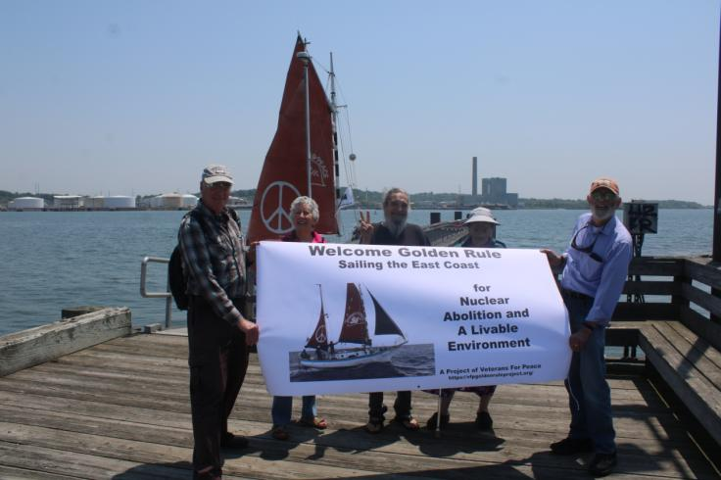
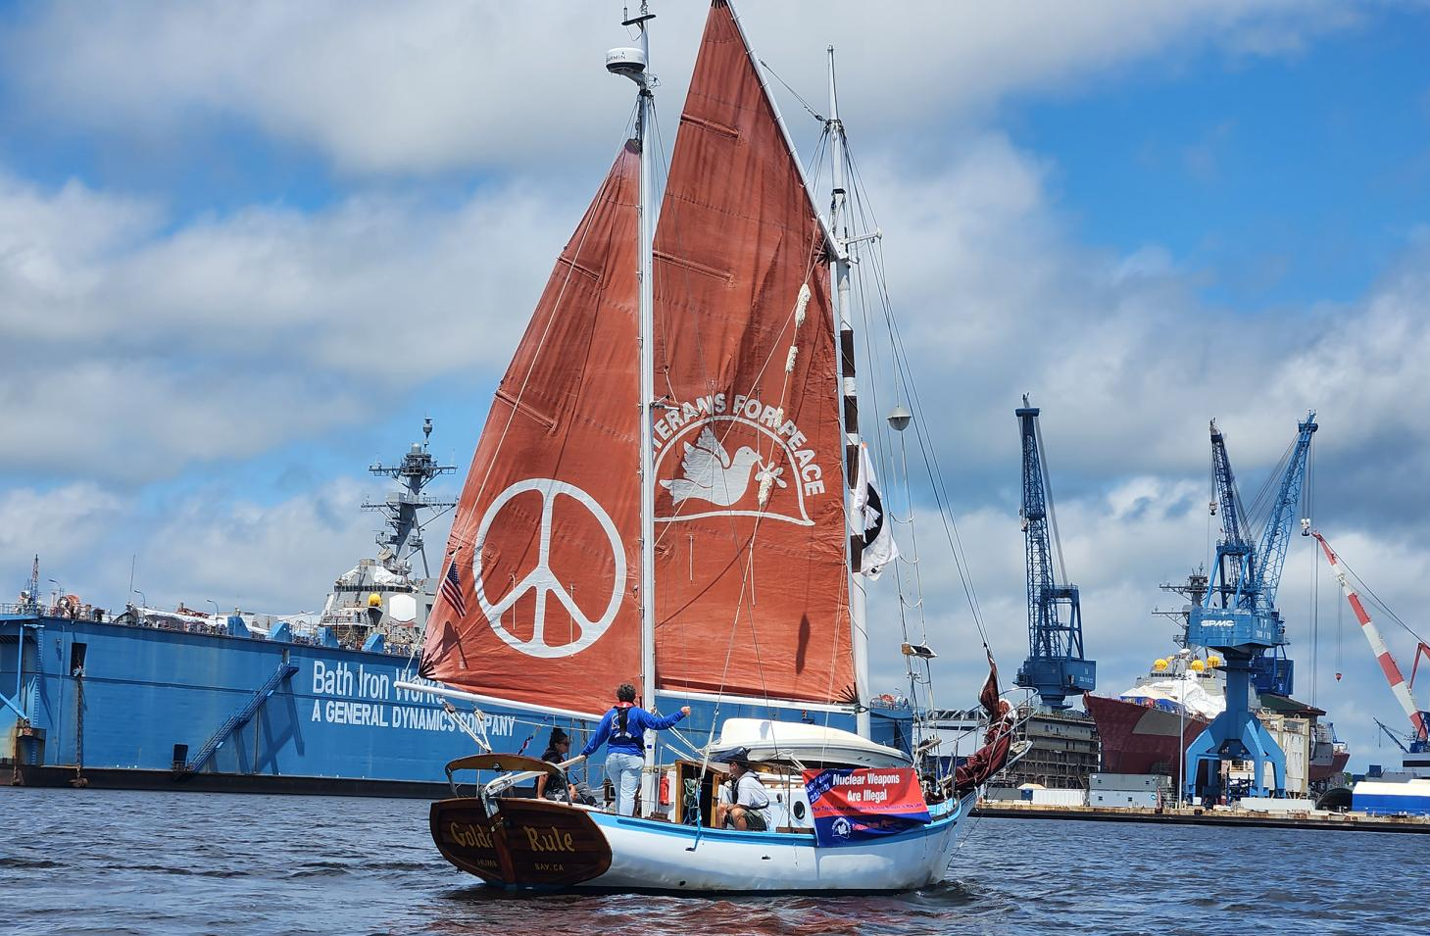
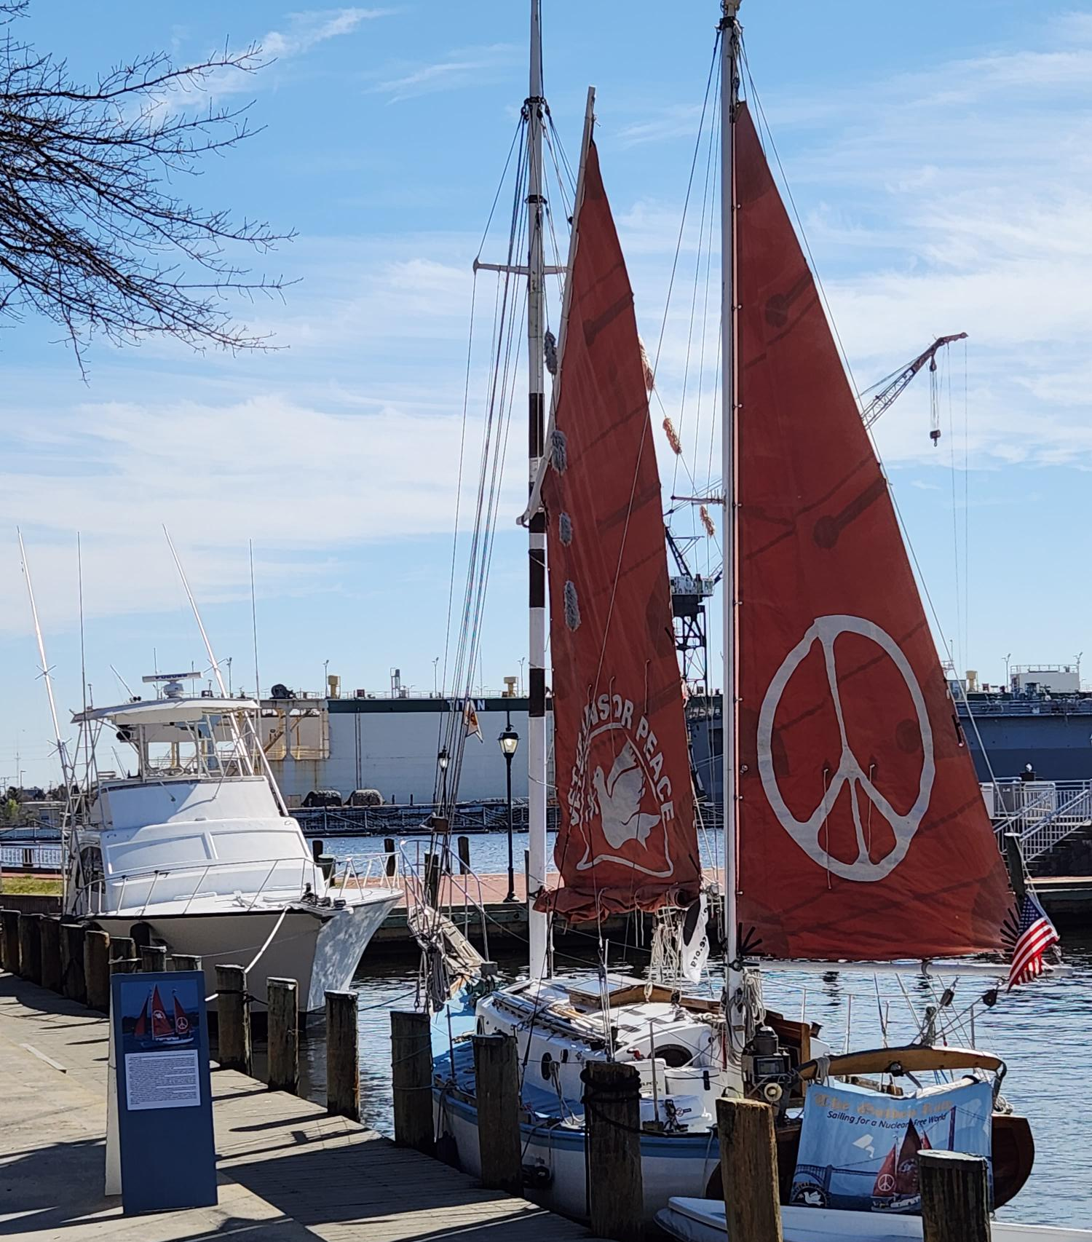
Fleet Week Parade of War Ships, Hudson River, NYC
New Haven, Connecticut welcomed the Golden Rule - several groups sailed by Groton Electric Boat, manufacturer of nuclear-armed submarines.
Norfolk, Virginia - home to all branches of the military The Golden Rule with a huge navy ship in the background
The ship of peace sails in protest of Bath Iron Works, makers of nuclear-capable war ships

Slide 22
Alexandria, VA and Washington, DC March 26 - April 16 On April 12 & 13 Golden Rule crew and representatives walked the halls of Congress! Every member of Congress and the Senate received a VFP Nuclear Posture Review!

Slide 23
Potomac River, Piscataway Creek, Chesapeake Bay - Military Poisons tour
Julie Tayak Yates talks about the poisoning of her ancestral lands by the US military
The Golden Rule sailed past the Calvert Cliffs NPP, just 3 miles from an LNG export facility

Slide 24
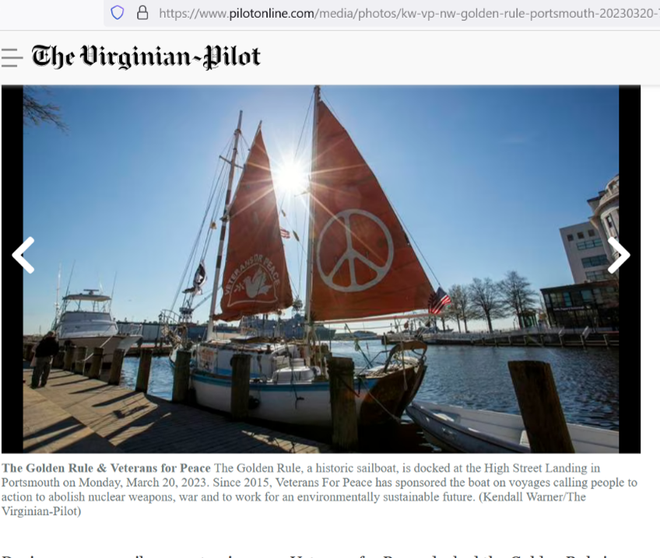
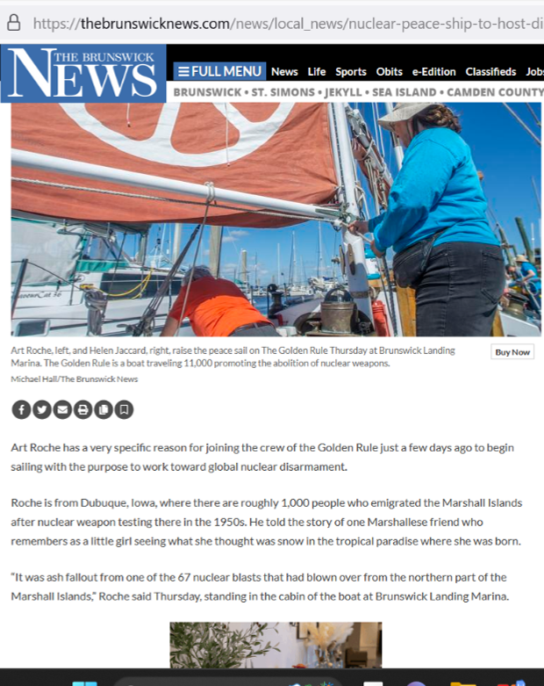
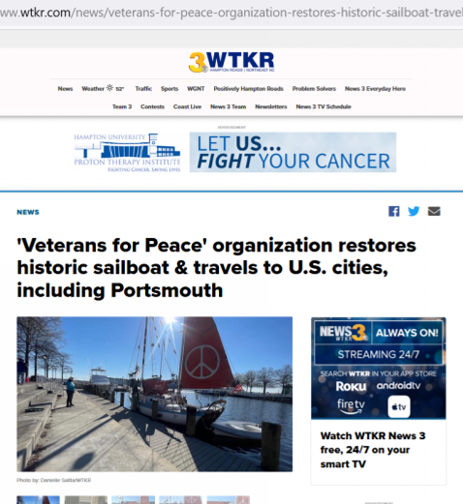
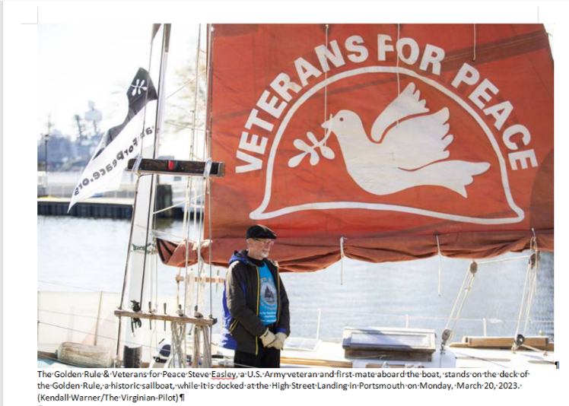
Media Coverage - EVERYWHERE!
Medium | Count
Paper | 40
TV | 22
eNews | 21
Radio | 7
Magazine | 4
Blog | 1
Podcast | 1
Radio, YouTube | 1
Total # Articles | 97
Baltimore Sun, Philadelphia Inquirer!

Slide 25
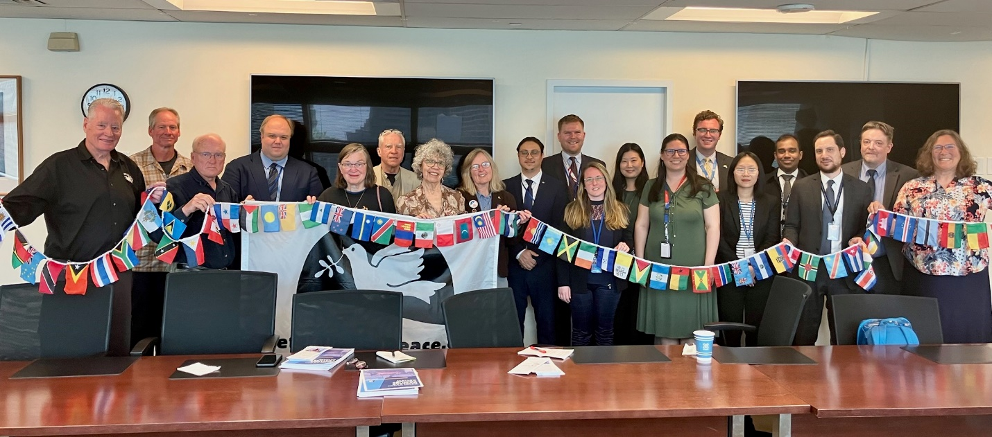
United Nations Missions!
Veterans For Peace and the Golden Rule team met with twelve UN missions, including New Zealand, Malaysia, Vietnam, Cuba, South Africa, Austria, Indonesia, Ireland, Costa Rica, Kiribati, and the Vatican
Veterans For Peace delegation visited with the Permanent UN Representative from the Republic of the Marshall Islands. Ambassador Amatlain Elizabeth Kabua gave a very warm welcome in her cozy UN office and spoke with the group for over two hours.

Slide 26
Rhode Island: Providence, Bristol
Golden Rule crew are greeted by members of the Pokanoket tribe.
(l-r) Golden Rule crew members Steve Baggerly, River Pember, Bristol Town Councilman Aaron Ley, crew member Bill Good and Councilman Tim Sweeney pose with a doctrine that states Bristol is in favor of a ban on nuclear weapons.
The Extraordinary Rendition Band played rousing music on the dock!

Slide 27
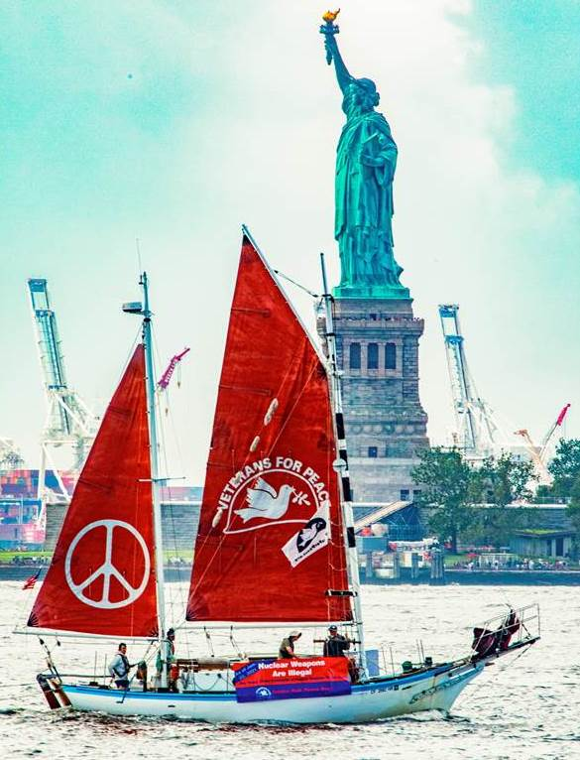

Slide 28
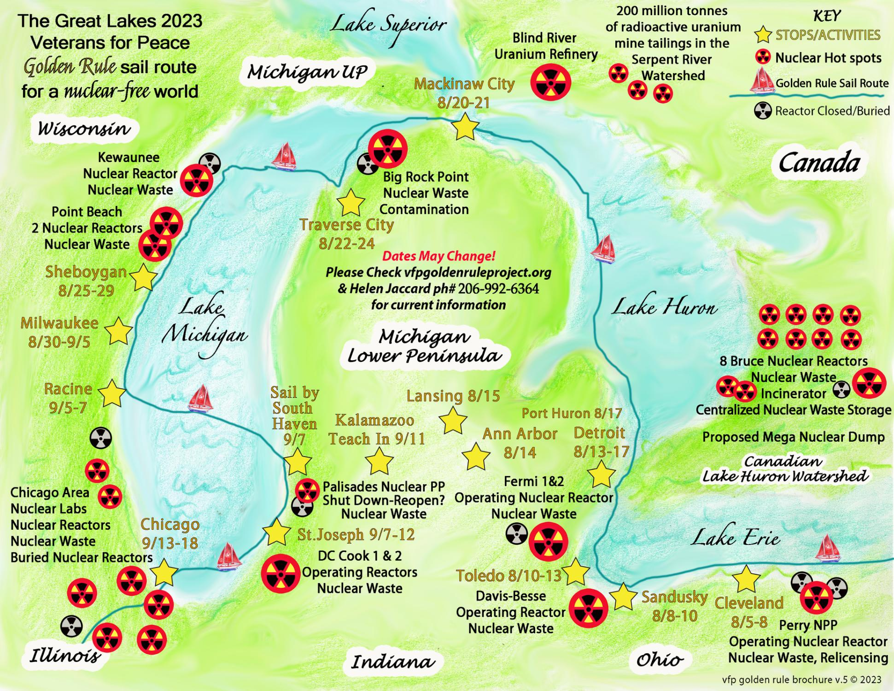

Slide 29
Great Looop Voyage Co-Sponsored by:
CodePink Women for Peace
Back from the Brink
World BEYOND War
RootsAction
Earth Quaker Action Team
Women’s International League for Peace & Freedom
NuclearBan.US
United for Peace & Justice
And supported by many local chapters of:
Physicians for Social Responsibility
Raging Grannies
Quakers
Unitarian Universalists
Catholic Workers

Slide 30
2024 Sailing Plan (Preliminary) to Pacific Northwest
Mon 7/15 Eureka, CA Departure Press Conference
Sat 7/27 – Sat 7/27 Bangor, WA Protest Nuclear Submarines
Mon 7/29 – Mon 8/29 Puget Sound 8/6-11 Fleet Week in Seattle
Fri 8/30 – Wed 9/04 Victoria, BC Victoria Classic Boat Festival
Fri 9/06 – Sun 9/08 Port Townsend, WA Port Townsend Wooden Boat Festival
Fri 9/13 – Wed 9/18 Vancouver, WA & Portland, OR 9/14 Vancouver Peace Fair
Mon 9/30 Eureka, CA Welcome Home Party, Press Conference

Slide 31
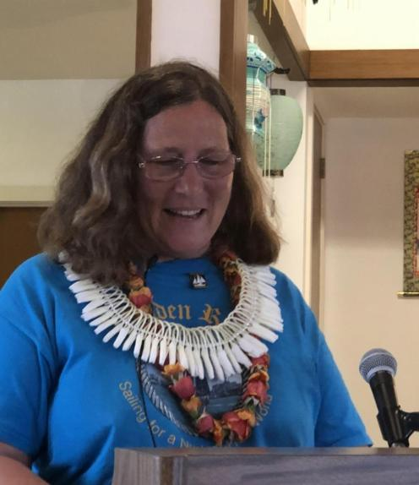
Program: 200 Presentations

Slide 32
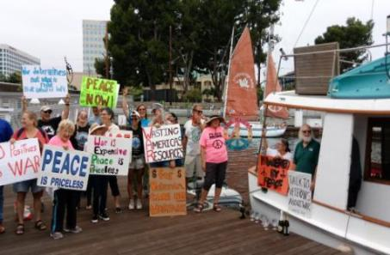
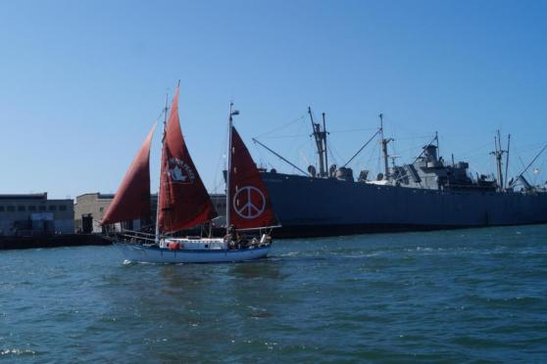
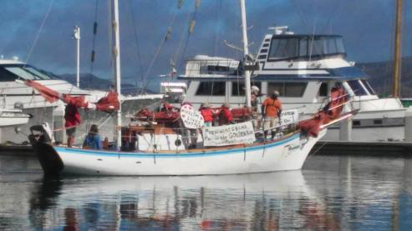
Program: Fleet Week Protests
Bringing a message of Peace in contrast to the Machines of War, Inspiring Activists!
Fleet Week in Seattle, Portland, San Francisco, Los Angeles, San Diego

Slide 33
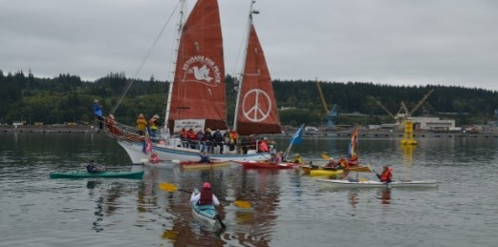
Program: Protest at Nuclear-Armed Submarine Base
First water-based protest since 1982 was with Golden Rule in 2016

Slide 34
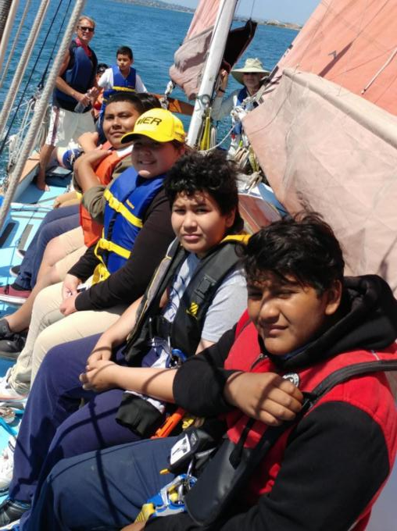
Program: Day Sails

Slide 35
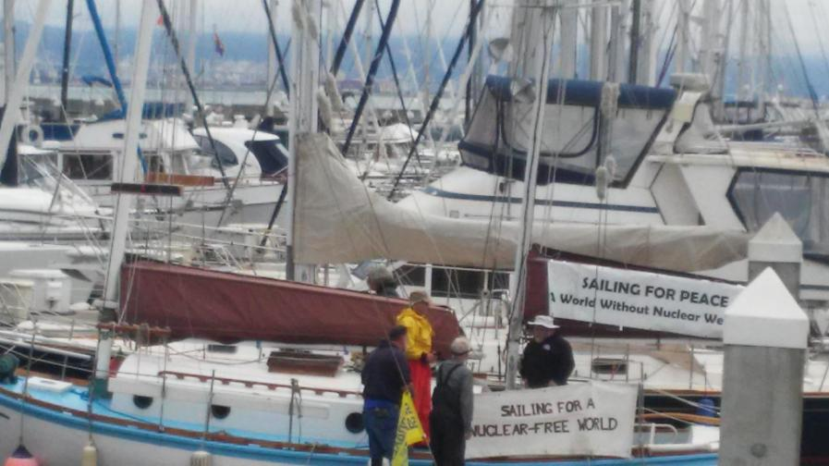
Program: Boat tours

Slide 36
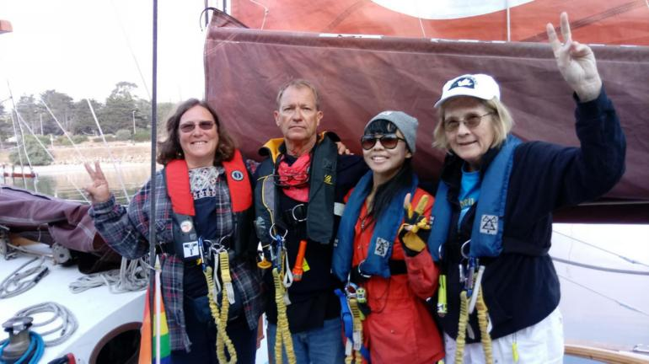
Program: Guest Crew

Slide 37
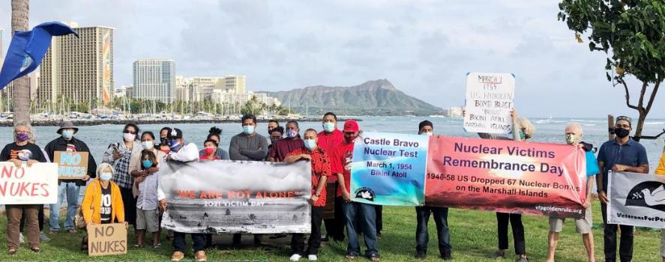
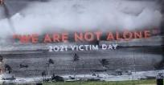
Solidarity with Marshall Islanders

Slide 38
The Golden Rule A Weapon of Mass Education
Past nuclear weapons tests, use, lasting effects on people and environment
Nuclear weapons are already used in war through threat of use
Effects of a nuclear war
Current dangers
Actions
UN Treaty on the Prohibition of Nuclear Weapons and other treaties
Bills before Congress
VFP No Nukes Working Group and Nuclear Posture Review
Organizations (mentioned as Great Loop sponsors above)

Slide 39
Nobel Peace Prize Awarded to Anti-nuclear Activists
The 2017 Nobel Peace Prize was awarded to the International Campaign to Abolitish Nuclear Weapons (ICAN) for its work to support the UN Treaty on the Prohibition of Nuclear Weapons (TPNW).
Veterans For Peace and the Golden Rule Project are members of ICAN

Slide 40
UN Votes to Ban the Bomb!
On July 7, 2017 the United Nations overwhelmingly passed the historic UN Treaty on the Prohibition of Nuclear Weapons. Approved by 122 countries - the UN Treaty makes it illegal to possess, use, deploy, transfer or threaten to use nuclear weapons.
Notes:
James Martin Center for Nonproliferation Studies at the Middlebury Institute of International Studies at Monterey

Slide 41
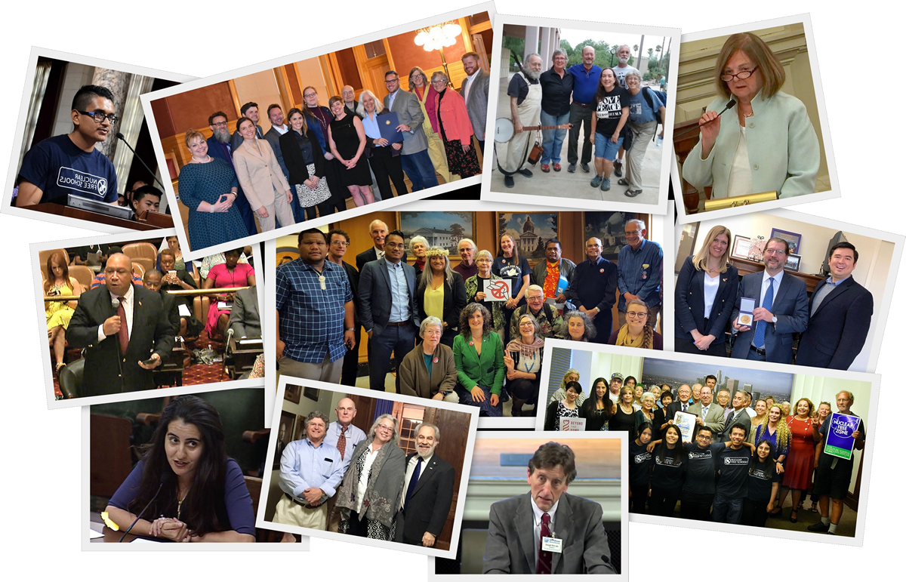
Organizing Locally To Prevent Nuclear War
A PRESENTATION
FOR COMMUNITIES
Notes:
Thank you all for joining us and making time to learn about this important campaign, called “Back From the Brink: Organizing Locally to Prevent Nuclear War.”

Slide 42
1f4a7f
PURSUE GLOBAL ELIMINATION
WE CALL ON THE UNITED STATES TO LEAD A GLOBAL EFFORT TO PREVENT NUCLEAR WAR.
END SOLE PRESIDENTIAL AUTHORITY
END HAIR-TRIGGER ALERT
CANCEL ENHANCED WEAPONS
RENOUNCE FIRST USE
Notes:
The first 4 policy points are interim steps to lower nuclear danger that most anti-nuclear advocates agree are essential. We are calling on the United States to:
renounce the option of using nuclear weapons first;
end the sole, unchecked authority of any president to launch a nuclear attack;
take U.S. nuclear weapons off hair-trigger alert;
cancel the plan to replace its entire arsenal with enhanced weapons; and
The language of the 5th policy point was crafted carefully to make our ultimate goal clear, while creating room for legislators and policy makers to embrace language they felt comfortable with. It says: “actively pursue a verifiable agreement among nuclear-armed states to eliminate their nuclear arsenals”. Such an agreement can be implemented through the Treaty on the Prohibition of Nuclear Weapons under its Article 4 provisions.

Slide 43
TAKE ACTION
Engage on social media
Urge your elected officials to endorse the campaign
Spread the word via local media (letters, Op Eds, radio)
Work with other groups and leaders in your community
Pass a resolution in your local government

Slide 44
Take Action!
VFP Nuclear Posture Review: www.tinyurl.com/VFP-NPR - share it widely, and use it as a tool in your own anti-nuclear activities.
The Nuclear Ban Treaty Collective has resources to help with your actions, including banners. nuclearban.us
If you are participating in MLK events, highlight his opposition to nuclear weapons!
Ask your Congressional Representatives to support federal legislation to:
Embrace the Goals and Provisions of the TPNW, H. Res. 77
Maintain Congress’ constitutional authority to declare war or a nuclear strike, H.R. 669
Redirect military spending to meet human needs, H.R. 1134
Redirect nuclear weapons spending to clean energy and human needs, H.R. 2775
5. As your member of Congress to join the Parliamentary Pledge of the International Campaign to Abolish Nuclear Weapons (ICAN) https://pledge.icanw.org/.
6. Enroll your City or State in the ICAN Cities Campaign. https://cities.icanw.org/ and Mayors For Peace.

