Slide 1
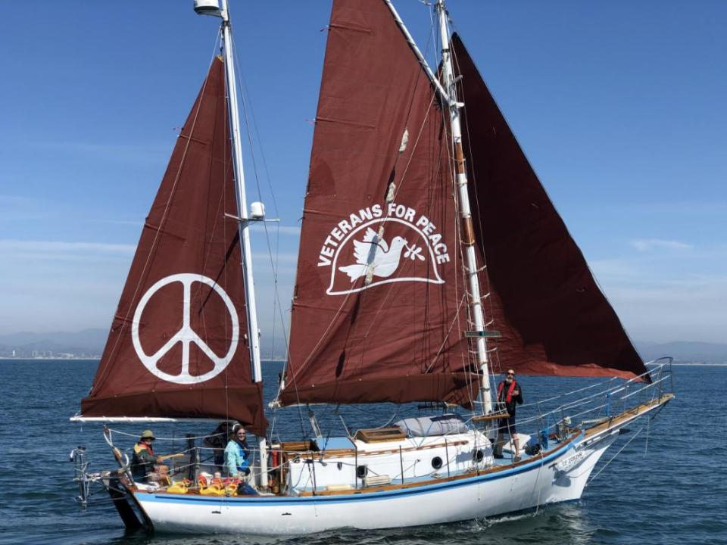
The Golden Rule: Do Unto Others as you would have others do unto you
Golden Rule Sails Again for a Nuclear Free Future!
Veterans For Peace
Golden Rule Project
www.vfpgoldenruleproject.org
vfpgoldenruleproject@gmail.com
(206) 992-6364
VFP Golden Rule Project
P.O. Box 87 Samoa, CA 95564

Slide 2
The Golden Rule is a Project of Veterans For Peace
Over 100 chapters, 10 international chapters
Over 3000 members
We aim to advance Veterans For Peace opposition to nuclear weapons and war, and to do so in a dramatic fashion.

Slide 3
The Golden Rule: 1958 Mission and Motivation
William Huntington, Captain Albert Bigelow, Orion Sherwood and George Willoughby
Notes:
His is the Golden Rule as she was in 1958.

Slide 4
67 Nuclear Bomb Tests in the Marshall Islands 1946-58
Persistent through today:
Birth defects
Cancer
Radiation in the atmosphere globally
Can’t grow food or catch fish - totally dependent on imported, poor quality food
Notes:
Then there was the bombing of the Marshall Islands, a terrible series of crimes against humanity and the planet with repercussions for thousands of years! The people are still giving birth to deformed babies and suffering incredible rates of cancer and other radiation-caused diseases.

Slide 5
Laying the Foundation for Nonviolent Direct Action
Letters, calls, visits to Congress, the President
Letters, articles in newspapers, magazines
TV, radio interviews
Protests, demonstrations
Notes:
You don’t just go out and buy a boat and try to sail to the Marshall Islands without laying the foundation and trying other means, and use other tactics.
So you.. (read the slide)
But ultimately the Quakers decided that even their best attempts were falling on deaf ears and they must do something more drastic.

Slide 6
So, off they went…

Slide 7
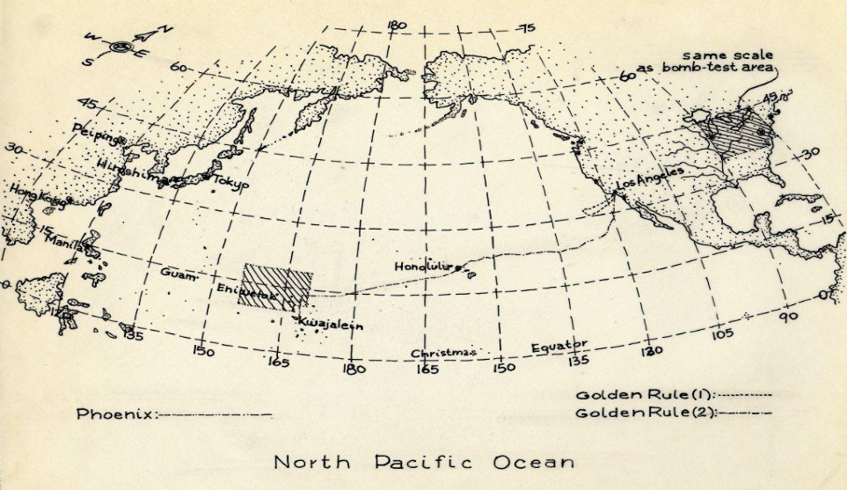
The Plan: Sail from California thru Hawaii to Marshall Islands

Slide 8
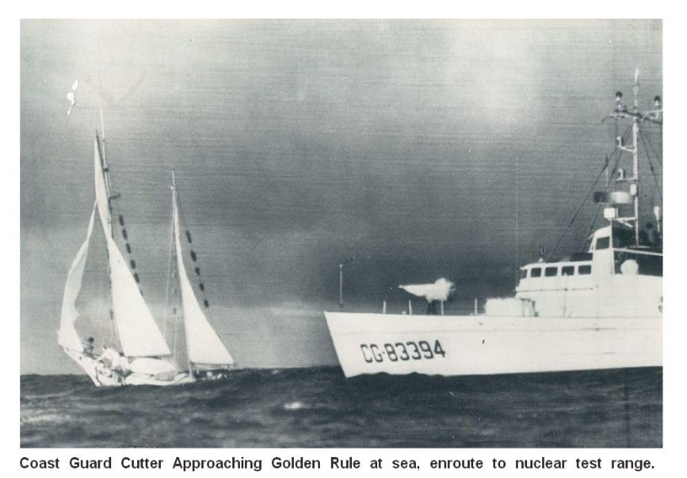

Slide 9
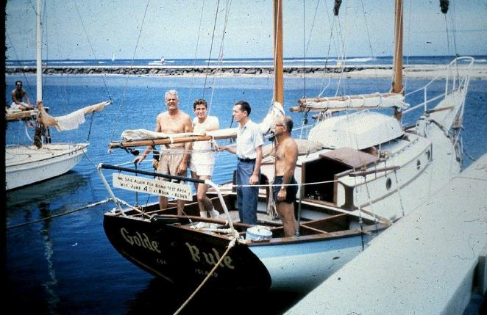
Arrested & Sentenced to 60 days in Jail
"WE SAIL AGAIN FOR BOMB-TEST AREA WED. JUNE 4TH AT NOON -- ALOHA!" Crew, left to right: Capt. Albert S. Bigelow, Orion Sherwood, William Huntington, and George Willoughby Photo courtesy of Jessica (Reynolds) Renshaw

Slide 10
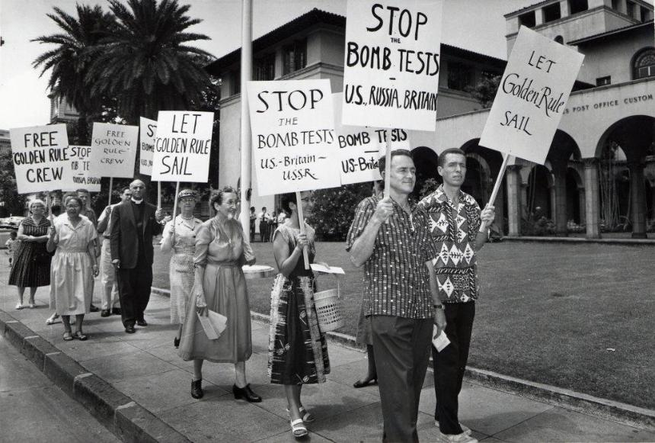
Anti-Nuclear Protests in Honolulu

Slide 11
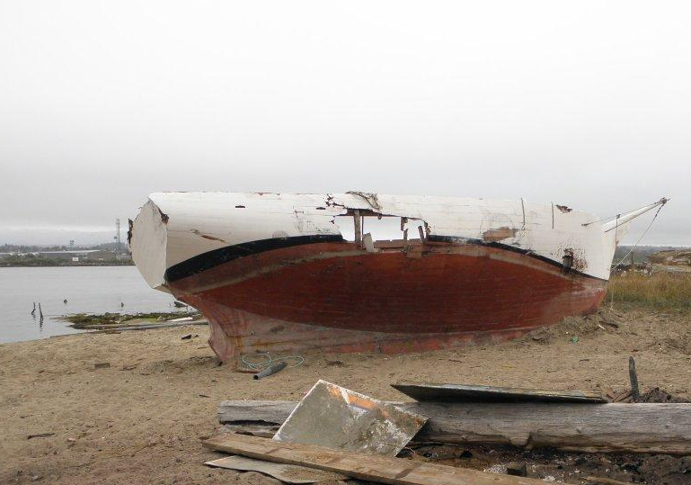
Golden Rule Found in 2010 in Humboldt Bay, Eureka, California

Slide 13
Launch! June 20, 2015

Slide 14
2016 Voyage 2015, 17-19,22

Slide 15
2019-21: 22 months in the Hawaiian Islands

Slide 16
The Golden Rule in Honolulu 1958 and 2020

Slide 17
The Great Loop - 2022-23

Slide 18
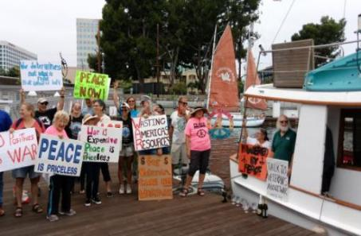
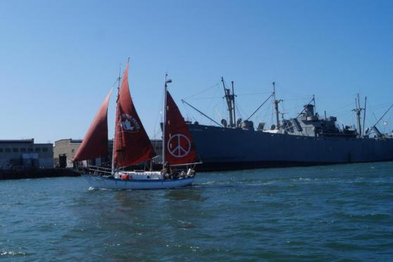
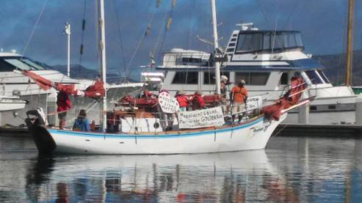
Program: Fleet Week Protests
Bringing a message of Peace in contrast to the Machines of War, Inspiring Activists!
Fleet Week in Seattle, Portland, San Francisco, Los Angeles, San Diego

Slide 19
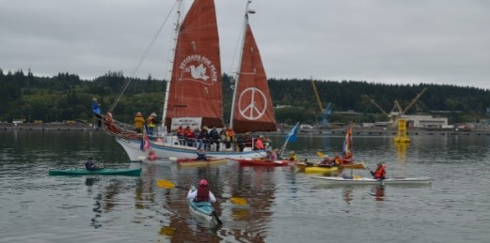
Program: Protest at Nuclear-Armed Submarine Base
First water-based protest since 1982 was with Golden Rule in 2016

Slide 20
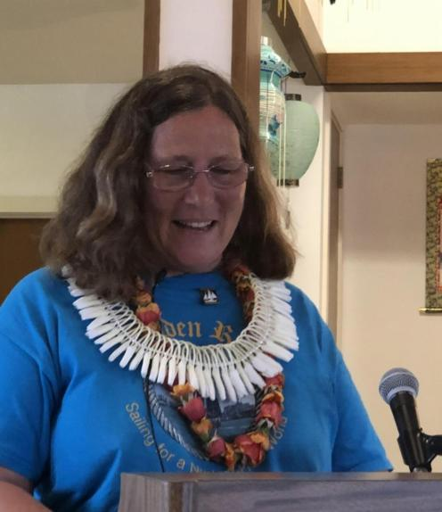
Program: 200 Presentations

Slide 21
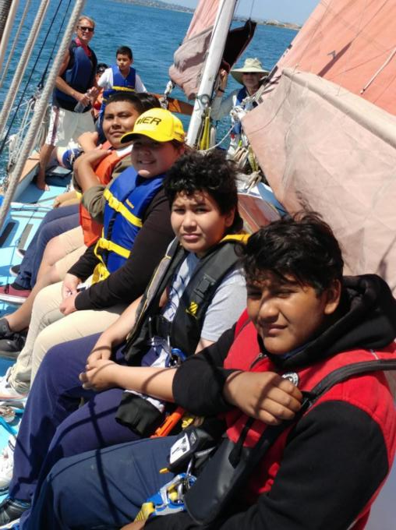
Program: Day Sails

Slide 22
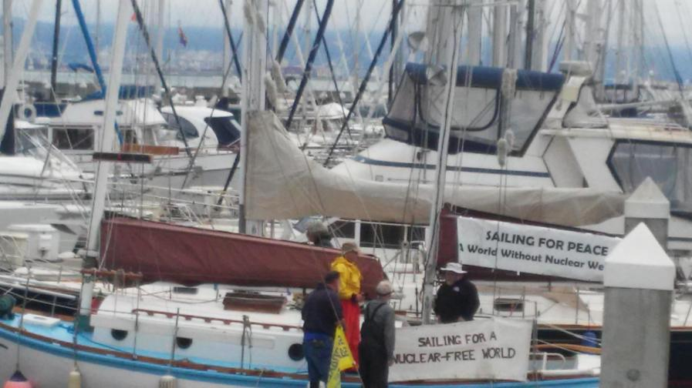
Program: Boat tours

Slide 23
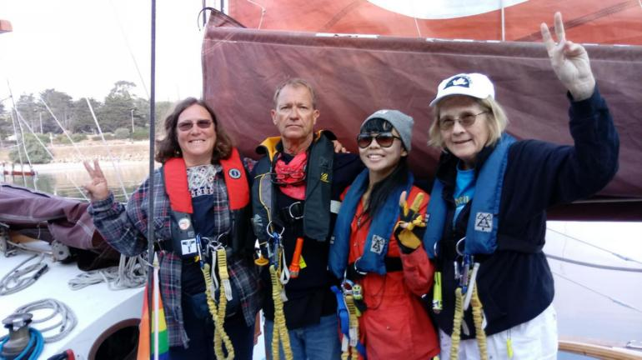
Program: Guest Crew

Slide 24
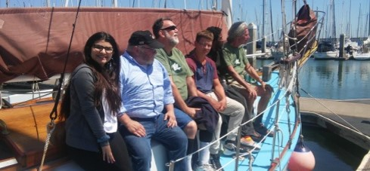
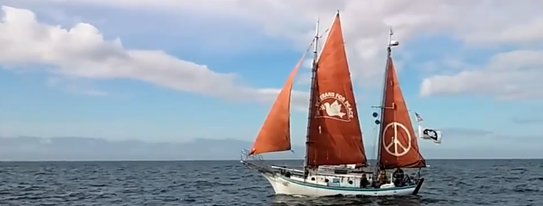
Program: Peace Action / Sailing Camp
A week of education with Nonviolence trainers from Tucson

Slide 25
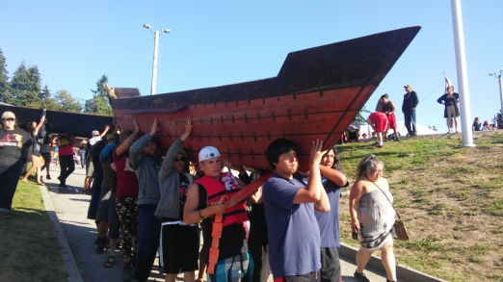
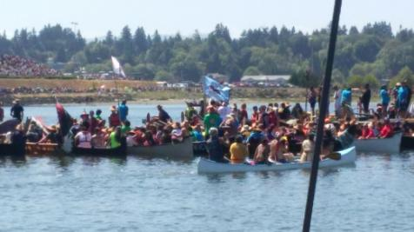
Program: Support Boat for Indigenous Canoe Journey

Slide 26
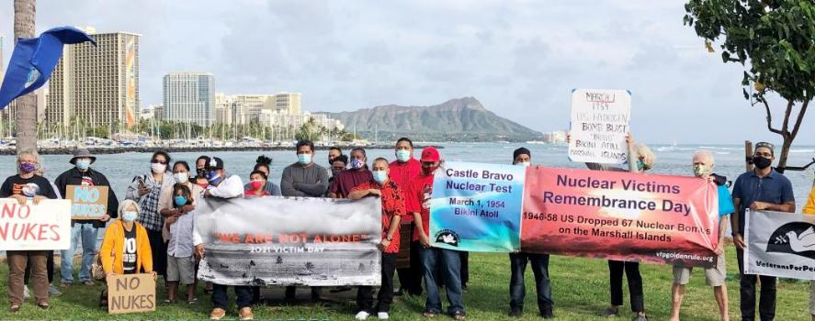
Solidarity with Marshall Islanders

Slide 27
Program: “The Great Loop” Option GRC Decision: February 2022
Start | End | Stop
9/22/2022 | 10/4/2022 | Minneapolis: Step masts, launch, boat tours, sailing, presentations
10/5/2022 | 11/8/2022 | Upper Mississippi: Minnesota, Iowa, Illinois, Missouri
11/10/2022 | 12/1/2022 | Lower Mississippi: Tennessee, Arkansas, Mississippi, Louisiana
12/2/2022 | 2/5/2023 | Alabama, Florida
2/6/2023 | 4/3/2023 | Georgia, S Carolina, N Carolina, Virginia
4/4/2023 | 5/18/2023 | Virginia, DC, Maryland, Delaware, Pennsylvania, New York
5/19/2023 | 7/19/2023 | New York, New Jersey, Connecticut, Rhode Island, Massachusetts, Maine
 |  | Return to New York, up the Hudson River and through the Erie Canal
7/20/2023 | 9/20/2023 | Great Lakes - Ohio, Wisconsin, Michigan, Illinois
9/21/2023 | 12/1/2023 | Illinois, Mississippi, Ohio, Tennessee, Tombigbee rivers to Mobile, Alabama
10,300 miles
28 big cities, 68 small towns
480 presentations - reach 12,400 people directly
100,000s through press ALL THIS AT NO EXTRA COST TO VFP!
New York City: Arrive evening of 5/20. Depart morning of 5/28.

Slide 28
Call to Action
Download VFP Nuclear Posture Review. www.tinyurl.com/VFP-NPR, share it widely, and use it as a tool in your own anti-nuclear activities.
Ask your member of Congress to sponsor the Nuclear Weapons Abolition and Economic Energy Conversion Act, HR 2850, which calls on Congress to immediately cancel the current planned 30 year program at nearly 2 trillion dollars for two new nuclear weapons factories, bombs, missiles, planes, and submarines, and use those funds for windmills not warheads to prevent catastrophic climate disasters with clean energy jobs and systems that will save our Mother Earth.
As your member of Congress to join the Parliamentary Pledge of the International Campaign to Abolish Nuclear Weapons (ICAN) https://pledge.icanw.org/.
Enroll your City or State in the ICAN Cities Campaign. https://cities.icanw.org/ and
Ask your City to join Mayors For Peace.
Participate in Don’t Bank on the Bomb!

